Slide 1

Youth Engagement- Ages 14-15 (9th Grade)
Relationship Standards & Setting Boundaries

Slide 2

PREVENTION THROUGH EDUCATION IS THE SOLUTION
Connect for Freedom is a 501(c)(3) nonprofit committed to providing free online safety and human trafficking awareness materials to youth-serving organizations and communities.

Slide 3


Lesson Outline
Lesson
  Introduction to Healthy Relationships
  Oasis Mental Health Applications “Building Healthy Relationships” Video (2 min.)
    Discussion Questions
  Setting Relationship Boundaries
  Consent
  Your Story Studio “What is Consent?” Video (3 min.)
    Discussion Question
  RHNTC Handout: The Healthy Relationship Wheel
  Activity
Relationship Standards & Setting Boundaries

Slide 4

Importance of Healthy Relationships
Healthy romantic relationships are important to happiness and overall well-being.
96% of teens report mental/emotional abuse in their dating relationships.
The Dibble Institute
Negative interactions and relationships with partners can lead to increased risk of anxiety, depression, and suicidal thoughts.
Mental Health Foundation
Relationship issues are a major factor of teen suicides, which is the second leading cause of teenage death.
The Dibble Institute

Slide 5
Healthy Relationship vs. Unhealthy Relationship
Healthy Relationship:
Unhealthy Relationship:
  Respect one another
  Honest communication
  Open to positive change
  Supportive during difficult times
  Kind and caring
  Want the best for one another
  Respect one another’s boundaries/space
  Loyalty and trust
  Feel safe and secure
  Physical aggression or abuse
  Emotional manipulation
  Name calling
  Controlling
  Cruel and mean communication
  Shaming and/or blaming their partner
  Extreme possessiveness and jealousy
  Pressure for sexual activity
  Threats and/or abuse
Source: https://www.missingkids.org/education

Slide 6
Healthy Relationship vs. Unhealthy Relationship
Example 1: Emily is a sophomore girl dating Mario, a senior boy. She feels nervous around her boyfriend because this is her first relationship. Mario tends to be forward and asks her for things that she does not feel comfortable doing, but she does it anyway. Afterwards, she feels guilty but she tells herself this is how a relationship is supposed to be.
Is this a healthy or unhealthy relationship? Why?

Slide 7
Healthy Relationship vs. Unhealthy Relationship
Example 2: Alicia is a senior girl dating Keith, a senior boy. This is Alicia’s first relationship and she feels very happy with Keith. She does not have much experience but tells him what she does and does not like. Keith always respects Alicia and her feelings and does not try to make her do anything she does not want to do.
Is this a healthy or unhealthy relationship? Why?

Slide 8
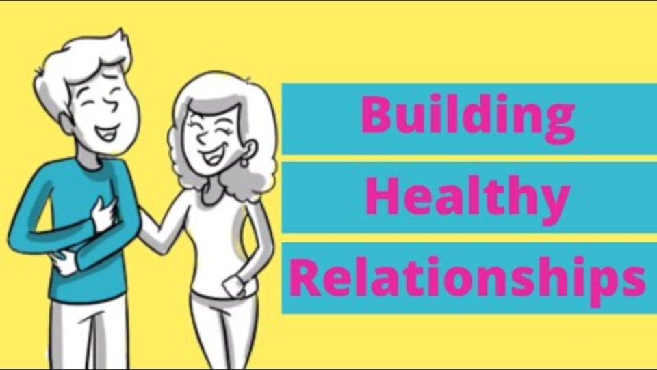
Oasis Mental Health Applications “Building Healthy Relationships” Video
Duration: 2:42 minutes
Source: https://www.youtube.com/watch?v=ELLaMPiPqPM

Slide 9
Oasis Mental Health Applications “Building Healthy Relationships” Discussion Questions
Participants should get into 2 groups, and staff will designate each group a number. Each group will work together and answer the questions with their group number. Then each group will take turns presenting their answers to everyone.
Group 1 Questions
Group 2 Questions
What unhealthy relationship behaviors did Kyle exhibit?
Why does Ashley find it hard to leave the relationship with Kyle?
What are some healthy relationship behaviors you should look for?
Ashley opened up to the school guidance counselor. Who else could she have turned to for help?

Slide 10

Setting Boundaries for Dating
Setting boundaries for dating is important to having a healthy relationship.
Know yourself. Having self-worth and confidence will help you walk away from any relationship that does not serve you.
Know your expectations. Being aware of what is unacceptable behavior in a relationship will help you walk away from an unhealthy relationship.
Know when to walk away. Keeping yourself safe is the most important thing you can do for yourself. Do not ever stay with someone who makes you feel unsafe or uncomfortable.
Source: https://www.missingkids.org/education

Slide 11
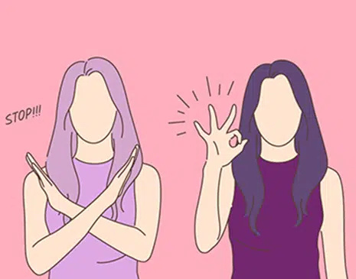
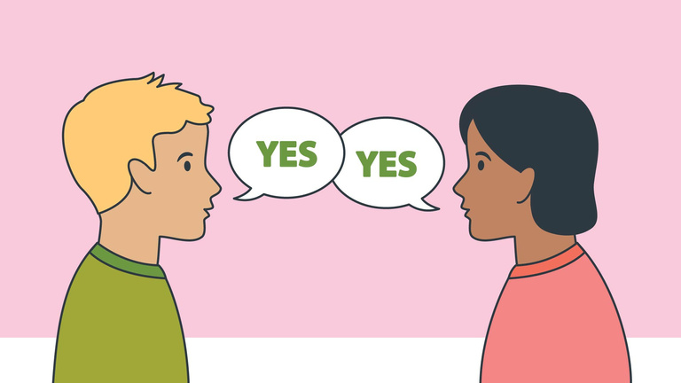
Consent
Consent is when two people agree to engage in a sexual act.
Consent cannot be given if someone is:
  Pressured or threatened to do so
  Under the influence of drugs or alcohol
  Asleep or unconscious
Consent can be revoked at any time during a sexual encounter. A sexual act without consent from both parties is sexual assault.
Source: https://rainn.org/articles/what-is-consent

Slide 12
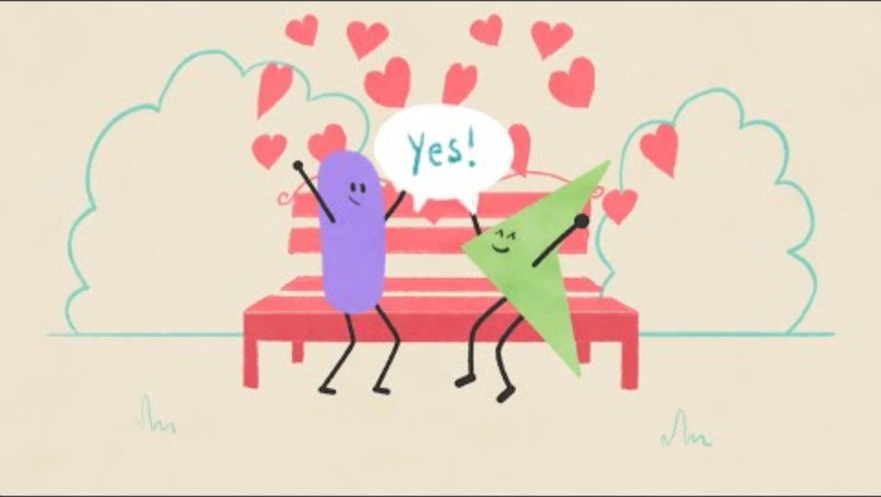
Your Story Studio “What is Consent?” Video
Duration: 2:57 minutes
Source: https://www.youtube.com/watch?v=iBvD3sACS4o

Slide 13
Your Story Studio “What is Consent?” Staff-Led Discussion Question
Sometimes consent cannot be given if there is a power imbalance.
What are some examples of relationships where a power imbalance may be present?

Slide 14

Activity

Slide 15
Activity
We recommend playing
Healthy Relationship Jeopardy.

Slide 17
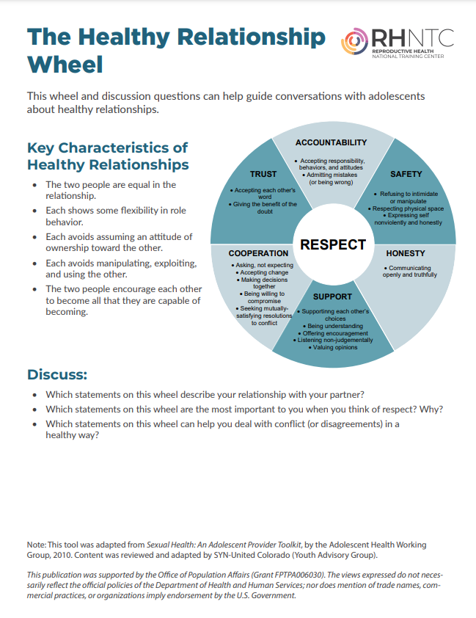
Lesson Handout from RHNTC

Slide 18
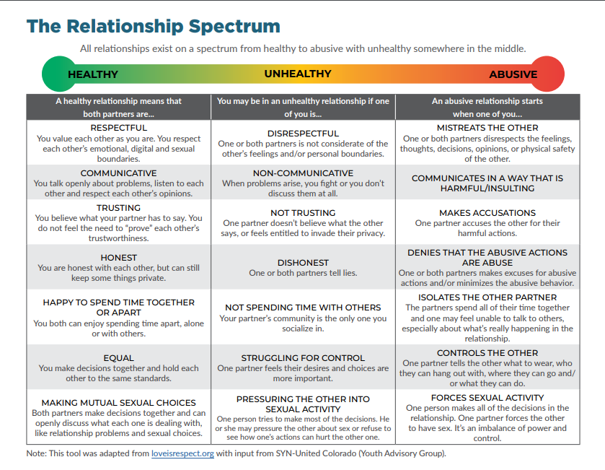
Lesson Handout from RHNTC

Slide 19
Links to Lesson Materials
Oasis Mental Health Applications “Building Healthy Relationships” Video
Your Story Studio “What is Consent?” Video
RHNTC “The Healthy Relationship Wheel” Handout
Healthy Relationship Jeopardy

Slide 20
Recap of Lesson
Signs of a healthy relationship:
  Respect one another
  Honest communication
  Open to positive change
  Supportive during difficult times
  Feel safe and secure
  Kind and caring
  Want the best for one another
  Respect one another’s boundaries/space
  Loyal and trustworthy
Consent is when two people agree to engage in a sexual act.
Consent cannot be given if someone is pressured or threatened to do so, under the influence of alcohol or drugs, or is asleep or unconscious.

