Slide 1

Youth Engagement- Ages 13-14 (8th Grade)
Online Enticement Can Lead to Sex Trafficking

Slide 2

PREVENTION THROUGH EDUCATION IS THE SOLUTION
Connect for Freedom is a 501(c)(3) nonprofit committed to providing free online safety and human trafficking awareness materials to youth-serving organizations and communities.

Slide 3
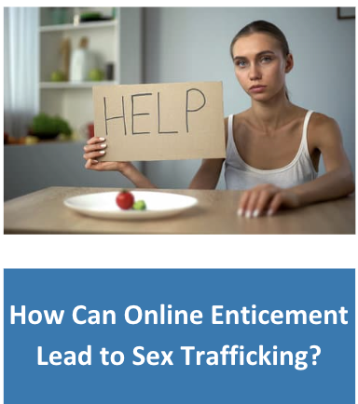
Lesson Outline
Lesson
  Introduction to Human Trafficking
    Human Trafficking Stats
    Why Is It Important for Youth to be Educated on It
  DHS “Human Trafficking 101" Video (4 min.)
  Youth Risk Factors & Vulnerabilities
  DHS “Mia’s Story 1 & 2” Video (4 min.)
    Discussion Questions
  DHS “Mia’s Story 3 & 4” Video (4 min.)
    Discussion Questions
  NJ Coalition Against Human Trafficking Handout
    Red Flags
  Activity
How to Protect Yourself & Your Friends

Slide 4
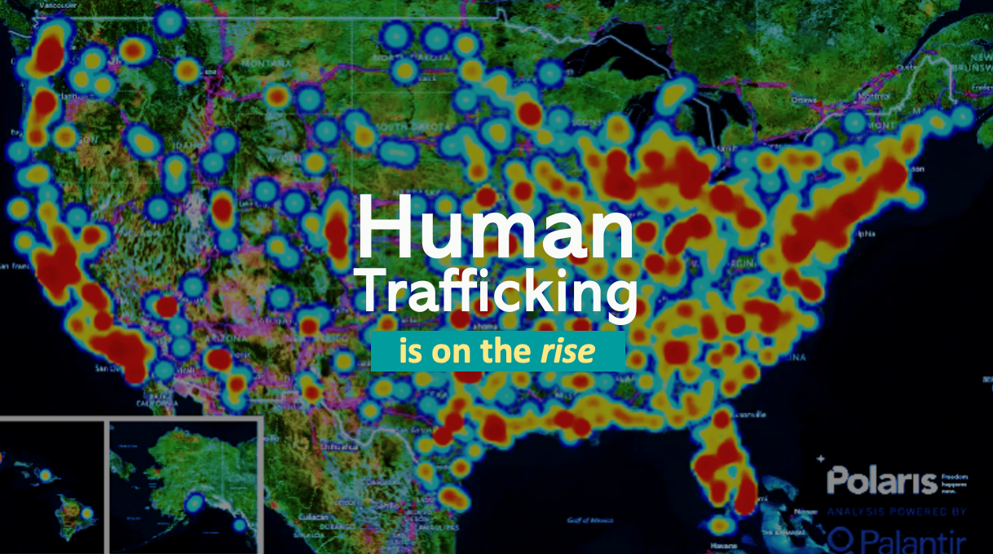

Slide 5

A Pervasive Problem
The Data
The U.S. is the #1 consumer of sex trafficking.
US Institute Against Human Trafficking
38% of sex trafficking victims are minors.
Polaris Project
Human trafficking is a
$150 billion dollar industry.
Polaris Project
Only 2.7% of human trafficking cases are prosecuted.
Polaris Project

Slide 6


The Connection Between Online Enticement & Human Trafficking
In 2023, the CyberTipline received 36.2 million reports of suspected child sexual exploitation online.
-NCMEC
Online recruitment increased 22% from 2019-2020 and the internet was reported as the top recruitment location for all forms of trafficking.
Facebook had a 125% increase in reports of online recruitment from 2019-2020.
Instagram had a 95% increase in reports of online recruitment from 2019-2020.
Source: www.polarisproject.org

Slide 7

“What is Human Trafficking?” Video
Duration: 4:20 minutes
Source: https://www.dhs.gov/medialibrary/assets/video/21829

Slide 8
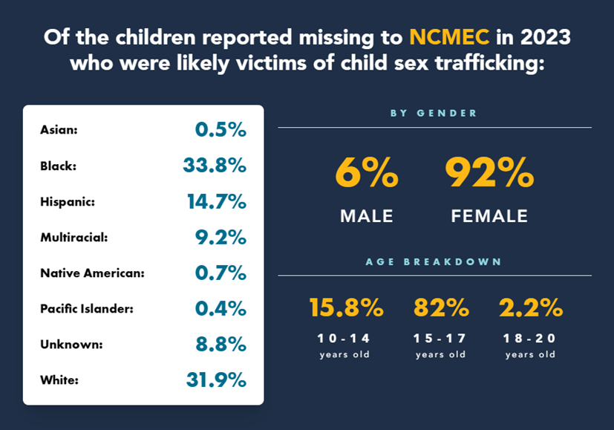
Child Sex Trafficking Statistics
Of the more than 28,800 missing children reported to NCMEC in 2023,
1 in 6 were likely victims of child sex trafficking.
Source: https://www.missingkids.org/ourwork/impact

Slide 9

Youth Risk Factors & Vulnerabilities
Poverty and/or homelessness
Interaction with foster care or juvenile justice systems
Lack of support networks, like strong relationships with friends, family, or other trusted adults
Gang involvement, especially among youth who identify as female
History of running away
Low self-esteem or being bullied
Experience discrimination due to their race, gender, identity, sexuality, disability, or other personal characteristic
Source: https://www.missingkids.org/theissues/trafficking

Slide 10

Youth Risk Factors & Vulnerabilities (cont.)
Family history of sexual abuse or violence
Community or familial history of trafficking and commercial sexual exploitation
Substance abuse or addictions
Experiencing or witnessing a traumatic event
Cultural-historical trauma (particularly among minority communities)
Being the sole or primary provider for their family
Source: https://www.missingkids.org/theissues/trafficking

Slide 11
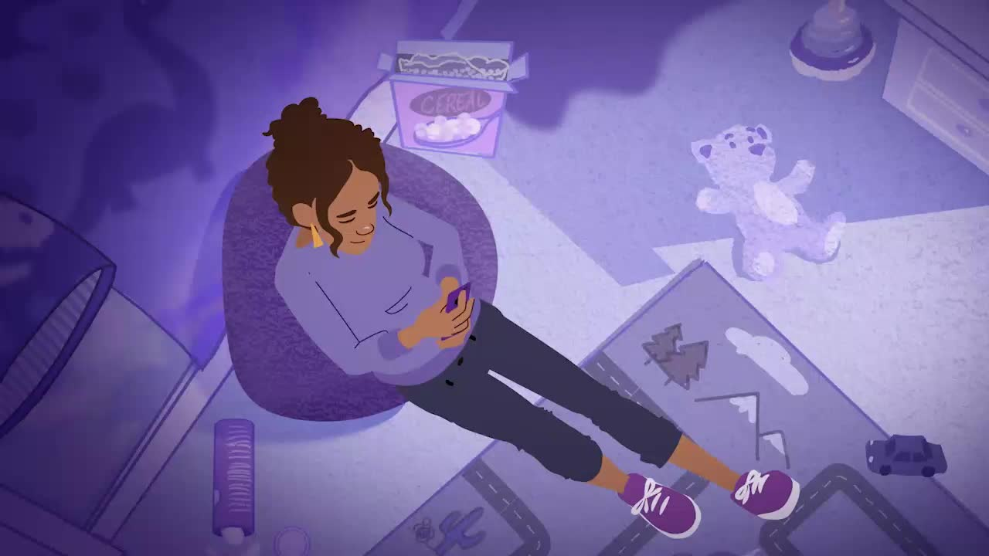
DHS “Mia’s Story Pt. 1” Video
Duration: 2:20 minutes
Source: https://www.dhs.gov/medialibrary/assets/videos/27904

Slide 12

DHS “Mia’s Story Pt. 2” Video
Duration: 2:20 minutes
Source: https://www.dhs.gov/medialibrary/assets/video/36086

Slide 13
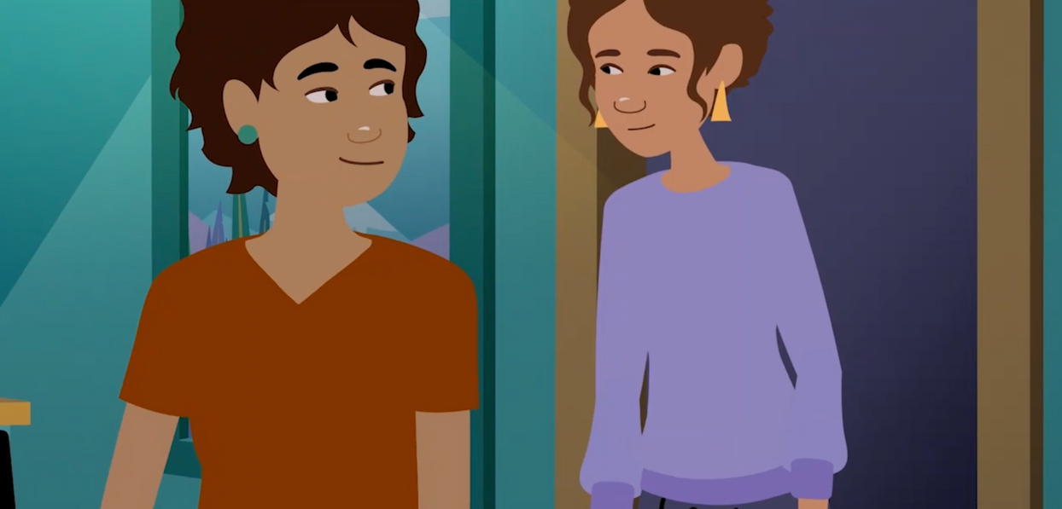
DHS “Mia’s Story Pt. 1 & 2” Discussion Questions
Participants should get into 3 groups, and staff will assign each group a question. Each group will answer the question together and then present their answers to everyone.
What vulnerabilities did the trafficker prey on?
What grooming and manipulation tactics did you identify?
Why might Mia not want to talk to the guidance counselor?

Slide 14
Mia’s Story Pt. 1
DHS “Mia’s Story Pt. 3” Video
Source: https://www.dhs.gov/medialibrary/assets/video/36282
Duration: 2:20 minutes

Slide 15
DHS “Mia’s Story Pt. 4” Video
Source: https://www.dhs.gov/medialibrary/assets/video/37163
Duration: 2:20 minutes

Slide 16
DHS “Mia’s Story Pt. 3 & 4” Discussion Questions
Participants should get into 3 groups, and staff will assign each group a question. Each group will answer the question together and then present their answer to everyone.
What red flags are Mia’s friends observing?
Mia’s friends do not really know what is going on..
what could they do with the information they have?
What are some of the good ways that Mia’s friends handled the situation? How did they talk to her?

Slide 17

Activity

Slide 18
Activity
We recommend playing
Human Trafficking Kahoot! or
Risk Factors Bingo.

Slide 20
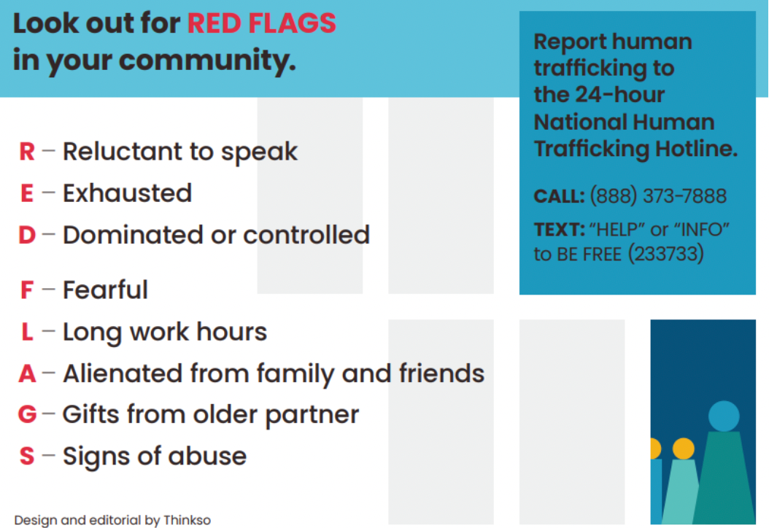
Lesson Handout from NJ Coalition Against Human Trafficking

Slide 21
Links to Lesson Materials
DHS “Mia’s Story Pt. 1” Video
DHS “Mia’s Story Pt. 2” Video
DHS “Mia’s Story Pt. 3” Video
DHS “Mia’s Story Pt. 4” Video
NJ Coalition Lesson Handout
Human Trafficking Kahoot!
Risk Factors Bingo

Slide 22
Recap of Lesson
The U.S. is the #1 consumer of sex trafficking.
38% of sex trafficking victims are minors.
Human trafficking is a $150 billion dollar industry.
Only 2.7% of human trafficking cases are prosecuted.
Youth Risk Factors & Vulnerabilities:
  Poverty and/or homelessness
  Interaction with foster care or juvenile justice systems
  Lack of support networks
  Gang involvement
  History of running away
  Low self-esteem
  Being bullied
  Experience with discrimination due to race, gender, sexuality, etc.
  Family history of sexual abuse/violence
  Community or family history of trafficking or commercial sex exploitation
  Experiencing a traumatic event
  Being a sole provider for the family

