Slide 1

Youth Engagement- Ages 11-12 (6th Grade)
Protecting Yourself from Online Predators

Slide 2

PREVENTION THROUGH EDUCATION IS THE SOLUTION
Connect for Freedom is a 501(c)(3) nonprofit committed to providing free online safety and human trafficking awareness materials to youth-serving organizations and communities.

Slide 3
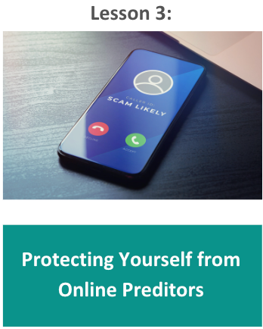
Lesson Outline
Lesson
  Vulnerabilities Offenders Prey On
  Online Red Flags
  Auroris Media “Sextortion Module 2" Video (6 min.)
    Discussion Questions
  Auroris Media “Sextortion Module 3" Video (6 min.)
    Discussion Questions
  Privacy Suggestions
  Additional Reminders
  NCMEC Handout: You Sent a Sext
  Activity
Protecting Yourself from Online Predators

Slide 4
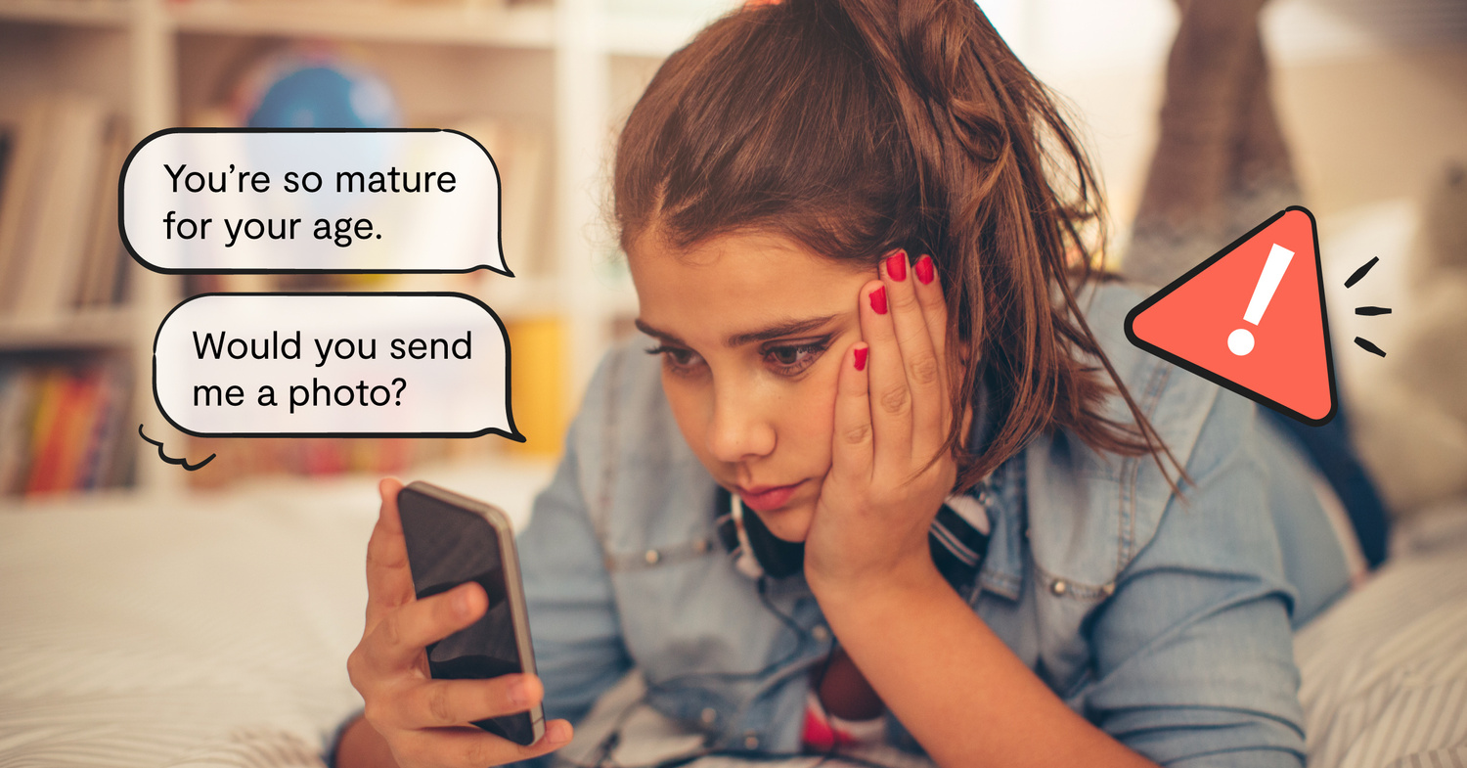
Vulnerabilities Offenders Prey On
  Lack of supportive family and friends
  Familial history of abuse, addiction, or mental health issues
  History of running away from home
  Financial instability
  Low self-esteem
  History of trauma
  Involvement in child welfare or juvenile justice system
  Nonacceptance of sexual orientation
Source: https://www.missingkids.org/theissues/trafficking

Slide 5
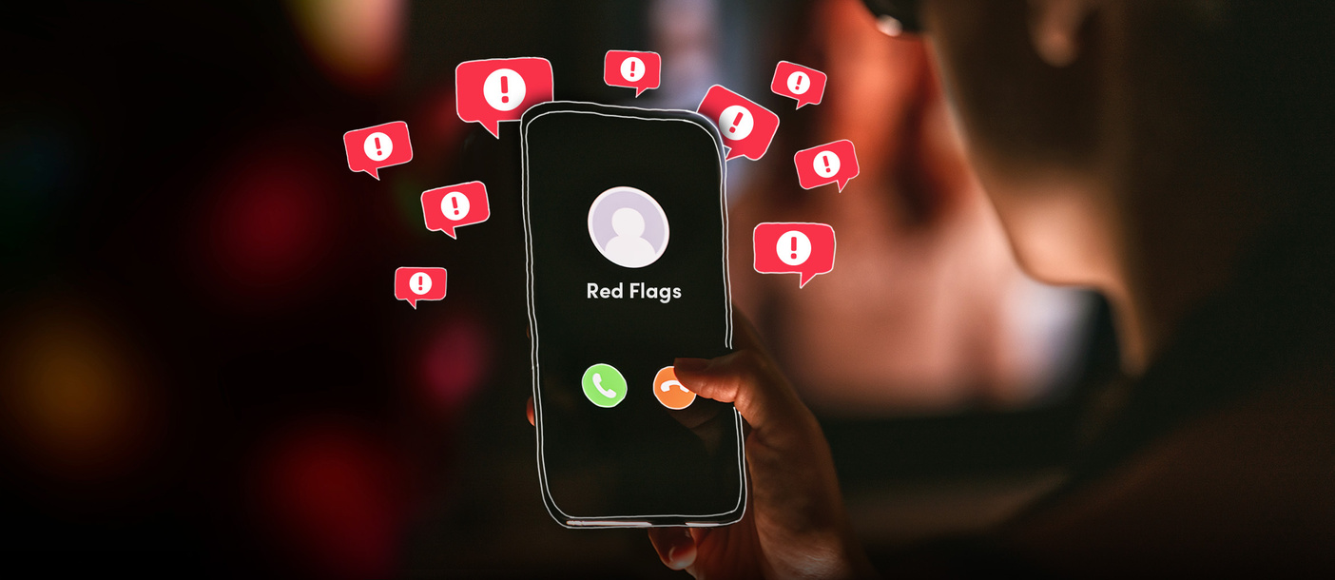
Online Red Flags
  Asks you personal questions
  Initiates conversations about sex and intimacy
  Sends you inappropriate pictures
  Asks for pictures of you
  Makes you feel uncomfortable
  Tries to meet in real life
  Wants to follow all your social media accounts on multiple apps
  Gets mad at you if you’re not online
  Isolates you from your friends and family
  Talks badly about other people in your life
Source: https://www.missingkids.org/theissues/onlineenticement

Slide 6

Auroris Media “Sextortion Module 2” Video
Source: https://vimeo.com/718061896
Duration: 6:29 minutes

Slide 7
Auroris Media “Sextortion Module 2” Discussion Guide
Click here to access Auroris Media and NCMEC “Sextortion Module 2” Discussion Guide and questions.

Slide 8
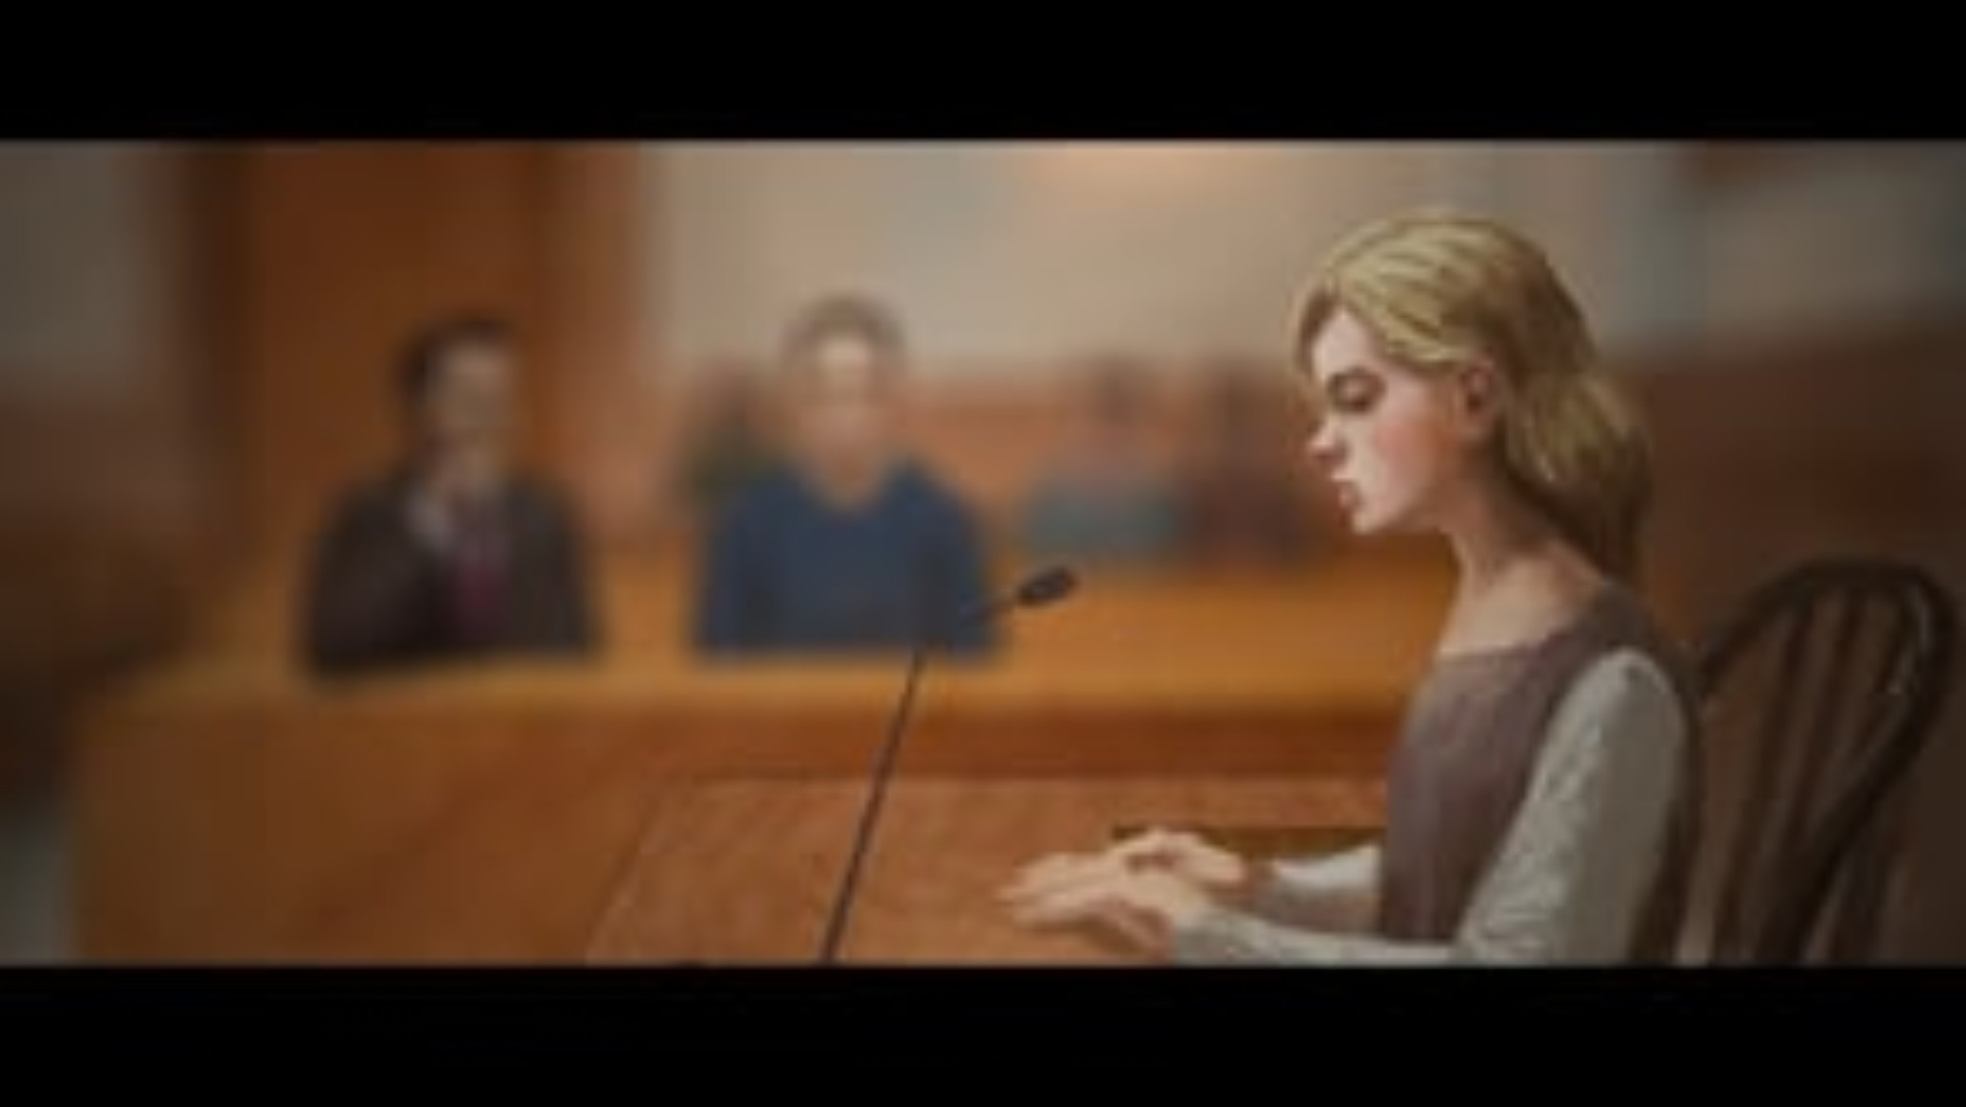
Auroris Media “Sextortion Module 3" Video
Source: https://vimeo.com/717550746
Duration: 5:52 minutes

Slide 9
Auroris Media “Sextortion Module 3” Discussion Guide
Click here to access Auroris Media and NCMEC “Sextortion Module 3” Discussion Guide and questions.

Slide 10

Privacy Suggestions
Have a different password for each account.
Use privacy settings.
Choose carefully who you friend.
Limit access to your location.
Look for the lock symbol or “https”.
Don’t share any personal information online.
Don’t share passwords.
Don’t share or forward explicit content.
Source: Kent Place & Connect for Freedom Workshop 2023

Slide 11

Additional Reminders
Take screenshots of anything that looks or feels dangerous.
Block individuals who exhibit inappropriate or predatory behavior.
Source: https://www.missingkids.org/netsmartz/home

Slide 12

Additional Reminders
File a report with the police, offering as much information as possible about who is involved and in what ways.
Call a Cybertipline to report potential abuse or exploitation and receive additional recommendations for action steps.
Source: https://www.missingkids.org/netsmartz/home

Slide 13

Activity

Slide 14
Activity
We recommend playing
Top 5 Quiz
Online Safety & Online Enticement.

Slide 16
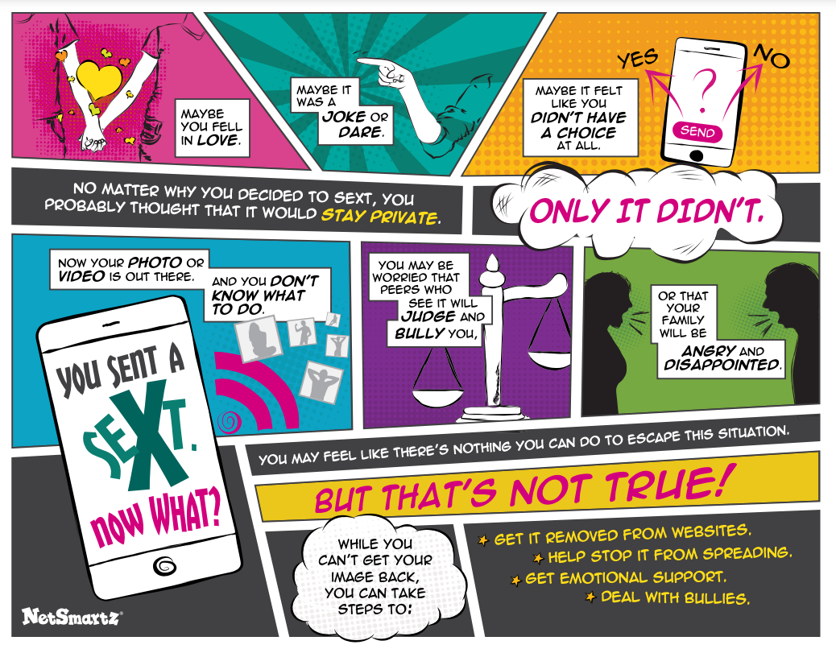
Lesson Handout from NCMEC

Slide 17
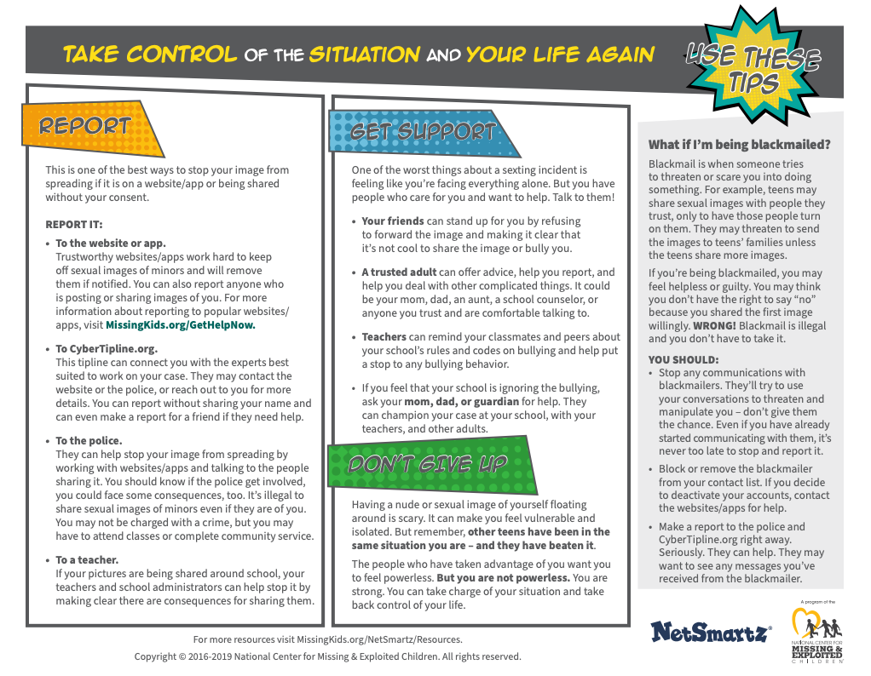
Lesson Handout from NCMEC

Slide 18
Links to Lesson Materials
Auroris Media “Sextortion Module 2” Video
Auroris Media & NCMEC “Sextortion Module 2” Discussion Guide
Auroris Media “Sextortion Module 3” Video
Auroris Media & NCMEC “Sextortion Module 3” Discussion Guide
NCMEC “You Sent a Sext” Handout
Top 5 Quiz Online Safety & Online Enticement

Slide 19
Recap of Lesson
Vulnerabilities that offenders prey on:
  Lack of supportive family and friends
  Familial history of abuse, addiction, or mental health issues
  History of running away from home
  Financial instability
  Low self-esteem
  History of trauma
  Involvement in child welfare or juvenile justice system
  Nonacceptance of sexual orientation
Online red flags:
  Someone sending inappropriate pictures
  Talking to you about sex
  Asking for pictures of you
  Trying to meet up in real life
  Following all your profiles
  Asking a lot of personal questions
  Getting mad if you aren’t online

