Slide 1

Youth Engagement- Ages 11-12 (6th Grade)
Healthy Relationships & How to Cultivate Them

Slide 2

PREVENTION THROUGH EDUCATION IS THE SOLUTION
Connect for Freedom is a 501(c)(3) nonprofit committed to providing free online safety and human trafficking awareness materials to youth-serving organizations and communities.

Slide 3
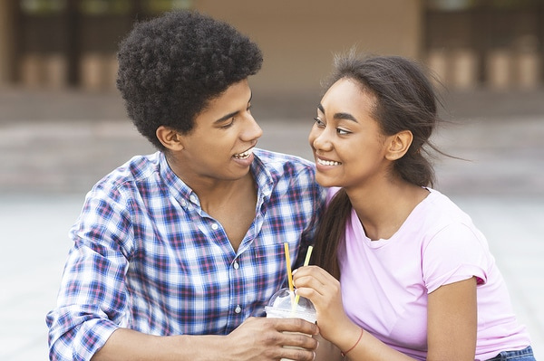
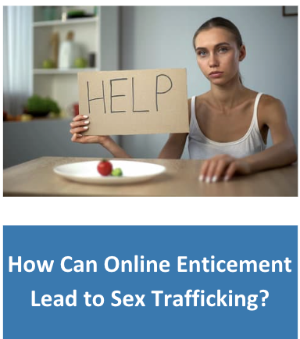
Lesson Outline
Lesson
  Introduction to Teen Relationships
  NCMEC “Healthy Relationships” Video (2 min.)
    Discussion Questions
  Take Time to Get to Know Each Other
  DayOneNY “Don’t Confuse Love & Abuse” Video (2.5 min.)
    Discussion Questions
  Why Is It Hard to Leave?
  The Dibble Institute Handout: Facts About Dating Violence
  Activity
Healthy Relationships & How to Cultivate Them

Slide 4
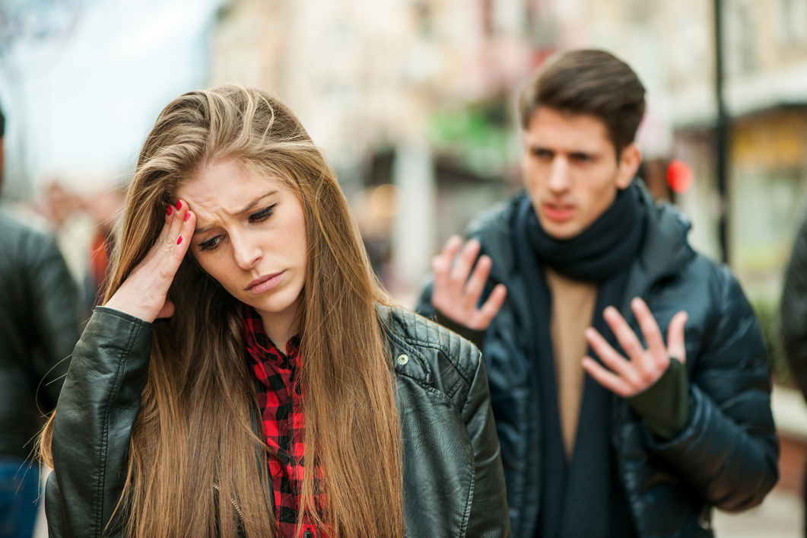
Teen Relationships
The Data
96% of teens report mental/emotional abuse in their dating relationships.
The Dibble Institute
1 in 11 students said they had been hit, slapped, or physically abused in the past year.
The Dibble Institute
28% of teens who have been in relationships are victims of digital dating abuse.
The Dibble Institute

Slide 5
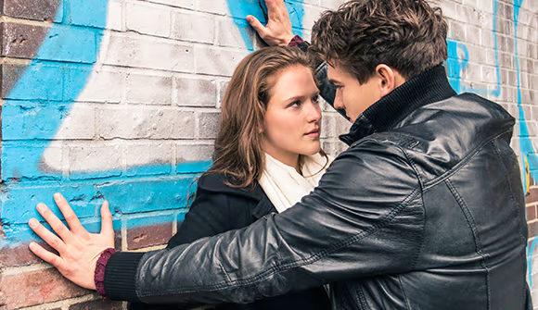
Signs of an Unhealthy Relationship Online & Offline
You feel scared, unsafe, or threatened.
You feel manipulated or guilted often by your partner.
You feel pressured to agree to do something you don’t want to do.
You feel disrespected during arguments with your partner.
You feel emotionally drained, insulted, or threatened during arguments.
You feel as though you are the only one to compromise.
Source: https://www.missingkids.org/education

Slide 6

Signs of a Healthy Relationship Online & Offline
You feel safe, loved, and cared for.
You have open and honest communication with your significant other.
You feel comfortable discussing your feelings with them.
Even if you disagree with your significant other, you both remain respectful.
You feel like an equal to your significant other.
Source: https://www.missingkids.org/education

Slide 7
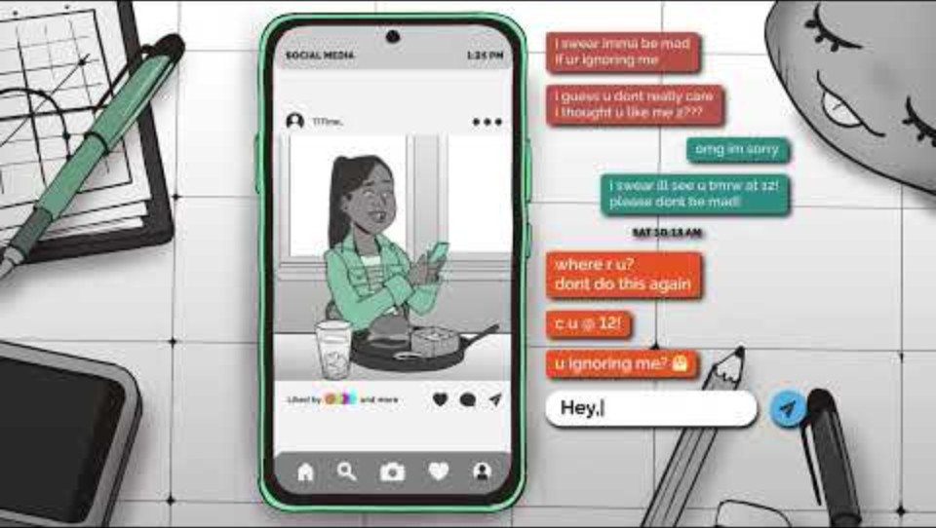
NCMEC “Healthy Relationships” Video
Duration: 1:56 minutes
Source: https://www.youtube.com/watch?v=ldjZCvqhNWw&t=64s

Slide 8
NCMEC “Healthy Relationships” Discussion Guide
Click here to access NCMEC “Healthy Relationships” Discussion Guide and questions.

Slide 9
Taking Time to Get to Know Someone is Healthy
Learn about who they really are. It takes time to learn someone’s interests, hobbies, likes, dislikes, etc.
Build trust. Trust is essential to having a healthy relationship. See how the person reacts to different situations, how they deal with emotions, how they communicate and problem solve.
Explore your feelings. Sometimes we can have strong initial chemistry or attraction but that doesn’t mean you are compatible with someone.
Source: https://www.missingkids.org/education

Slide 10
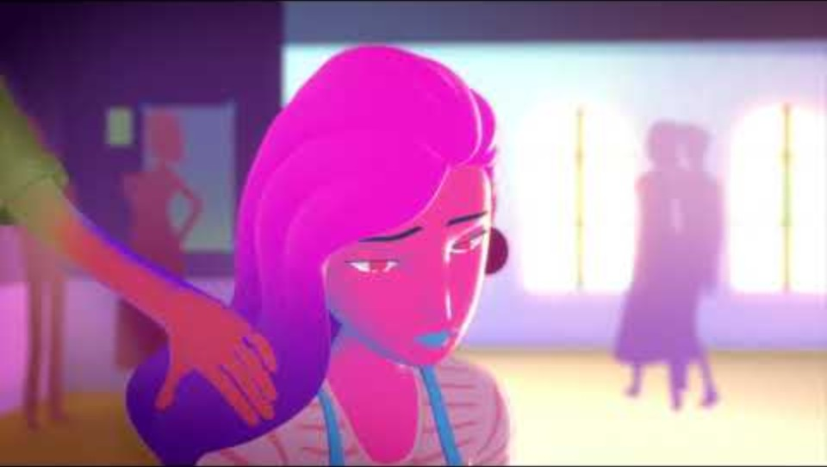
DayOneNY “Don’t Confuse Love & Abuse” Video
Duration: 2:45 minutes
Source: https://www.youtube.com/watch?v=1L6HB97lbrQ

Slide 11
“Don’t Confuse Love & Abuse” Discussion Questions
Participants should get into 2 groups, and staff will designate each group a number. Each group will answer the questions correlated with their group number and then present their answers to everyone.
Group 1 Questions
Group 2 Questions
What do you think the girl should do to get out of the abusive relationship? Who can she contact?
Have you seen relationships like this before among people your age?
What do you think was the biggest red flag in the boys behavior and why?
How would you have handled the situation?

Slide 12
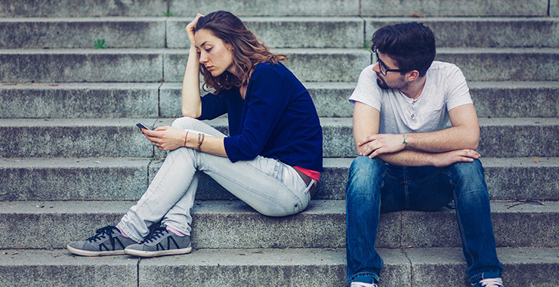
Why Is It Hard to Leave an Unhealthy Relationship?
Fear of being alone.
Fear of changing their mind after the break-up.
Feeling like they can’t end it.
Feeling pulled back in.
Feeling responsible for the other person’s safety.
The other person threatens or blackmails you.
Feeling like the other person does not let you end things.
Source: https://www.missingkids.org/education

Slide 13
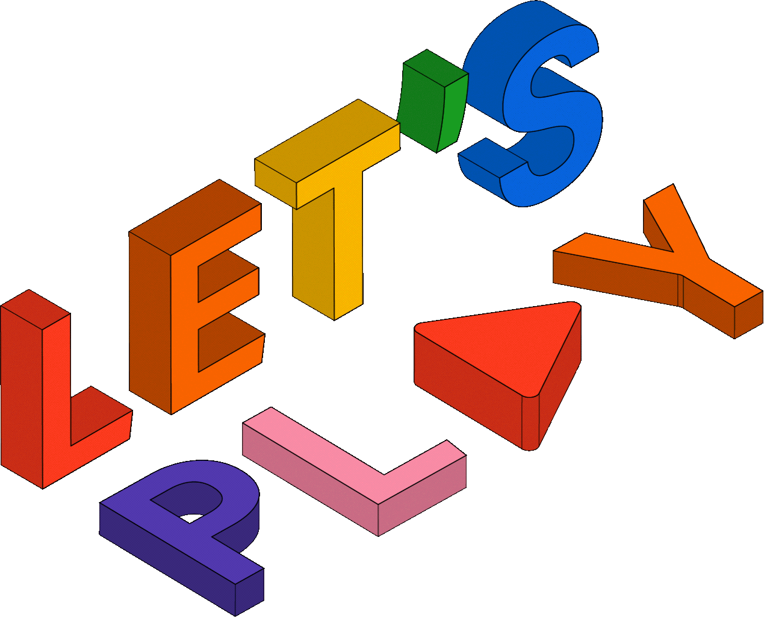
Activity

Slide 14
Activity
We recommend playing
Relationship Red Flags BINGO.

Slide 16
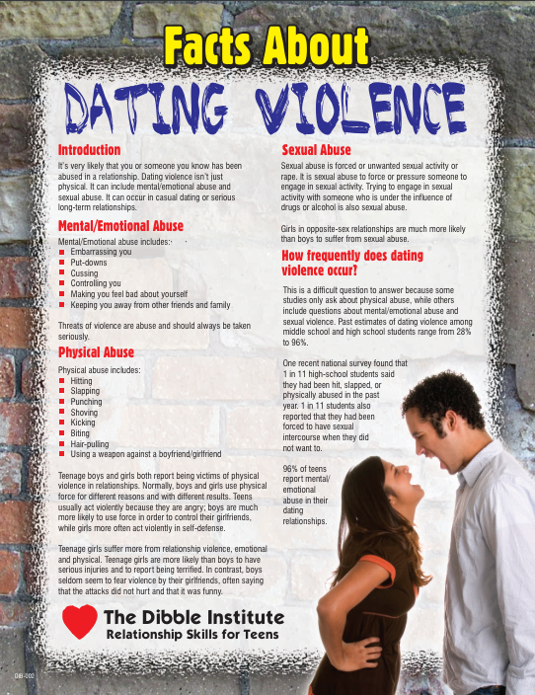
Lesson Handout from The Dibble Institute

Slide 17
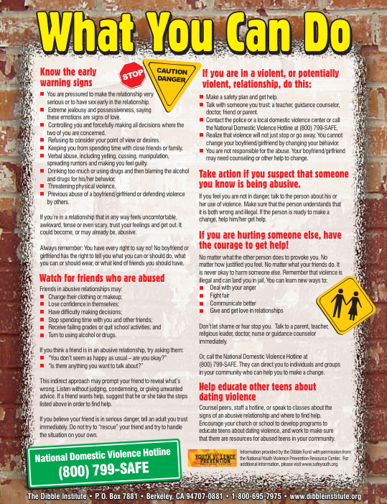
Lesson Handout from The Dibble Institute

Slide 18
Links to Lesson Materials
NCMEC “Healthy Relationships” Video
NCMEC “Healthy Relationships” Discussion Guide
DayOneNY “Don’t Confuse Love and Abuse” Video
The Dibble Institute “Dating Violence” Handout
Relationship Red Flags BINGO

Slide 19
Recap of Lesson
Signs of an unhealthy relationship:
  Feeling scared, unsafe, or threatened
  Feeling manipulated or guilted often
  Feeling as though you are the only one who compromises
  Feeling disrespected during arguments
  Feeling emotionally drained, insulted or threatened during arguments
  Feeling pressured to do something
Taking time to get to know someone is healthy because:
  Learn about who they really are
  Build trust
  Explore your feelings
It can be hard to leave an unhealthy relationship due to:
  Fear of being alone
  Fear of changing their mind
  Feeling like they can’t end it
  Feeling pulled back in
  Feeling responsible for the other person’s safety
  Being threatened or blackmailed
  The other person not letting you end things

