Slide 1

Youth Engagement- Ages 17-18 (12th Grade)
Healthy Relationships & Lifestyle Choices

Slide 2

PREVENTION THROUGH EDUCATION IS THE SOLUTION
Connect for Freedom is a 501(c)(3) nonprofit committed to providing free online safety and human trafficking awareness materials to youth-serving organizations and communities.

Slide 3


Lesson Outline
Lesson
  Introduction to Healthy Relationships
  Tedx Talks “The Surprising Key to Building a Healthy Relationship That Lasts” Video (8.5 min.)
    Discussion Question
  Setting Boundaries
  Consent
  Teaching Sexual Health Alberta Health Services “Understanding Consent” Video (3 min.)
    Discussion Question
  Fight Child Abuse “Don’t Let Pressure End Up as Sexual Abuse” Video (4.5 min.)
    Discussion Questions
  Real Life Story- Sandra
  Therapist Aid LLC Handout: Attachment Styles
  Activity
Healthy Relationships & Lifestyle Choices

Slide 4

Importance of Healthy Relationships
Healthy romantic relationships are important to happiness and overall wellbeing.
96% of teens report mental/emotional abuse in their dating relationships.
The Dibble Institute
Negative interactions and relationships with partners can lead to increased risk of anxiety, depression, and suicidal thoughts.
Mental Health Foundation
Relationship issues are a major factor of teen suicides, which is the second leading cause of teenage death.
The Dibble Institute

Slide 5

Characteristics of an Unhealthy Relationship
  Physical aggression or abuse
  Emotional manipulation
  Name calling
  Controlling
  Cruel and mean communication
  Shaming and/or blaming their partner
  Extreme possessiveness and jealousy
  Pressure for sexual activity
  Threats and/or abuse
Source: https://www.missingkids.org/education

Slide 6
Characteristics of a Healthy Relationship
  Respect one another
  Honest communication
  Open to positive change
  Supportive during difficult times
  Kind and caring
  Want the best for one another
  Respect one another’s boundaries
  Loyalty and trust
  Feel safe and secure
Source: https://www.missingkids.org/education

Slide 7

How to Maintain a Healthy Relationship
Manage your own anger.
Make decisions together.
Communicate honestly with one another.
Be generous without expectations.
Source: https://www.missingkids.org/education

Slide 8

TEDx Talks “The Surprising Key to Building a Healthy Relationship that Lasts” Video
Duration: 8:31 minutes
Source: https://www.youtube.com/watch?v=Xvb-v83qJ8U

Slide 9
TEDx Talks “The Surprising Key to Building a Healthy Relationship that Lasts” Teacher Led Discussion Question
Think about what a healthy relationship looks like to you. Think about those in your life who you see in healthy relationships.
What do you think are some important factors to having a healthy relationship that were not mentioned in the Tedx Talk?

Slide 10

Setting Boundaries for Dating
Setting boundaries for dating is important to having a healthy relationship.
Know yourself. Having self-worth and confidence will help you walk away from any relationship that does not serve you.
Know what your expectations are. Being aware of what is unacceptable behavior in a relationship will help you walk away from an unhealthy relationship.
Know when to walk away. Keeping yourself safe is the most important thing you can do for yourself. Don’t ever stay with someone who makes you feel unsafe or uncomfortable.
Source: https://www.missingkids.org/education

Slide 11
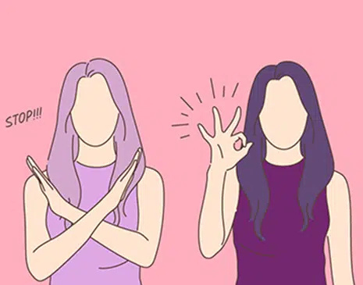
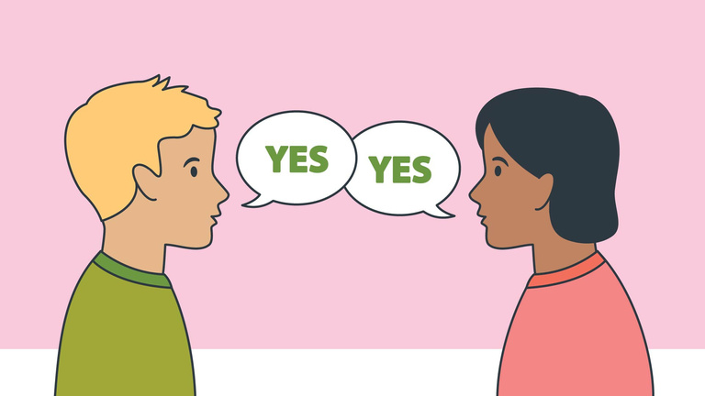
Consent
Consent is when two people agree to engage in a sexual act.
Consent cannot be given if someone is:
  Pressured or threatened to do so
  Under the influence of drugs or alcohol
  Asleep or unconscious
Consent can be revoked at any time during a sexual encounter. A sexual act without consent from both parties is sexual assault.
Source: https://rainn.org/articles/what-is-consent

Slide 12
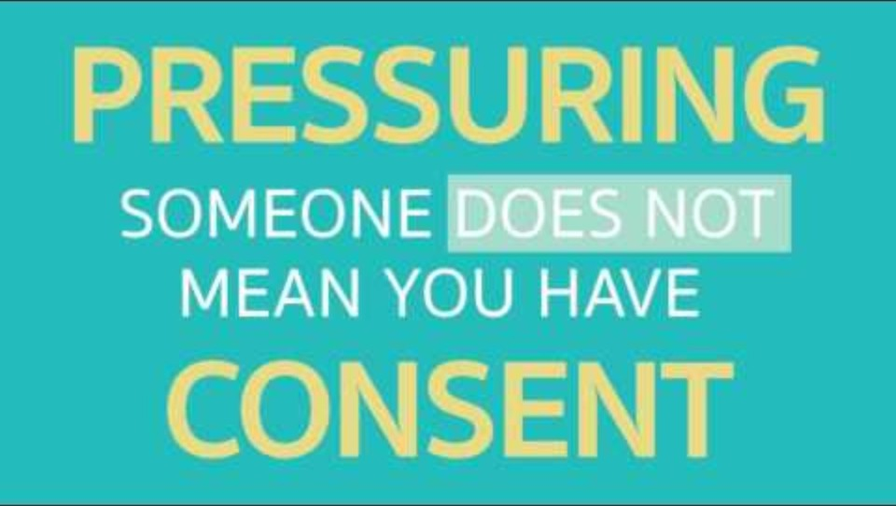
Teaching Sexual Health Alberta Health Services “Understanding Consent” Video
Duration: 3:02 minutes
Source: https://www.youtube.com/watch?v=raxPKklDF2k

Slide 13
Teaching Sexual Health Alberta Health Services “Understanding Consent” Staff-Led Discussion Questions
What are some examples of situations where someone cannot give consent?
What would you do if you saw someone being pressured to engage in sexual activity at a party but they were unable to consent?

Slide 14
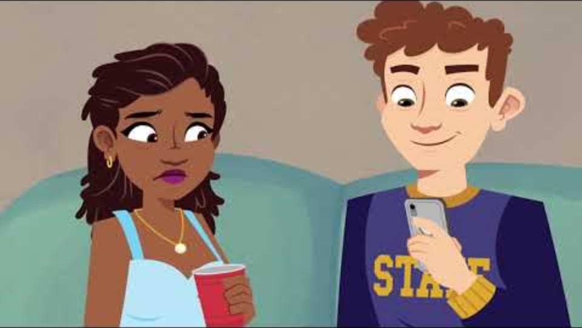
Fight Child Abuse “Don’t Let Pressure End Up As Sexual Abuse” Video
Duration: 4:35 minutes
Source: https://www.youtube.com/watch?v=F9lCVyLSHvc

Slide 15
Fight Child Abuse “Don’t Let Pressure End Up As Sexual Abuse” Discussion Questions
Participants should get into 2 groups, and staff will designate each group a number. Each group will work together and answer the questions with their group number. Then each group will take turns presenting their answers to everyone.
Group 1 Questions
Group 2 Questions
Make a list of red flags that Willow overlooked in this video.
Come up with a list of ideas of how you would handle the situation.
At what point do you think Willow should have gone home?
Who would you recommend turning to if you were in this situation?

Slide 16
Real Life Story- Sandra
Sandra, 17, immigrated to the U.S. when she was 15. She has always been shy at school and has trouble connecting with her peers because of her limited English skills. She often chatted with an employee in the school cafeteria who speaks Spanish.
When Sandra first started school, she was very motivated but has recently been absent frequently and seems tired and distracted. The cafeteria worker continued to check in with Sandra and encouraged Sandra to keep coming to school.
One day, the cafeteria worker noticed Sandra has been crying and asked her if she is okay. Sandra disclosed that she was in an abusive relationship and that her boyfriend had convinced her to film videos of them engaging in sex acts, even though it made her uncomfortable. She learned that her boyfriend had been selling the videos on the Internet. When she tried to break up with him, he threatened to send the videos to her family and members of her church if she told anyone or if she refused to continue filming. She is scared that her family will disown her and is afraid of calling the police because she believes she will be deported.
Source: https://www.nj.gov/education/safety/sandp/cwss/ht/docs/HT%20Prevention%20Guidelines%20for%20Schools_Jan2022_updated%202.24.22.pdf

Slide 17

Activity

Slide 18
Activity
We recommend playing
Healthy Relationship Jeopardy.

Slide 20
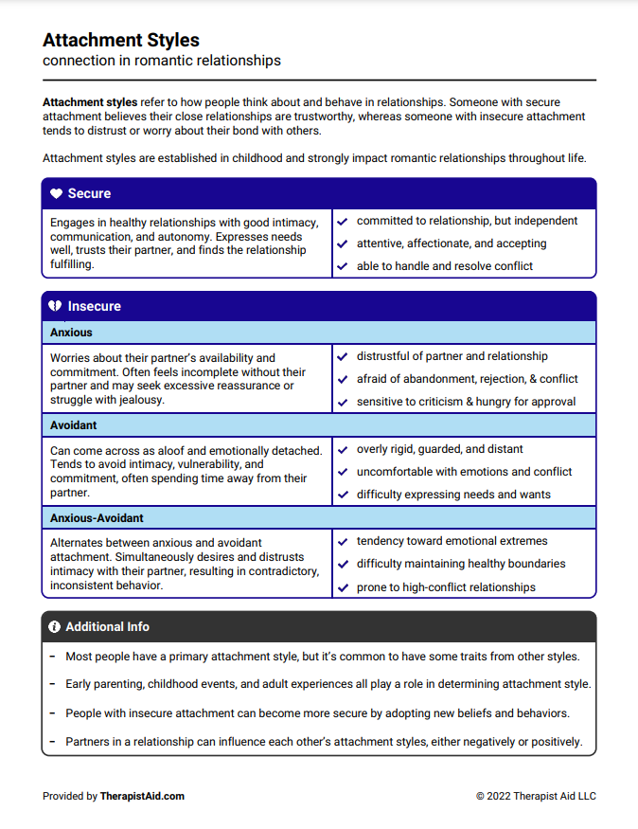
Lesson Handout from Therapist Aid LLC

Slide 21
Links to Lesson Materials
Tedx Talks “The Surprising Key to Building a Healthy Relationship That Lasts” Video
Teaching Sexual Health Alberta Health Services “Understanding Consent” Video
Fight Child Abuse “Don’t Let Pressure End Up as Sexual Abuse” Video
Therapist Aid LLC "Attachment Styles" Handout
Healthy Relationship Jeopardy

Slide 22
Recap of Lesson
Signs of a healthy relationship:
  Respect one another
  Honest communication
  Open to positive change
  Supportive during difficult times
  Feel safe and secure
  Kind and caring
  Want the best for one another
  Respect one another’s boundaries
  Loyal and trustworthy
Consent is when two people agree to engage in a sexual act.
Consent cannot be given if someone is pressured or threatened to do so, under the influence of alcohol or drugs, or is asleep or unconscious.

