Slide 1


501(c)(3)
Parent/Caregiver Presentation

Slide 2

Prevention Through Education is the Solution
Connect for Freedom is a 501(c)(3) nonprofit committed to providing free online exploitation and human trafficking awareness and prevention education materials to K-12 schools.

Slide 3

NJ Department of Education Standard
N.J.S.A. 18A:6-131.2-131.3
  Guidelines for Schools on the Prevention of Human Trafficking of Students as of January 2022
  Requirements:
    K-12 Lesson Plans
    Faculty Training
    Response Protocol
    Parent Presentations, Information & Training
  Recommendations:
    Student Engagement
    After-School Program
  Our program MEETS & EXCEEDS the State guidelines

Slide 4

School-Aged Children Are Being Targeted

Slide 5
What Connect for Freedom provides schools to raise awareness:
  Lesson Plans for Grades K-12
  Student Engagement Activities
  Display Kits for K-12 Schools
  Program Implementation Guide
  School District Response Protocol
  Faculty Training
  SRO & Security Director Training
  Parent/Caregiver Presentation
  Parent/Caregiver Training Guides

Slide 6

Connect for Freedom
K-12 Lesson Plan Breakdown
Elementary School: Personal Safety & Online Safety
Middle School: Online Exploitation, Online Safety & Healthy Relationships
High School: Online Exploitation, Online Safety, Healthy Relationships & Human Trafficking

Slide 7
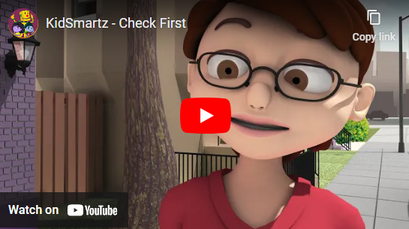
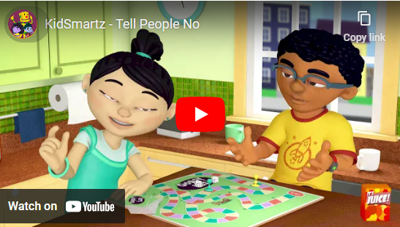
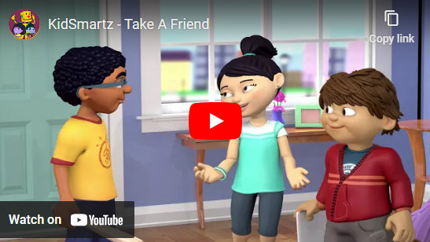
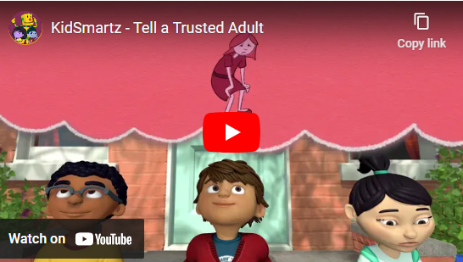
Elementary School Program
KidSmartz Lessons from NCMEC
Grades K-5 Presentation: Be Safer
  Personal safety lesson with educational videos
Grades K-2 Presentation: Be Safer Online
  Digital safety lesson
Grades 3-5 Presentation: Being a Good Digital Citizen
  Digital safety lesson

Slide 8

KidSmartz “Check First” Video
Duration: 1:40 minutes
Source: https://www.youtube.com/watch?v=5S8-Evqzn7E

Slide 9

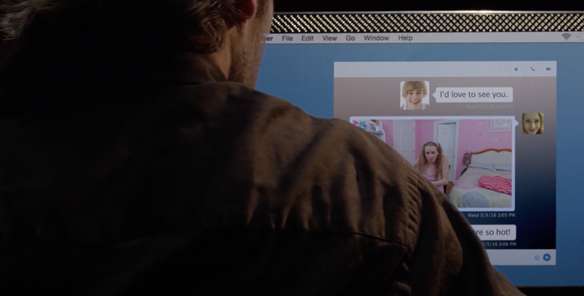
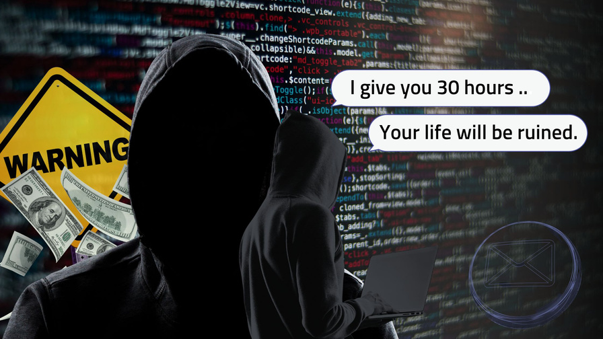
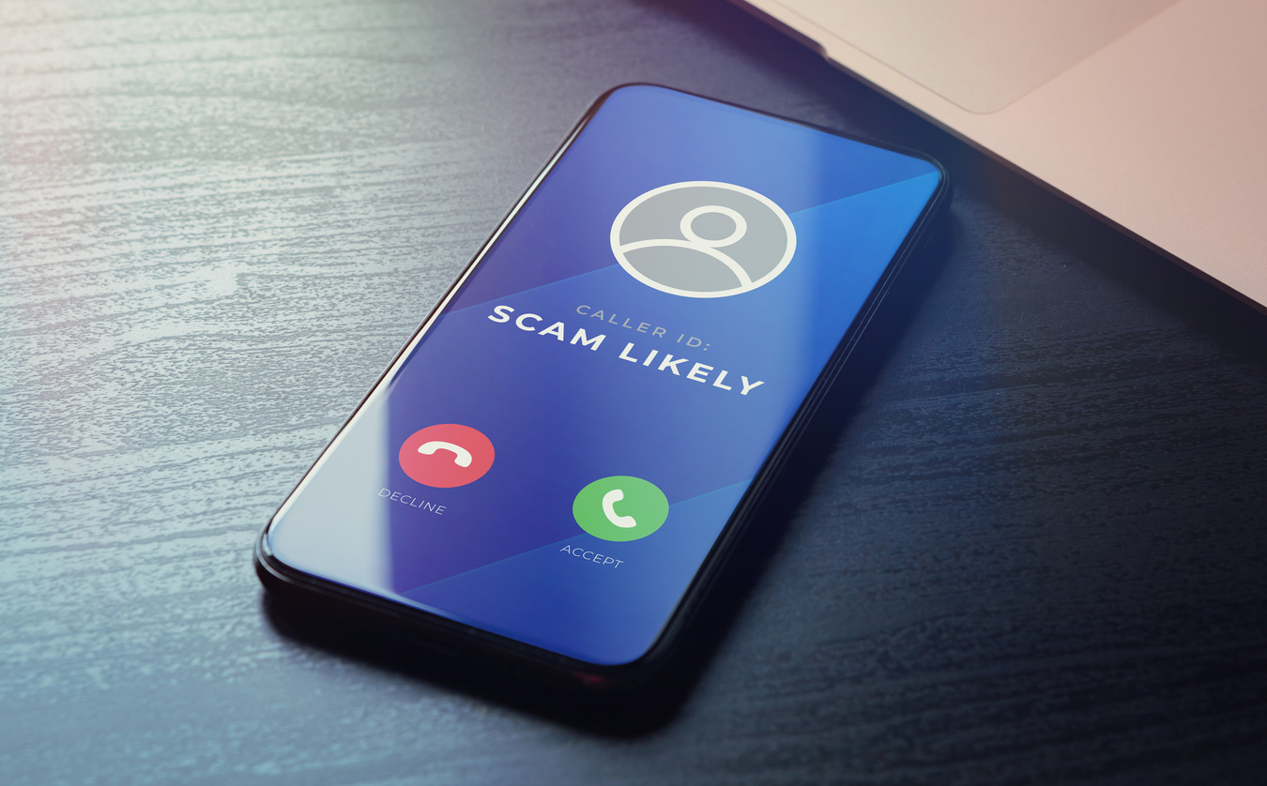

Middle School Program - 6th Grade
Online Safety & Understanding Online Enticement
Sextortion & Understanding Offender Tactics
Protecting Yourself from Online Predators
Healthy Relationships & How to Cultivate Them

Slide 10




Middle School Program - 8th Grade
Dangers of the Internet & Online Predators
Online Enticement Can
Lead to Sex Trafficking
Labor Trafficking &
The Legal System
Healthy Relationships Lead to Safe Decision Making

Slide 11
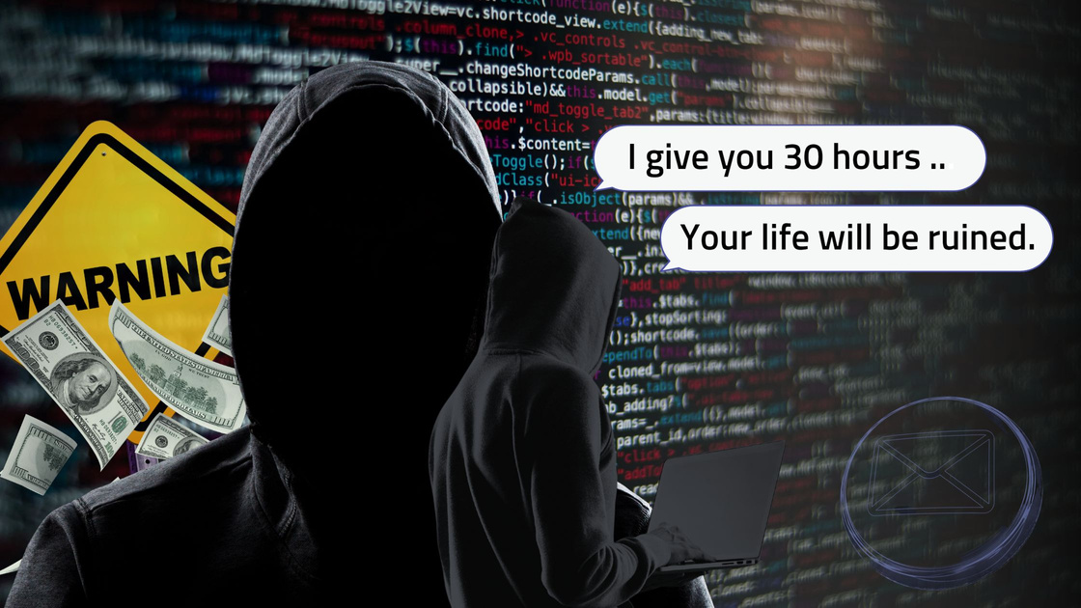
Online Exploitation
Online Enticement
  individual communicates with child online
  intent: commit a sexual offense or abduction
Sextortion
  form of child sexual exploitation
  child is threatened or blackmailed with nude image
  demands additional images, sexual activity or money from child
Source: https://www.missingkids.org/netsmartz/topics/onlineenticement

Slide 12

Online Enticement
In 2023, the CyberTipline received 186,819 reports of online enticement, the category that includes sextortion.
Between 2021 and 2023, the number of online enticement reports increased by 323%.
98% of reported offenders were seemingly unknown to the child offline.
In a NCMEC analysis, 78% of reported victims were girls, 13% were boys, and for 9% of reports, gender was unknown.
Source: https://www.missingkids.org/netsmartz/topics/onlineenticement

Slide 13

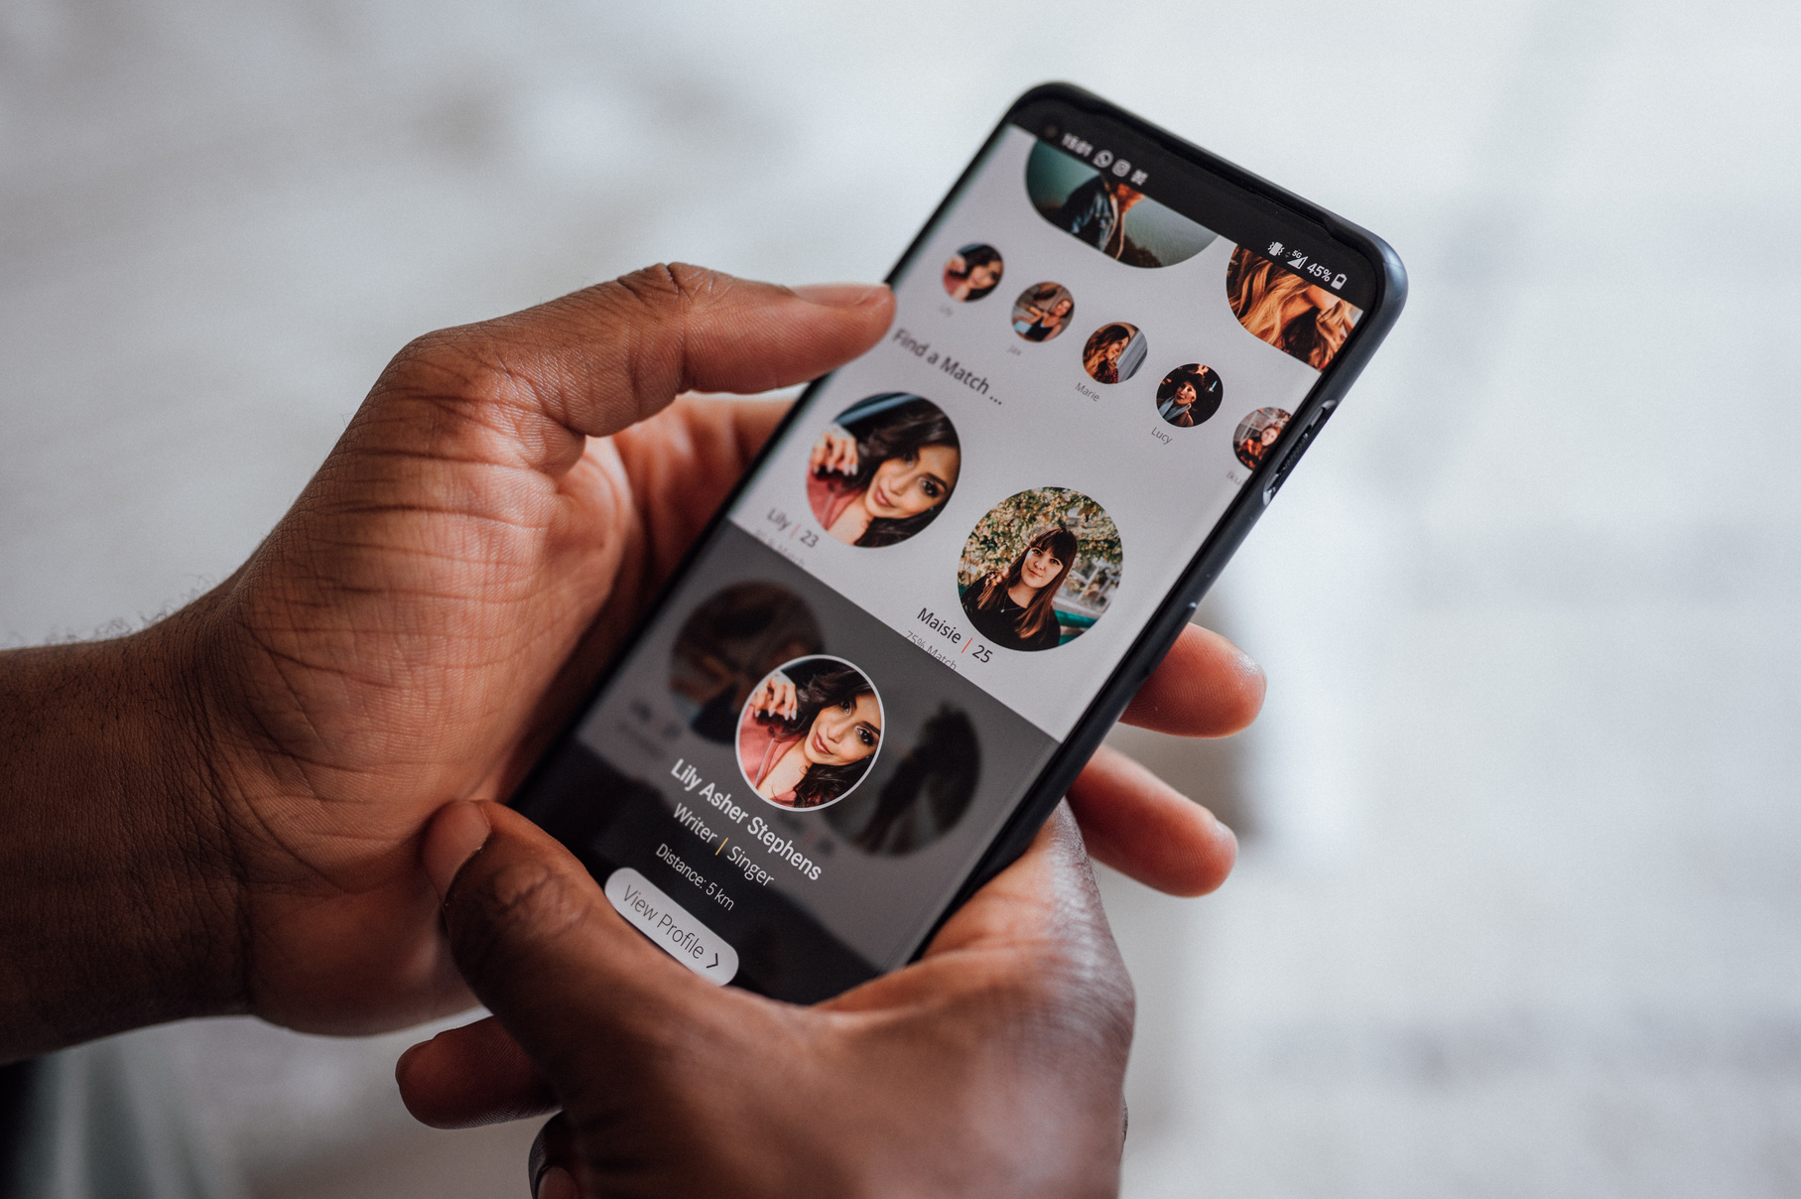
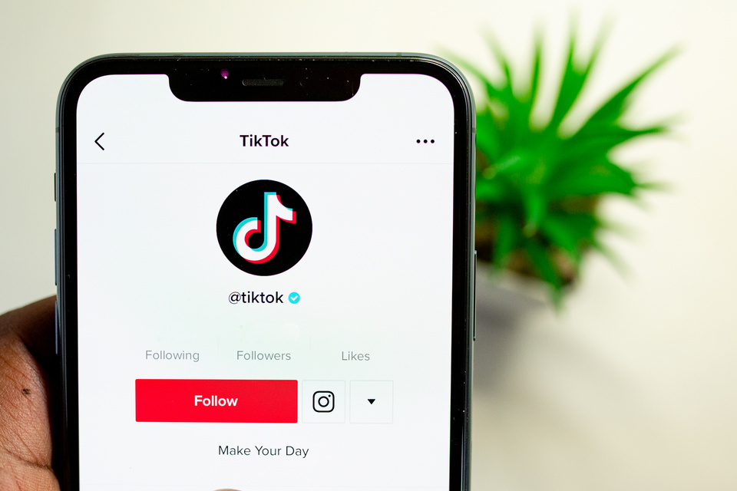
Where are Online Predators Reaching Victims?
Social media platforms
Game apps
Anonymous chat apps
Dating apps
Source: https://www.missingkids.org/theissues/onlineenticement

Slide 14
NCMEC “Sextortion” Video
Duration: 1:00 minute
Source: https://www.youtube.com/watch?v=NzKLcvUQAqA

Slide 15


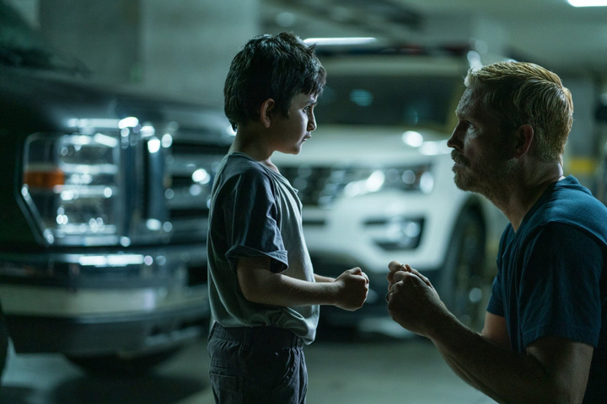

High School Program- 9th Grade
Online Decisions with Real Life Consequences
Relationship Standards & Setting Boundaries
Human Trafficking Awareness & Prevention
How to Protect Yourself & Your Friends
Sextortion & Understanding Offender Tactics
Protecting Yourself from Online Predators
Healthy Relationships & How to Cultivate Them

Slide 16




High School Program- 12th Grade
Digital Awareness & Online Safety
Exploitation & How to Identify It
A Breakdown of Human Trafficking
Healthy Relationships & Lifestyle Choices
Sextortion & Understanding Offender Tactics
Protecting Yourself from Online Predators
Healthy Relationships & How to Cultivate Them

Slide 17
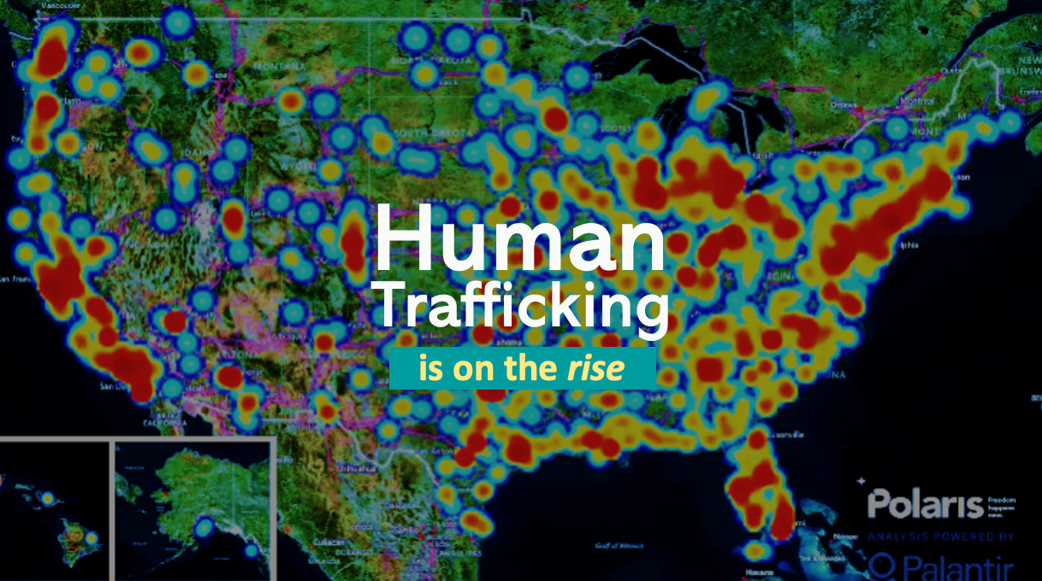

Slide 18

A Pervasive Problem
The U.S. is the #1 consumer of sex trafficking.
US Institute Against Human Trafficking
38% of sex trafficking victims are minors.
Polaris Project
Human trafficking is a
$150 billion dollar industry.
Polaris Project
Only 2.7% of human trafficking cases are prosecuted.
Polaris Project

Slide 19
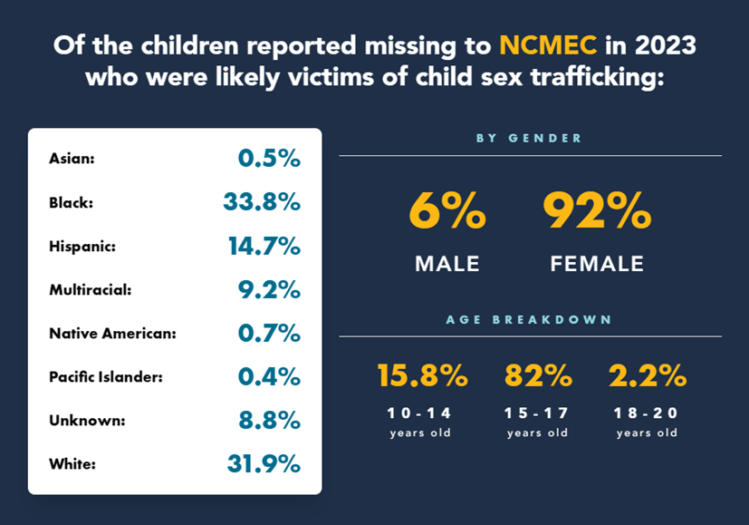
Human Trafficking Stats In The United States
Of the more than 28,800 missing children reported to NCMEC in 2023,
1 in 6 were likely victims of child sex trafficking.
Source: https://www.missingkids.org/ourwork/impact

Slide 20
UNBOUND NOW “Human Trafficking 101: Risk Factors & Traffickers’ Tactics” Video
Duration: 11:32 minutes
Source: https://www.youtube.com/watch?v=u-5XFBFq11o&t=234s

Slide 21

Check For Signs Of Grooming
Signs of grooming in children:
Isolating themselves from family and friends.
Hiding their phone or laptop screen.
Getting upset when they can’t be online.
Receiving random gifts and/or money.
Calling unknown or unsaved numbers.
Having inappropriate images saved.
Source: https://www.missingkids.org/blog/2020/grooming-in-the-digital-age

Slide 22
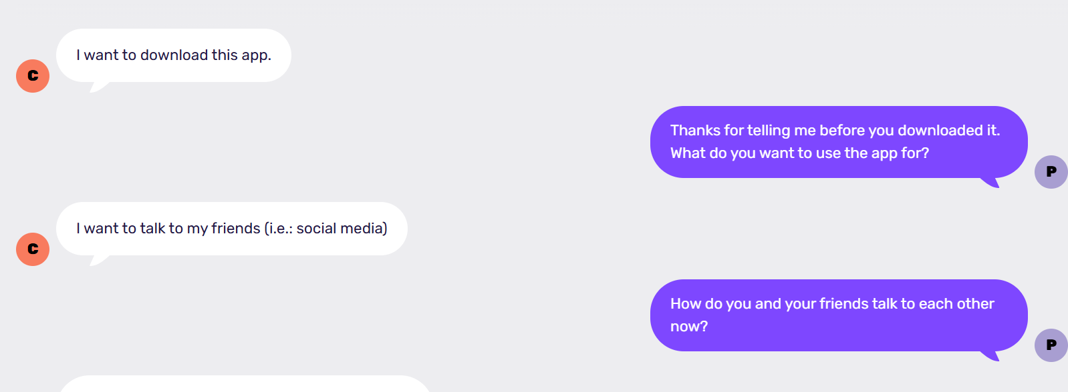
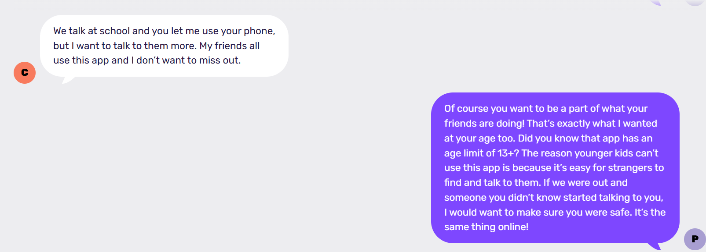
Thorn Discussion Guide- Start Talking About Social Media Platforms
Source: https://parents.thorn.org/guides/start-talking-about-social-media-platforms/

Slide 23
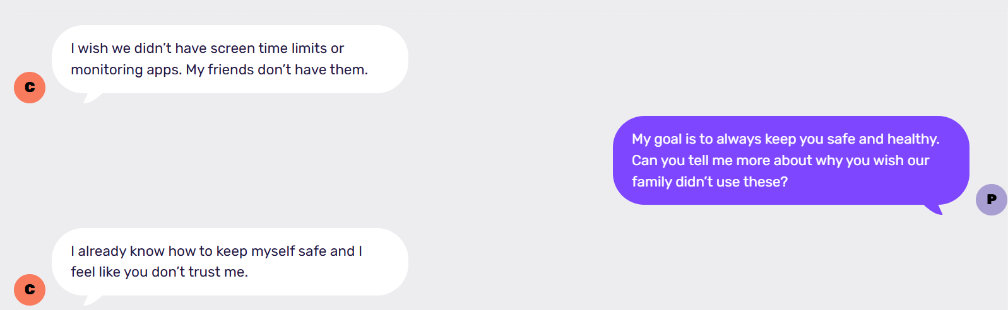
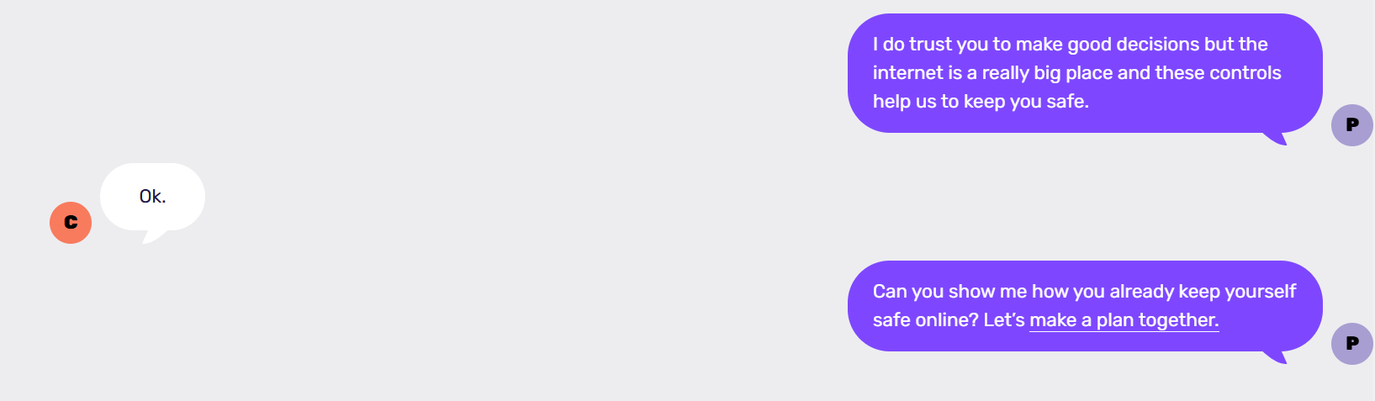
Thorn Discussion Guide- Screen Time & Online Monitoring
Source: https://parents.thorn.org/guides/screen-time-online-monitoring/

Slide 24

Online Safety Tips For Parents
Establish rules about what they can share.
Learn about reporting options.
Help them set privacy settings.
Help them create strong passwords.
Talk about friends lists.
Create a safety plan.
Implement a family technology agreement.
Source: https://www.missingkids.org/netsmartz/home

Slide 25
Take the Pledge2Protect
By taking this pledge, you are vowing to:
  Educate yourself and others about online child sexual exploitation and abuse (CSEA).
  Take the steps necessary to help prevent online CSEA.
  Support those impacted by this crime.
  Sit down with the kids and teens you know and take the pledge with them.
Source: https://www.dhs.gov/know2protect/p2p/parents-trusted-adults
Notes:
Megan

Slide 26
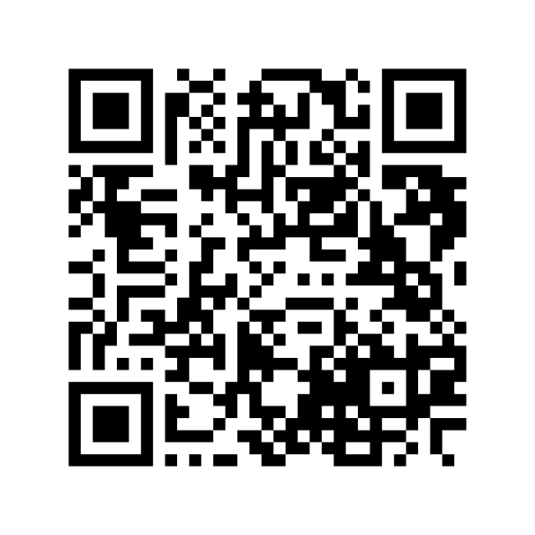
Take the Pledge2Protect
We are going to take a few minutes now to scan the QR code below and look through the Pledge2Protect materials.
Source: https://www.dhs.gov/know2protect/p2p/parents-trusted-adults
Notes:
Megan

Slide 27

What Is a Technology Agreement?
A written document that is meant to represent the entire family’s values around healthy technology use.
Source: https://theexodusroad.com/

Slide 28
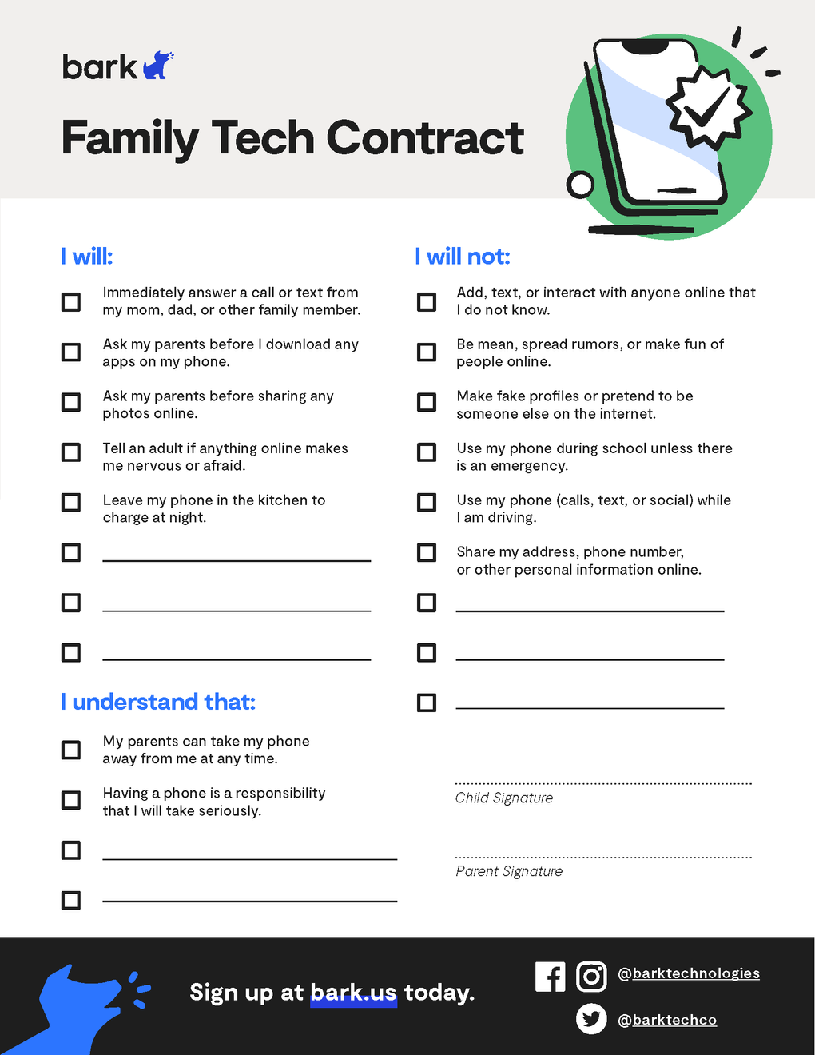
bark Family Technology Agreement

Slide 29
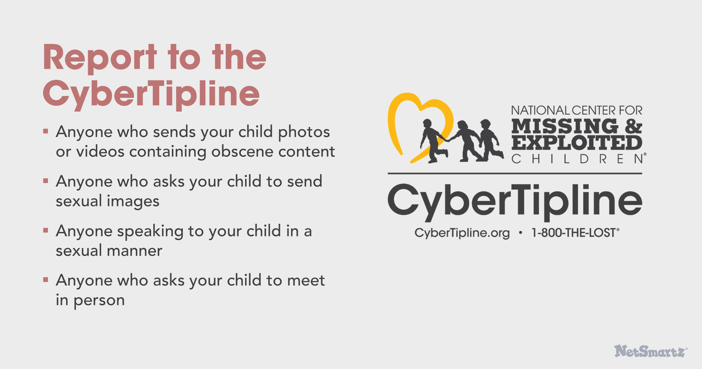
Appropriate Response For Parents
Report to the CyberTipline:
Anyone who sends your child photos or videos containing obscene content.
Anyone who asks your child to send sexual images.
Anyone speaking to your child in a sexual manner.
Anyone who asks your child to meet in person.
Source: https://www.missingkids.org/gethelpnow/cybertipline

Slide 30
Source: https://www.youtube.com/watch?v=pAaXbBzVdJE
Duration: 0:30 minutes

Slide 31
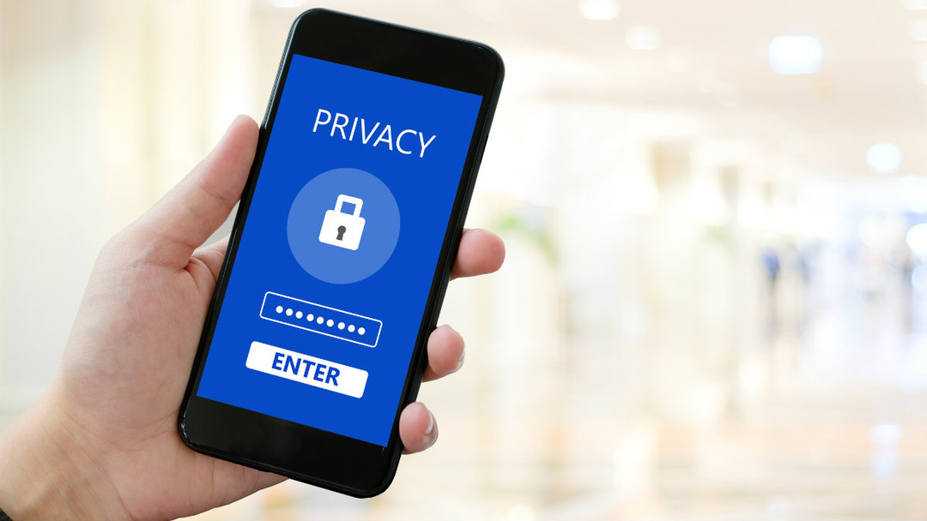
Use Parental Controls on Google & Apple Devices
Help keep your family safe online by managing security settings on all devices. You can use the links below for a full how-to tutorial.
Apple: https://support.apple.com/en-us/HT201304
Google Family Link: https://families.google/familylink/

Slide 32
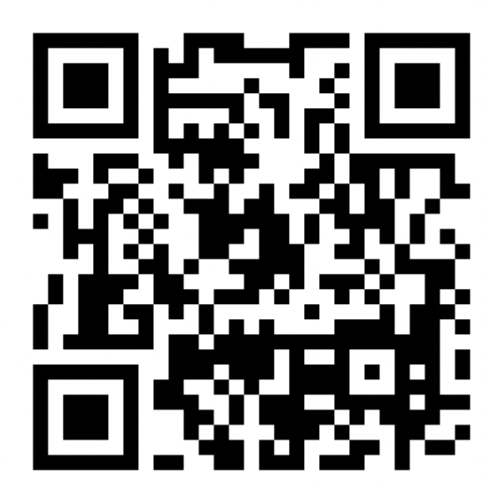
Use the QR Code Below to See Apple’s Security Options
Apple: https://support.apple.com/en-us/HT201304

Slide 33
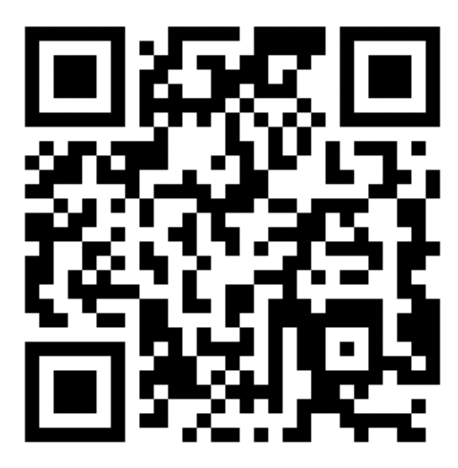
Use the QR Code Below to See Google Family Link’s Security Options
Google Family Link: https://families.google/familylink/

Slide 34
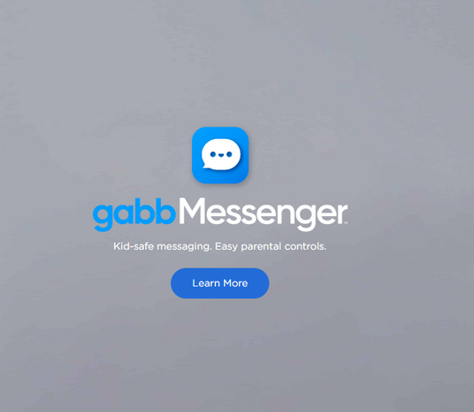

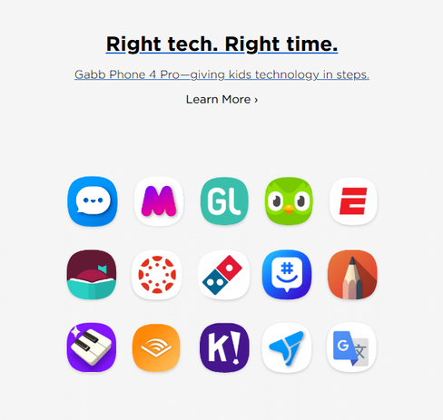
Parent Monitoring Device: Gabb
Source: https://gabb.com/

Slide 35
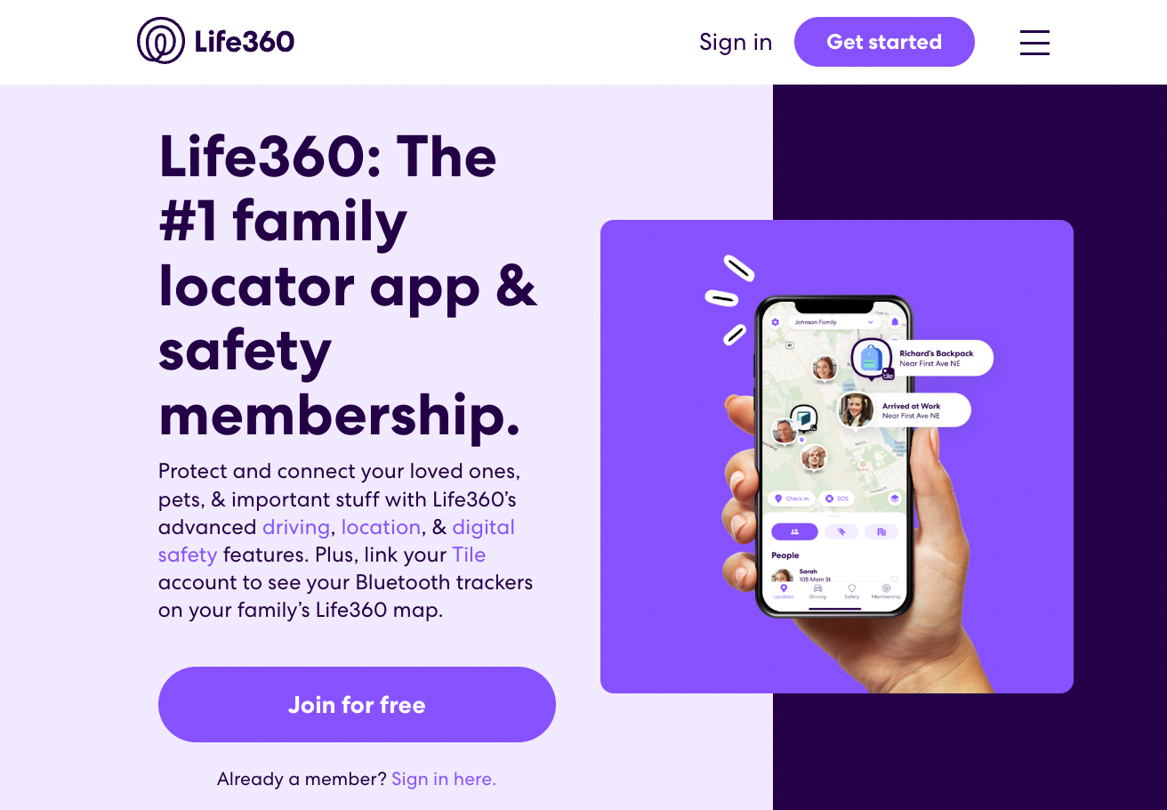
Parent Monitoring App: Life360
Source: https://www.life360.com/

Slide 36
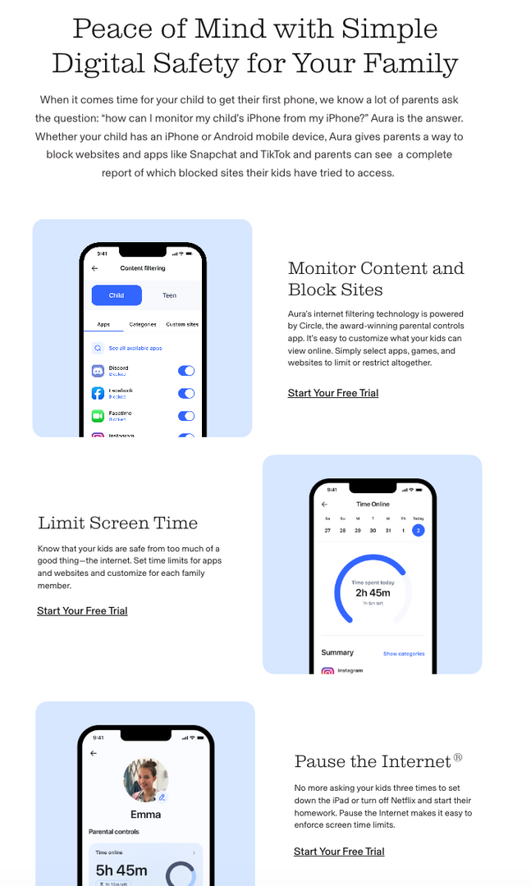

Parent Monitoring App: AURA
Source: https://www.aura.com/parental-controls

Slide 37
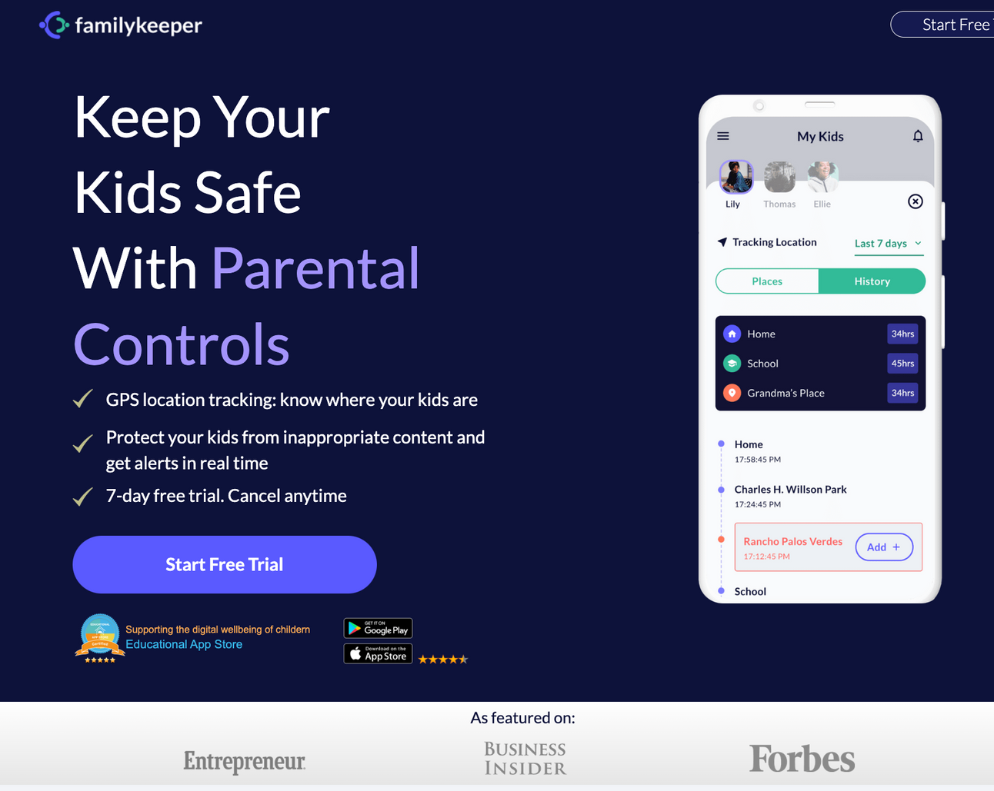
Parent Monitoring App: familykeeper
Source: https://familykeeper.reasonlabs.com/

Slide 38
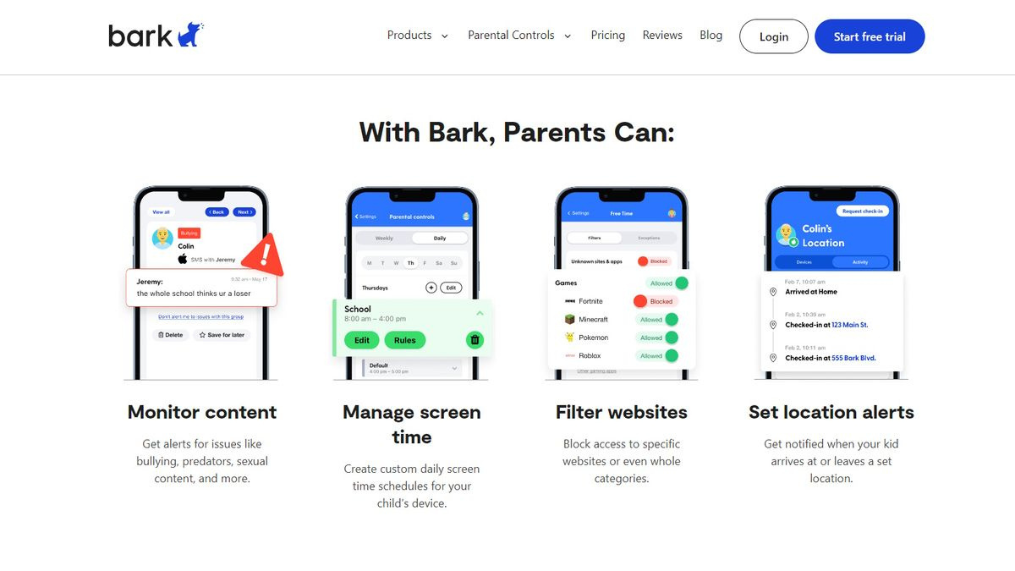
Parent Monitoring App: bark
Source: https://www.bark.us

Slide 39
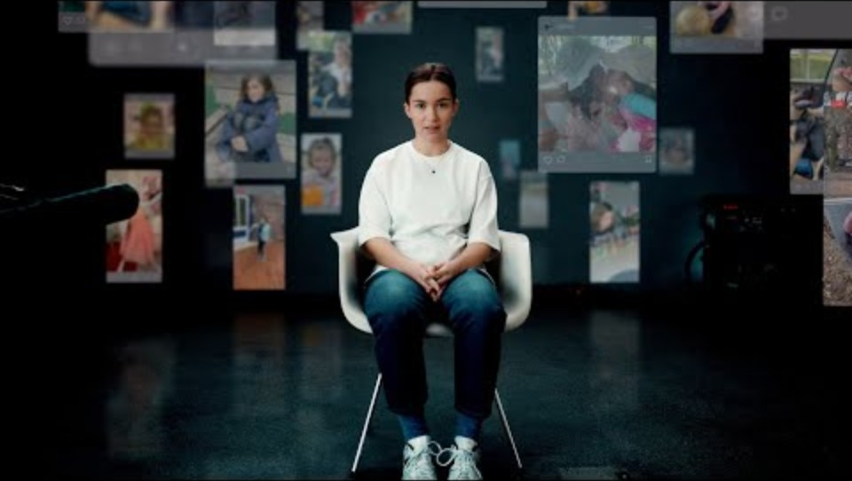
Deutsche Telekom Archiv “A Message from Ella-Without Consent” Video
Duration: 2:48 minutes
Source: https://www.youtube.com/watch?v=F4WZ_k0vUDM

Slide 40
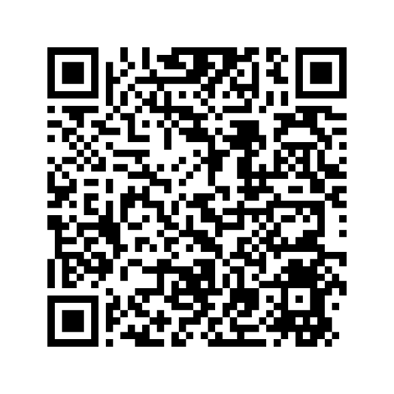
David’s Story
A Father’s Nightmare

Slide 41

DHS Blue Campaign Parent Handout
DHS Blue Campaign Guide for Parents/Caregivers
Source: DHS Blue Campaign How to Talk to Youth Guide

Slide 42
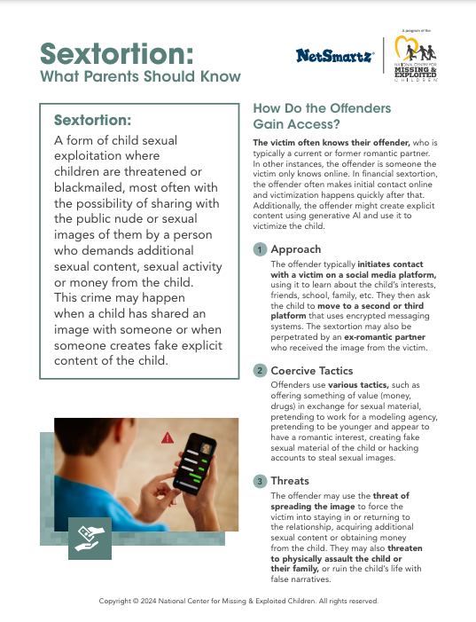
NCMEC Parent Handout
Source: https://www.missingkids.org/content/dam/netsmartz/downloadable/tipsheets/sextortion-what-parents-should-know.pdf

Slide 43

NCMEC Parent Handout
Source: https://www.missingkids.org/content/dam/netsmartz/downloadable/tipsheets/Talking%20to%20Teens%20About%20Sexting.pdf

Slide 44
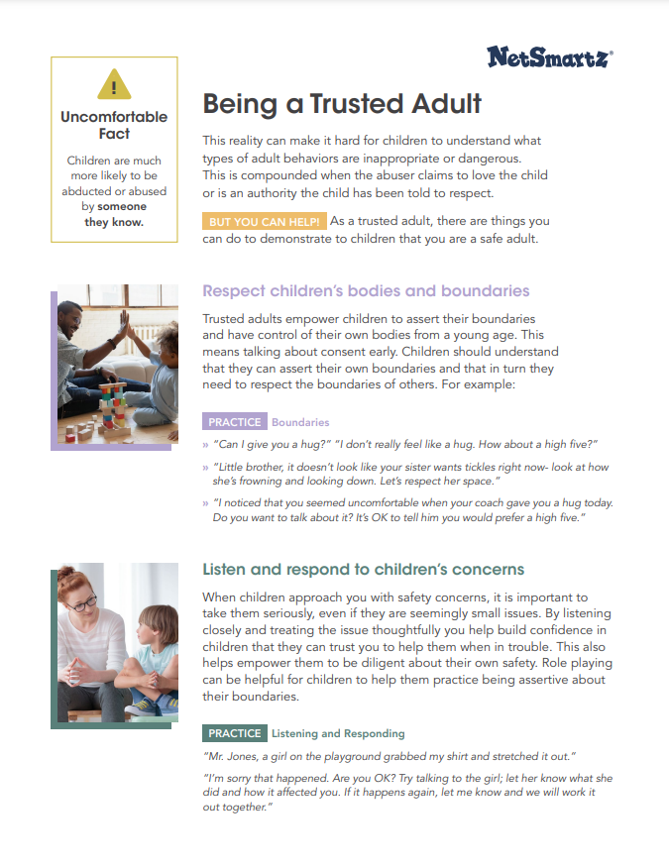
NCMEC Parent Handout
Source: https://www.missingkids.org/content/dam/netsmartz/downloadable/tipsheets/being-a-trusted-adult.pdf

Slide 45

Victim Resources
If you are a victim and need help, please contact:
National Human Trafficking Hotline
Call 1-888-373-7888 or Text “HELP” to BeFree (233733)
National Center for Missing & Exploited Children
Call 1-877-446-2632 ext. 6117 or Email familysupport@ncmec.org
If you want to report suspected human trafficking to Federal Law Enforcement, please contact:
Department of Homeland Security Tip Line
Call 1-866-347-2423

Slide 46
LOVE146 “Keep Your Teen Safe” Video
Duration: 0:30 minutes
Source: https://vimeo.com/664436069

Slide 47
What if I don’t feel comfortable or know how to talk to my child about the topics discussed today?

Slide 48
Read through discussion guides and become confident in talking to your child about these topics.
The discussion guides can be accessed at the link below:
https://parents.thorn.org/discussion-guides/

Slide 49
What is the first steps I should take as a parent to protect my child online?

Slide 50
Be actively engaged in your child’s social media and smartphone usage.
Set clear boundaries on time limits and expectations for online and offline behavior.
Be open and supportive, letting them know you are there to help them if they are in trouble.
Discuss not accepting friend requests from someone they don’t know.

Slide 51
What should I do if my child says their intimate images have been shared online?

Slide 52
You should report the images or videos to the National Center for Missing and Exploited Children’s CyberTipline.
To learn more about this option, please visit the link below:
https://www.missingkids.org/gethelpnow/isyourexplicitcontentoutthere?utm_source=dhs&utm_medium=landing_page&utm_campaign=blue-campaign-2024

Slide 53
What should I do if my child has been the victim of human trafficking?

Slide 54
Report suspected human trafficking to the Department of Homeland Security by calling
1-866-347-2423.
Get help from Polaris’s National Human
Trafficking Hotline by calling
1-888-373-7888.

Slide 55
Additional Materials & Resources for Parents
DHS “How to Talk to Youth About Human Trafficking” Guide
NCMEC “Sextortion: What Parents Should Know” Handout
NCMEC “Talking to Teens About Sexting” Handout
NCMEC “Being a Trusted Adult” Handout
“David’s Story: A Father’s Nightmare” Recording
bark “Family Tech Contract” Handout
thorn Discussion Guides for Parents
Apple Parental Controls
Google FamilyLink Parental Controls

