Slide 1

High School Engagement- Grade 9
Relationship Standards & Setting Boundaries

Slide 2

PREVENTION THROUGH EDUCATION IS THE SOLUTION
Connect for Freedom is a 501(c)(3) nonprofit committed to providing free online safety and human trafficking awareness materials to education stakeholders.

Slide 3

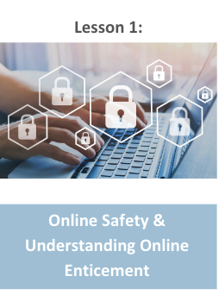
Lesson Outline
Lesson
Introduction to Healthy Relationships
Oasis Mental Health Applications “Building Healthy Relationships” Video (2 min.)
Discussion Questions
Setting Relationship Boundaries
Consent
Your Story Studio “What is Consent?” Video (3 min.)
Discussion Question
RHNTC Handout: The Healthy Relationship Wheel
Activity
Relationship Standards & Setting Boundaries

Slide 4

Importance of Healthy Relationships
Healthy romantic relationships are important to happiness and overall well-being.
96% of teens report mental/emotional abuse in their dating relationships.
The Dibble Institute
Negative interactions and relationships with partners can lead to increased risk of anxiety, depression, and suicidal thoughts.
Mental Health Foundation
Relationship issues are a major factor of teen suicides, which is the second leading cause of teenage death.
The Dibble Institute

Slide 5
Healthy Relationship vs. Unhealthy Relationship
Healthy Relationship:
Unhealthy Relationship:
Respect one another
Honest communication
Open to positive change
Supportive during difficult times
Kind and caring
Want the best for one another
Respect one another’s boundaries/space
Loyalty and trust
Feel safe and secure
Physical aggression or abuse
Emotional manipulation
Name calling
Controlling
Cruel and mean communication
Shaming and/or blaming their partner
Extreme possessiveness and jealousy
Pressure for sexual activity
Threats and/or abuse
Source: https://www.missingkids.org/education

Slide 6
Healthy Relationship vs. Unhealthy Relationship
Example 1: Emily is a sophomore girl dating Mario, a senior boy. She feels nervous around her boyfriend because this is her first relationship. Mario tends to be forward and asks her for things that she does not feel comfortable doing, but she does it anyway. Afterwards, she feels guilty but she tells herself this is how a relationship is supposed to be.
Is this a healthy or unhealthy relationship? Why?

Slide 7
Healthy Relationship vs. Unhealthy Relationship
Example 2: Alicia is a senior girl dating Keith, a senior boy. This is Alicia’s first relationship and she feels very happy with Keith. She does not have much experience but tells him what she does and does not like. Keith always respects Alicia and her feelings and does not try to make her do anything she does not want to do.
Is this a healthy or unhealthy relationship? Why?

Slide 8
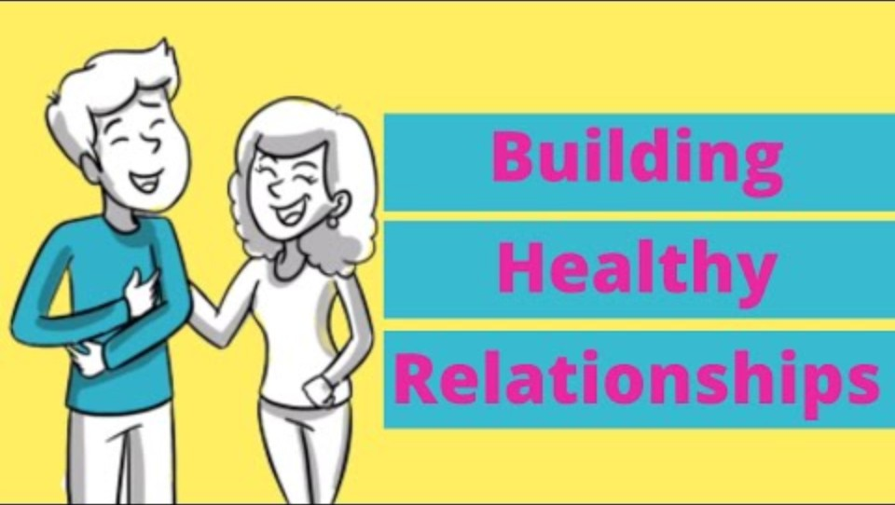
Oasis Mental Health Applications “Building Healthy Relationships” Video
Duration: 2:42 minutes
Source: https://www.youtube.com/watch?v=ELLaMPiPqPM

Slide 9
Oasis Mental Health Applications “Building Healthy Relationships” Discussion Questions
The class should get into 2 groups and the teacher will designate each group a number. Each group will work together and answer the questions with their group number. Then each group will take turns presenting the answers to the class.
Group 1 Questions
Group 2 Questions
What unhealthy relationship behaviors did Kyle exhibit?
Why does Ashley find it hard to leave the relationship with Kyle?
What are some healthy relationship behaviors you should look for?
Ashley opened up to the school guidance counselor. Who else could she have turned to for help?

Slide 10

Setting Boundaries for Dating
Setting boundaries for dating is important to having a healthy relationship.
Know yourself. Having self-worth and confidence will help you walk away from any relationship that does not serve you.
Know your expectations. Being aware of what is unacceptable behavior in a relationship will help you walk away from an unhealthy relationship.
Know when to walk away. Keeping yourself safe is the most important thing you can do for yourself. Do not ever stay with someone who makes you feel unsafe or uncomfortable.
Source: https://www.missingkids.org/education

Slide 11
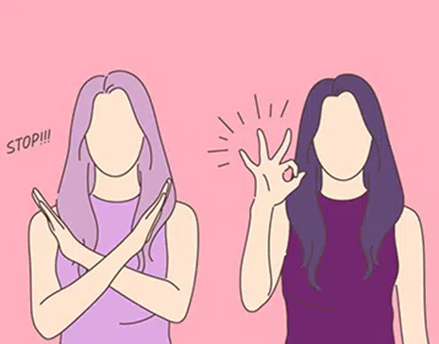
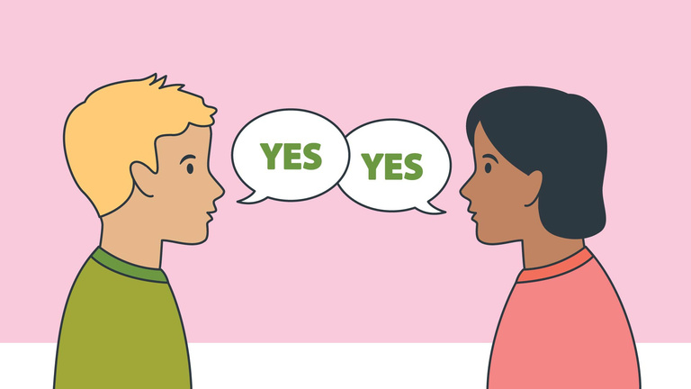
Consent
Consent is when two people agree to engage in a sexual act.
Consent cannot be given if someone is:
Pressured or threatened to do so
Under the influence of drugs or alcohol
Asleep or unconscious
Consent can be revoked at any time during a sexual encounter. A sexual act without consent from both parties is sexual assault.
Source: https://rainn.org/articles/what-is-consent

Slide 12
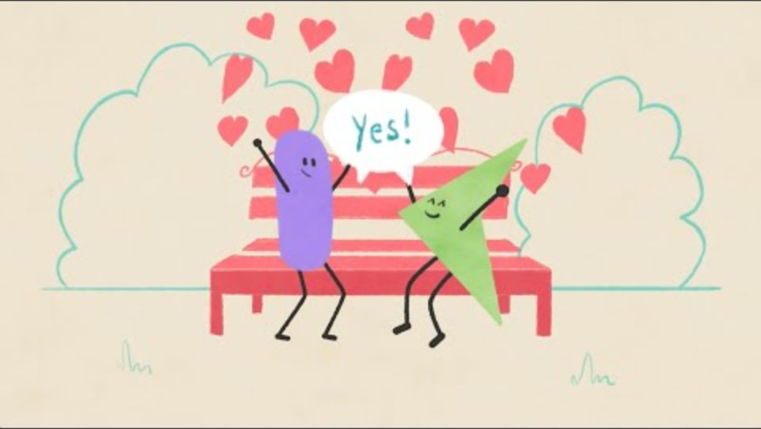
Your Story Studio “What is Consent?” Video
Duration: 2:57 minutes
Source: https://www.youtube.com/watch?v=iBvD3sACS4o

Slide 13
Your Story Studio “What is Consent?” Teacher Led Discussion Question
Sometimes consent cannot be given if there is a power imbalance.
What are some examples of relationships where a power imbalance may be present?

Slide 14

Activity

Slide 15
Activity
We recommend playing
Healthy Relationship Jeopardy.

Slide 16


Slide 17
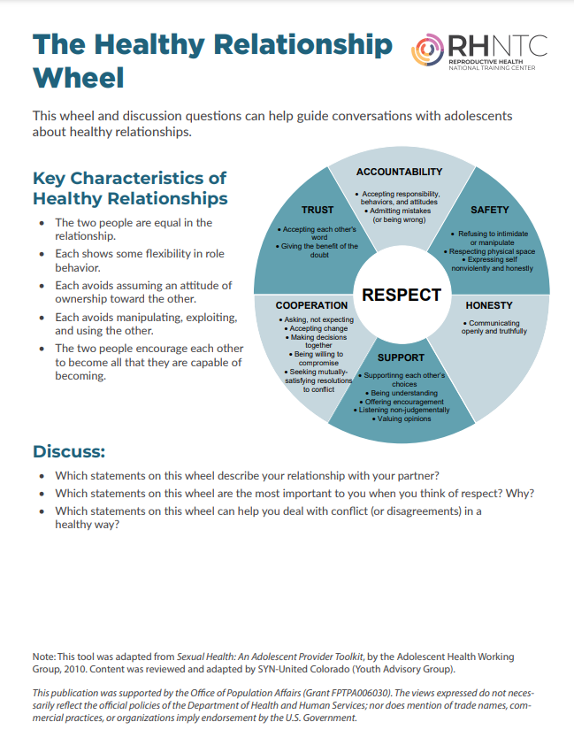
Lesson Handout from RHNTC

Slide 18
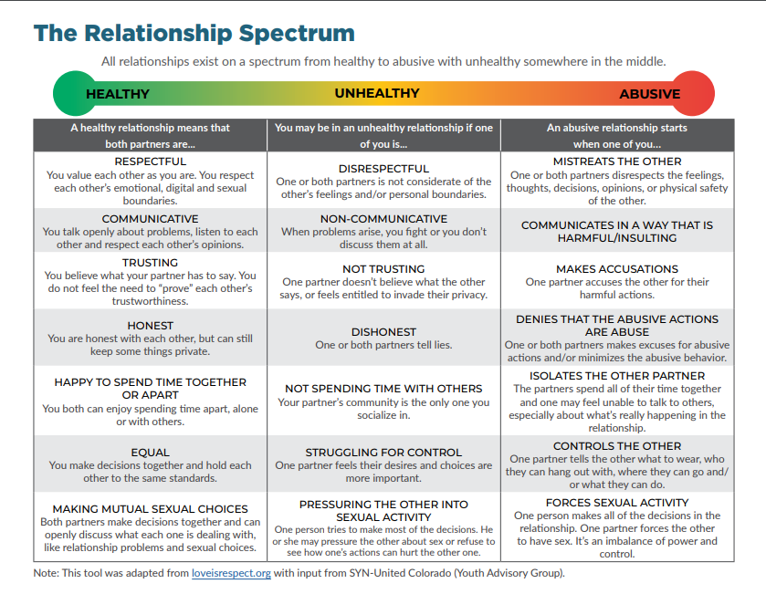
Lesson Handout from RHNTC

Slide 19
Links to Lesson Materials
Oasis Mental Health Applications “Building Healthy Relationships” Video
Your Story Studio “What is Consent?” Video
RHNTC “The Healthy Relationship Wheel” Handout
Healthy Relationship Jeopardy

Slide 20
Recap of Lesson
Signs of a healthy relationship:
Respect one another
Honest communication
Open to positive change
Supportive during difficult times
Feel safe and secure
Kind and caring
Want the best for one another
Respect one another’s boundaries/space
Loyal and trustworthy
Consent is when two people agree to engage in a sexual act.
Consent cannot be given if someone is pressured or threatened to do so, under the influence of alcohol or drugs, or is asleep or unconscious.

