Slide 1

High School Engagement- Grade 9
How to Protect Yourself & Your Friends

Slide 2

PREVENTION THROUGH EDUCATION IS THE SOLUTION
Connect for Freedom is a 501(c)(3) nonprofit committed to providing free online safety and human trafficking awareness materials to education stakeholders.

Slide 3

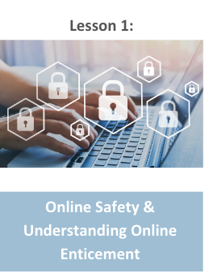
Lesson Outline
Lesson
  Introduction to Online Sexual Exploitation
  NCMEC “It’s Called Sextortion” Video (2 min.)
    Discussion Question
  Privacy Suggestions
  Take Action
  Fight Child Abuse “Friends Can Help Stop Sexual Abuse” Video (5 min.)
    Discussion Questions
  NCMEC Handout: Social Media Safety for Teens
  Activity
How to Protect Yourself & Your Friends

Slide 4
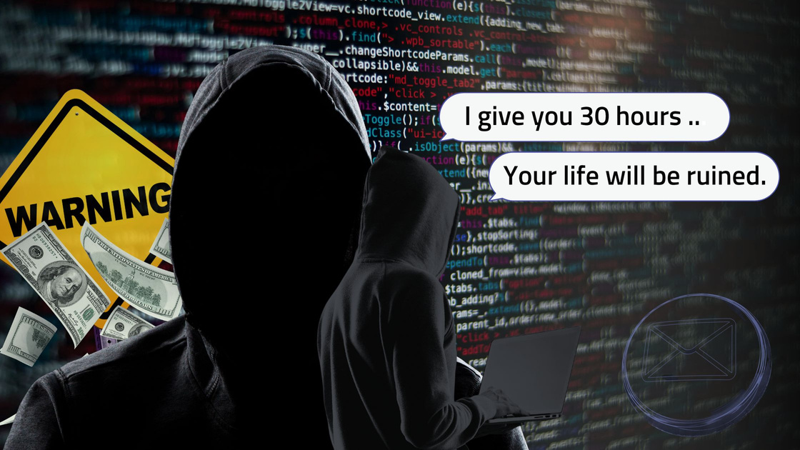
Online Sexual Exploitation
Online Enticement
  An individual communicates with a minor online with the intent to commit a sexual offense or abduction
Sextortion
  A form of child sexual exploitation
  A minor is threatened or blackmailed with their nude image with demands for additional images, sexual activity or money from them
Source: https://www.missingkids.org/netsmartz/topics/onlineenticement

Slide 5

Statistics on Online Enticement
In 2023, the CyberTipline received 186,819 reports of online enticement, the category that includes sextortion.
Between 2021 and 2023, the number of online enticement reports increased by 323%.
98% of reported offenders were seemingly unknown to the child offline.
In a NCMEC analysis, 78% of reported victims were girls, 13% were boys, and for 9% of reports, gender was unknown.
Source: https://www.missingkids.org/netsmartz/topics/onlineenticement

Slide 6
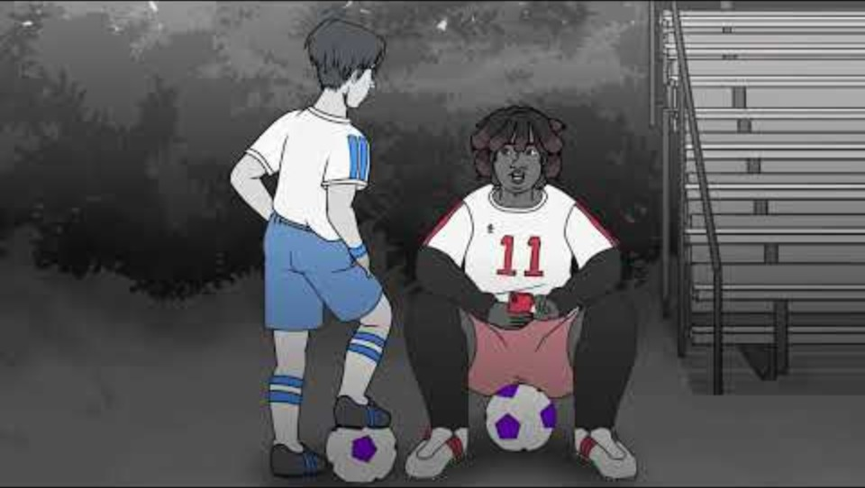
NCMEC “It’s Called Sextortion” Video
Duration: 1:41 minutes
Source: https://www.youtube.com/watch?v=9Q4pxdUimAU&t=1s

Slide 7
NCMEC “It’s Called Sextortion” Teacher Led Discussion Question
Nico is texting a girl that he met online. He thinks that she is a real person because he has other friends that are also friends with her on social media. Luckily, his friend speaks up and tells him that their teammate got sextorted recently by her.
What do you think Nico should do in this situation?

Slide 8

Privacy Suggestions
Have a different password for each account.
Use privacy settings.
Choose carefully who you add on social media.
Limit access to your location.
Look for the lock symbol or “https”.
Don’t share any personal information online.
Don’t share passwords.
Don’t share or forward explicit content.
Source: Kent Place & Connect for Freedom Workshop 2023

Slide 9

Take Action
Take screenshots of anything that looks or feels dangerous.
Block individuals who exhibit inappropriate or predatory behavior.
File a report with the police, offering as much information as possible about who is involved and in what ways.
Call a Cybertipline to report potential abuse or exploitation and receive additional recommendations for action steps.
Source: https://www.missingkids.org/netsmartz/home

Slide 10
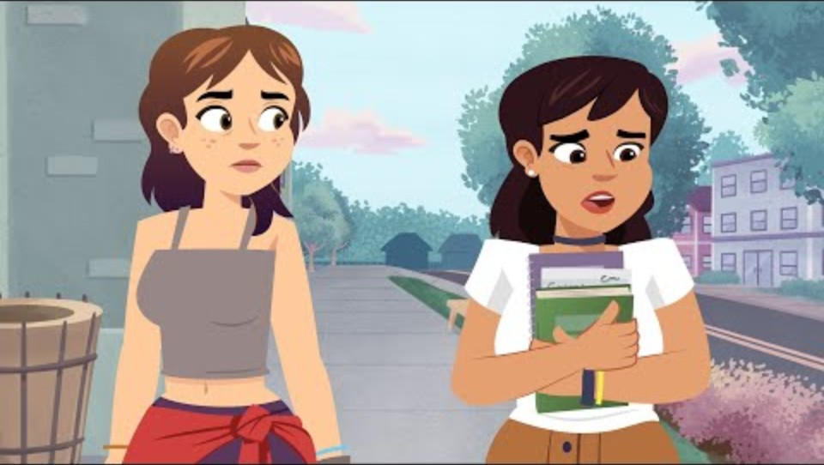
Fight Child Abuse “Friends Can Help Stop Sexual Abuse” Video
Duration: 4:45 minutes
Source: https://www.youtube.com/watch?v=c3L0iKqCaC0

Slide 11
Fight Child Abuse “Friends Can Help Stop Sexual Abuse” Discussion Questions
The class should get into 2 groups and the teacher will designate each group a number. Each group will work together and answer the questions with their group number. Then each group will take turns presenting the answers to the class.
Group 1 Questions
Group 2 Questions
What red flags did Maria notice in her relationship with Clay?
Do you think Emilia have done something sooner to help Maria? If so, what?
What should you do if you notice your friend is in a bad situation like Maria?
What would you do if you had a friend in a similar situation?

Slide 12

Activity

Slide 13
Activity
We recommend playing
Protecting Yourself Online Kahoot!

Slide 14


Slide 15

Lesson Handout from NCMEC

Slide 16
Links to Lesson Materials
NCMEC “It’s Called Sextortion” Video
Fight Child Abuse “Friends Can Help Stop Sexual Abuse” Video
NCMEC "Social Media Safety for Teens" Handout
Protecting Yourself Online Kahoot!

Slide 17
Recap of Lesson
Online enticement is when an individual communicates with a minor online with the intent to commit a sexual offense or abduction.
Sextortion is when a minor is threatened or blackmailed with their nude image with demands for additional images, sexual activity, or money from them.
Privacy Suggestions
Take Action
  Have a different password for each account.
  Use privacy settings.
  Choose carefully who you add on social media.
  Limit access to your location.
  Don’t share personal information online.
  Don’t share passwords.
  Don’t share or forward explicit content.
  Take screenshots.
  Block individuals.
  File a report with the police.
  Call a Cybertipline.

