Slide 1

Middle School Engagement- Grade 6
Healthy Relationships & How to Cultivate Them

Slide 2

PREVENTION THROUGH EDUCATION IS THE SOLUTION
Connect for Freedom is a 501(c)(3) nonprofit committed to providing free online safety and human trafficking awareness materials to education stakeholders.

Slide 3
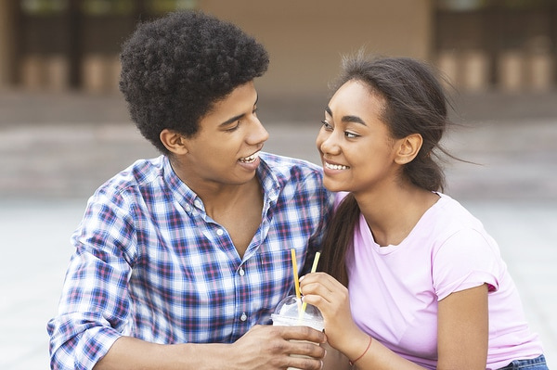
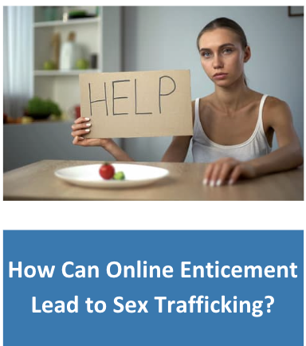
Lesson Outline
Lesson
Introduction to Teen Relationships
NCMEC “Healthy Relationships” Video (2 min.)
Discussion Questions
Take Time to Get to Know Each Other
DayOneNY “Don’t Confuse Love & Abuse” Video (2.5 min.)
Discussion Questions
Why Is It Hard to Leave?
The Dibble Institute Handout: Facts About Dating Violence
Activity
Healthy Relationships & How to Cultivate Them

Slide 4
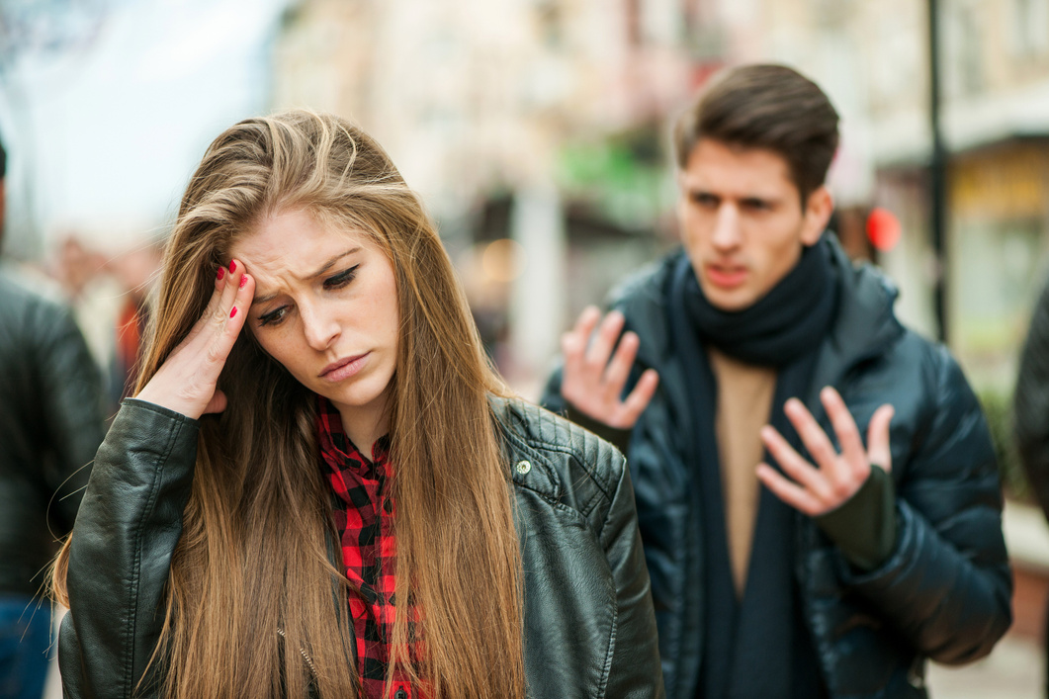
Teen Relationships
The Data
96% of teens report mental/emotional abuse in their dating relationships.
The Dibble Institute
1 in 11 students said they had been hit, slapped, or physically abused in the past year.
The Dibble Institute
28% of teens who have been in relationships are victims of digital dating abuse.
The Dibble Institute

Slide 5
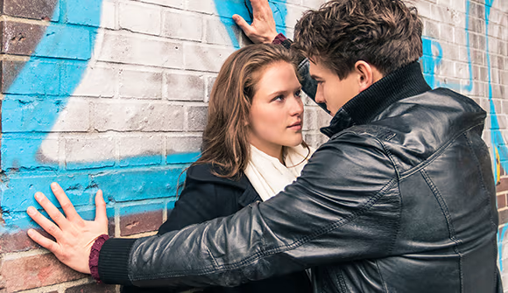
Signs of an Unhealthy Relationship Online & Offline
You feel scared, unsafe, or threatened.
You feel manipulated or guilted often by your partner.
You feel pressured to agree to do something you don’t want to do.
You feel disrespected during arguments with your partner.
You feel emotionally drained, insulted, or threatened during arguments.
You feel as though you are the only one to compromise.
Source: https://www.missingkids.org/education

Slide 6
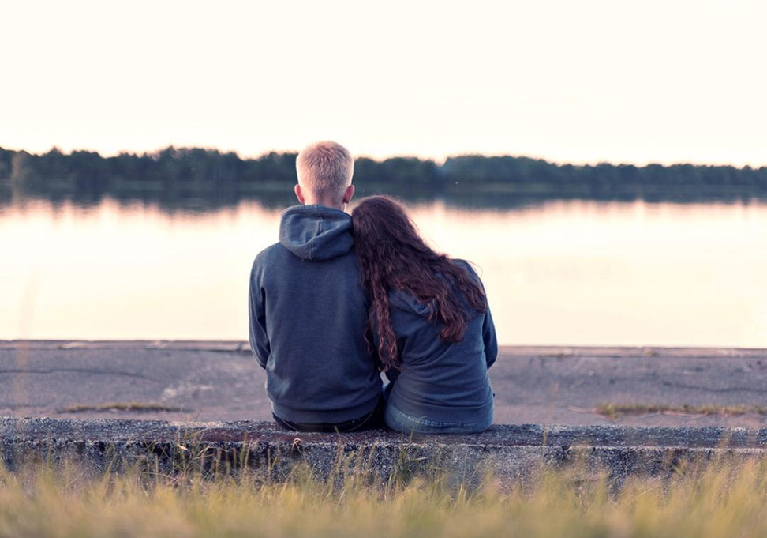
Signs of a Healthy Relationship Online & Offline
You feel safe, loved, and cared for.
You have open and honest communication with your significant other.
You feel comfortable discussing your feelings with them.
Even if you disagree with your significant other, you both remain respectful.
You feel like an equal to your significant other.
Source: https://www.missingkids.org/education

Slide 7
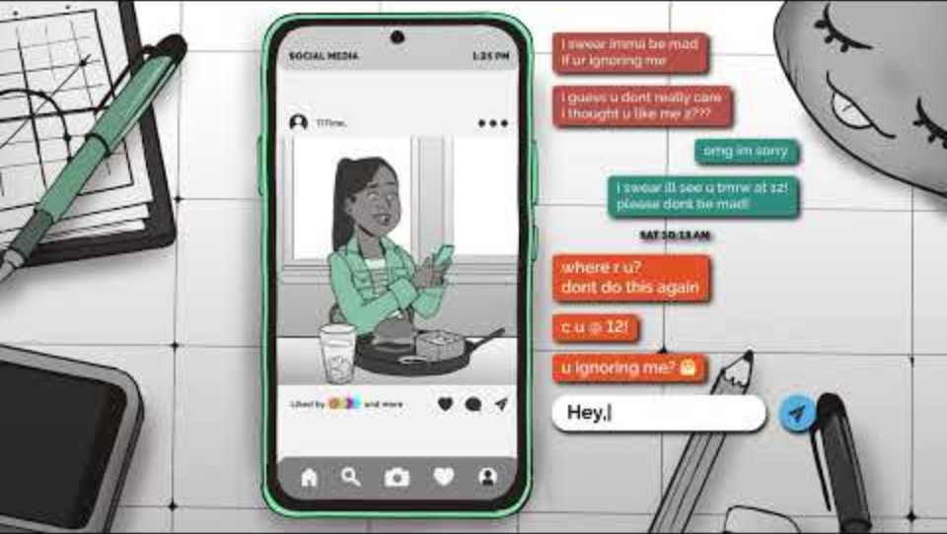
NCMEC “Healthy Relationships” Video
Duration: 1:56 minutes
Source: https://www.youtube.com/watch?v=ldjZCvqhNWw&t=64s

Slide 8
NCMEC “Healthy Relationships” Discussion Guide
Click here to access NCMEC “Healthy Relationships” Discussion Guide and questions.

Slide 9
Taking Time to Get to Know Someone is Healthy
Learn about who they really are. It takes time to learn someone’s interests, hobbies, likes, dislikes, etc.
Build trust. Trust is essential to having a healthy relationship. See how the person reacts to different situations, how they deal with emotions, how they communicate and problem solve.
Explore your feelings. Sometimes we can have strong initial chemistry or attraction but that doesn’t mean you are compatible with someone.
Source: https://www.missingkids.org/education

Slide 10
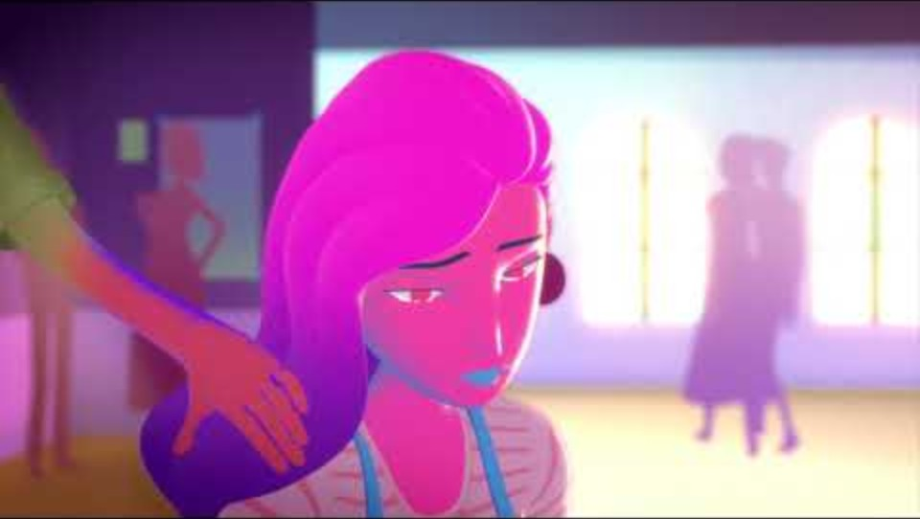
DayOneNY “Don’t Confuse Love & Abuse” Video
Duration: 2:45 minutes
Source: https://www.youtube.com/watch?v=1L6HB97lbrQ

Slide 11
“Don’t Confuse Love & Abuse” Discussion Questions
The class should get into 2 groups and the teacher will designate each group a number. Each group will answer the questions correlated with their group number and then present the answers to the class.
Group 1 Questions
Group 2 Questions
What do you think the girl should do to get out of the abusive relationship? Who can she contact?
Have you seen relationships like this before at your school?
What do you think was the biggest red flag in the boys behavior and why?
How would you have handled the situation?

Slide 12
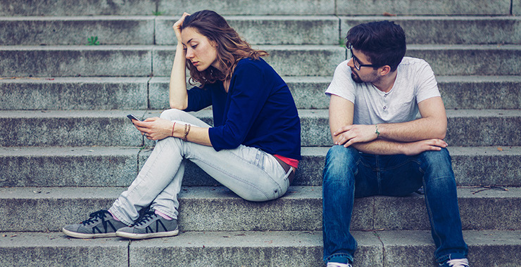
Why Is It Hard to Leave an Unhealthy Relationship?
Fear of being alone.
Fear of changing their mind after the break-up.
Feeling like they can’t end it.
Feeling pulled back in.
Feeling responsible for the other person’s safety.
The other person threatens or blackmails you.
Feeling like the other person does not let you end things.
Source: https://www.missingkids.org/education

Slide 13
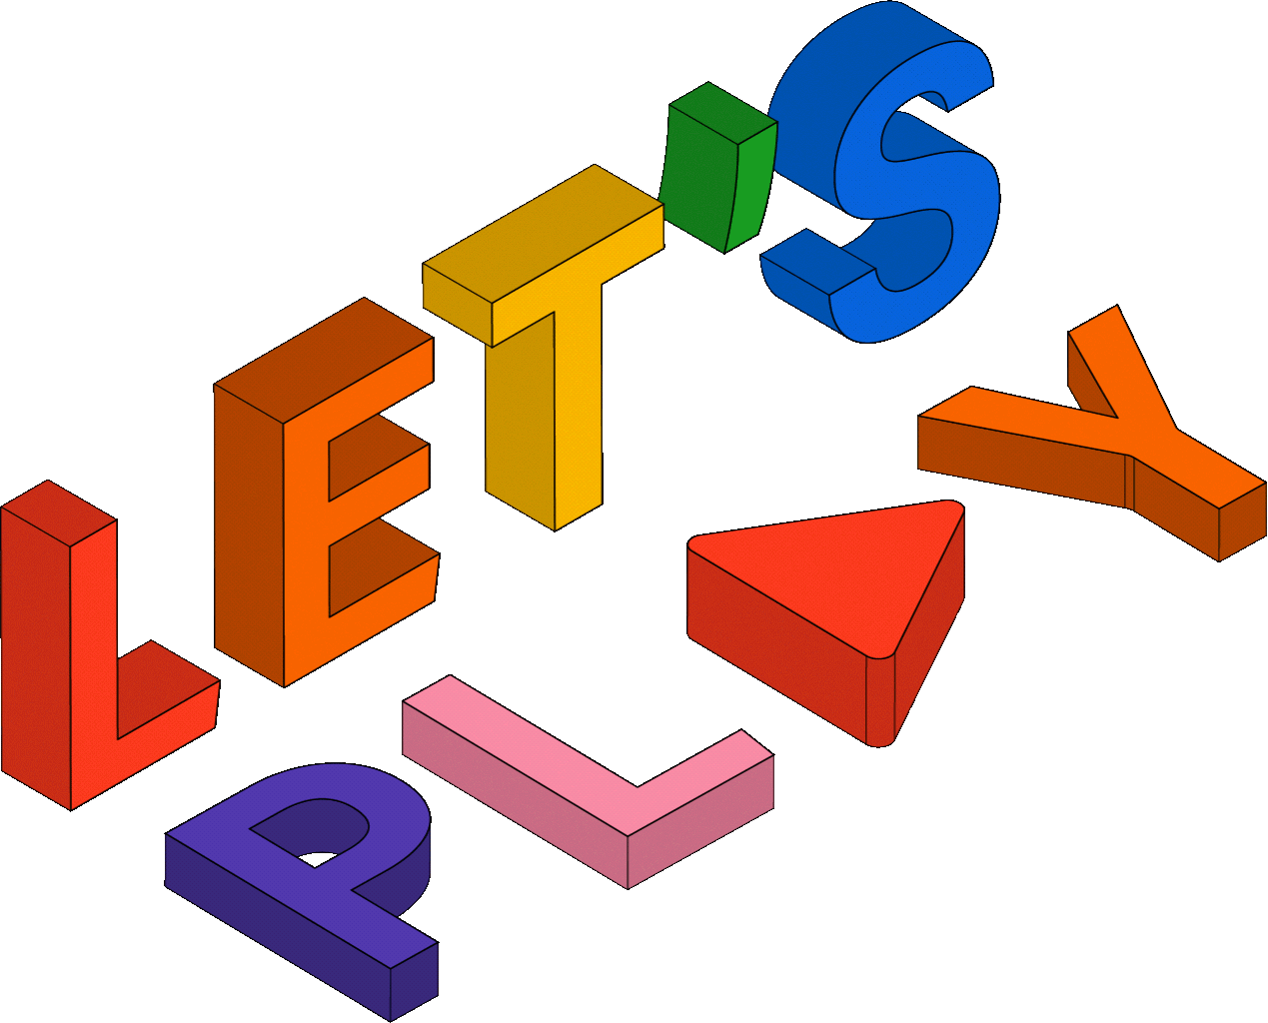
Activity

Slide 14
Activity
We recommend playing
Relationship Red Flags BINGO.

Slide 15


Slide 16
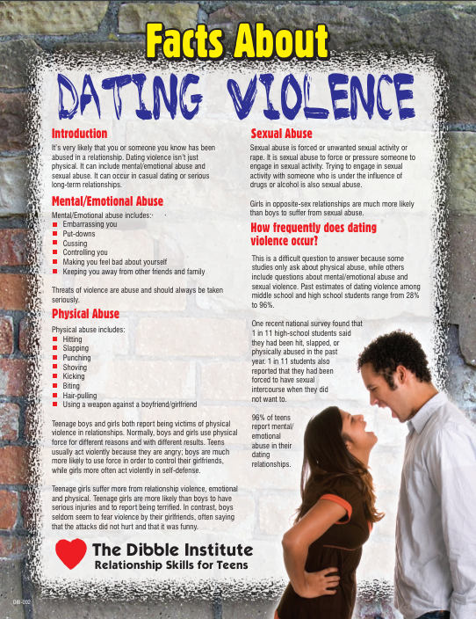
Lesson Handout from The Dibble Institute

Slide 17
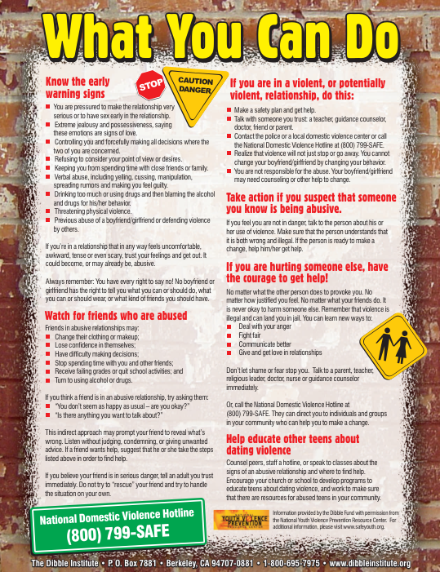
Lesson Handout from The Dibble Institute

Slide 18
Links to Lesson Materials
NCMEC “Healthy Relationships” Video
NCMEC “Healthy Relationships” Discussion Guide
DayOneNY “Don’t Confuse Love and Abuse” Video
The Dibble Institute “Dating Violence” Handout
Relationship Red Flags BINGO

Slide 19
Recap of Lesson
Signs of an unhealthy relationship:
Feeling scared, unsafe, or threatened
Feeling manipulated or guilted often
Feeling as though you are the only one who compromises
Feeling disrespected during arguments
Feeling emotionally drained, insulted or threatened during arguments
Feeling pressured to do something
Taking time to get to know someone is healthy because:
Learn about who they really are
Build trust
Explore your feelings
It can be hard to leave an unhealthy relationship due to:
Fear of being alone
Fear of changing their mind
Feeling like they can’t end it
Feeling pulled back in
Feeling responsible for the other person’s safety
Being threatened or blackmailed
The other person not letting you end things

