Slide 1

Middle School Engagement- Grade 8
Labor Trafficking & the Legal System

Slide 2

PREVENTION THROUGH EDUCATION IS THE SOLUTION
Connect for Freedom is a 501(c)(3) nonprofit committed to providing free online safety and human trafficking awareness materials to education stakeholders.

Slide 3

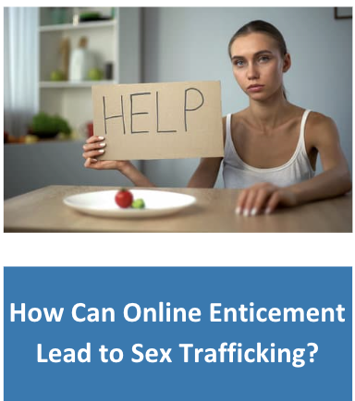
Lesson Outline
Lesson
Introduction to Labor Trafficking
Definition
Statistics
Risk Factors
Recruitment
Office for Victims of Crime “Sergio’s Story” Videos (7 min.)
Discussion Questions
Child Labor Laws
U.S. Department of Labor Handout: Child Labor & Forced Labor
Activity
Labor Trafficking &
The Legal System

Slide 4
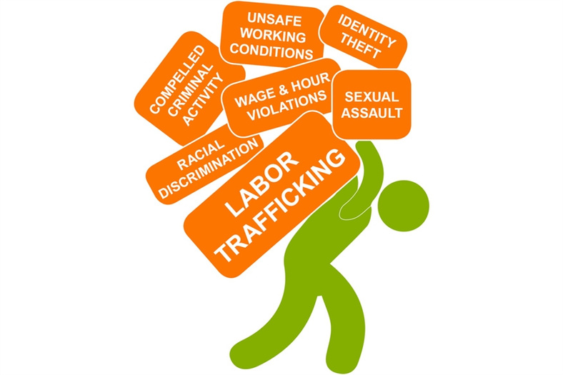
Labor Trafficking
Labor trafficking is the crime of using force, fraud, or coercion to induce another individual to work or provide service. Common types include agriculture, domestic work, restaurants, cleaning services, and carnivals.
Methods of control and abuse in labor trafficking situations:
Economic abuse
Threats
Denying needs or wants
Destruction of important documents
Excessive working hours
Emotional abuse
Fraud/misrepresentation of job
Isolation
Physical abuse
Source: https://polarisproject.org/wp-content/uploads/2020/07/Polaris-Analysis-of-2021-Data-from-the-National-Human-Trafficking-Hotline.pdf

Slide 5
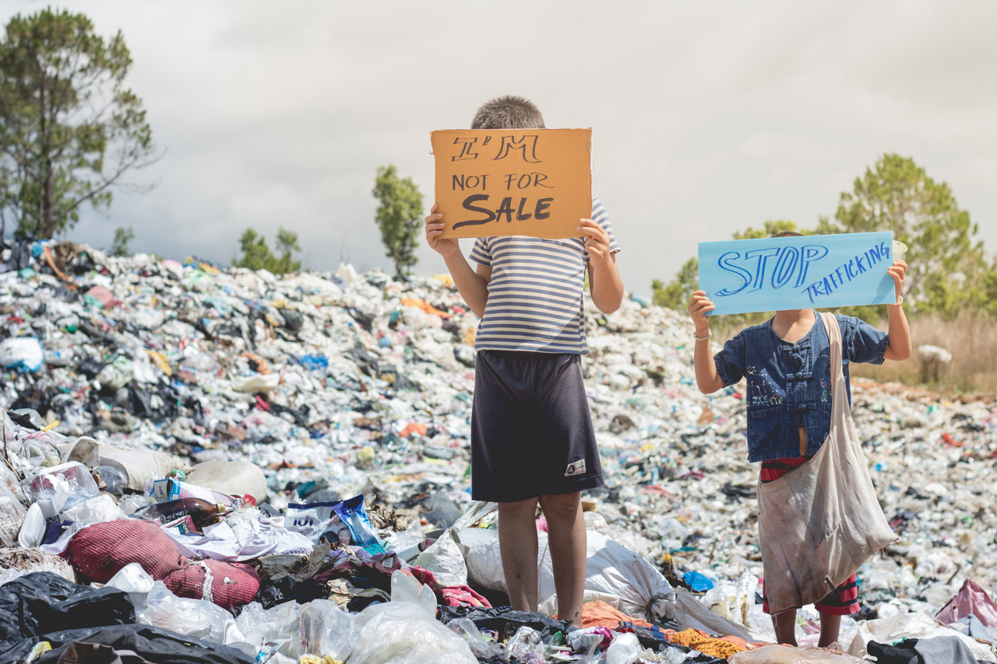
Child Labor Trafficking Statistics
The Data
In 2021, 310 minors were labor trafficked.
Polaris Project
There was a 30% increase of labor trafficking incidents involving minors from 2020 to 2021.
Polaris Project
54% of labor trafficking incidents began through online recruitment.
Polaris Project
Source: https://polarisproject.org/wp-content/uploads/2020/07/Polaris-Analysis-of-2021-Data-from-the-National-Human-Trafficking-Hotline.pdf

Slide 6
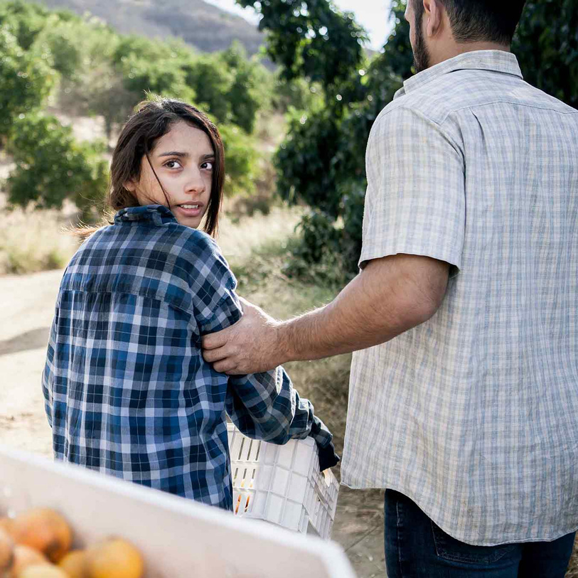
Risk Factors of Being Labor Trafficked
Recent migration/relocation
Unaccompanied refugee minor
Unstable housing
Mental or physical health concern
Economic hardship
Experienced abuse or violence
Intellectual or developmental disability
Criminal record/history
Recent financial debt
Runaway/homeless youth
Substance use concern
Source: https://polarisproject.org/wp-content/uploads/2020/07/Polaris-Analysis-of-2021-Data-from-the-National-Human-Trafficking-Hotline.pdf

Slide 7



Recruitment Location & Methods
Recruitment location:
Online (Facebook & dating websites/apps)
Institutional shelter
School
Detention Facility
Recruitment methods:
Job offer/advertisement
False promises/fraud
Smuggling-related
Great
Job!
Source: https://polarisproject.org/wp-content/uploads/2020/07/Polaris-Analysis-of-2021-Data-from-the-National-Human-Trafficking-Hotline.pdf

Slide 8
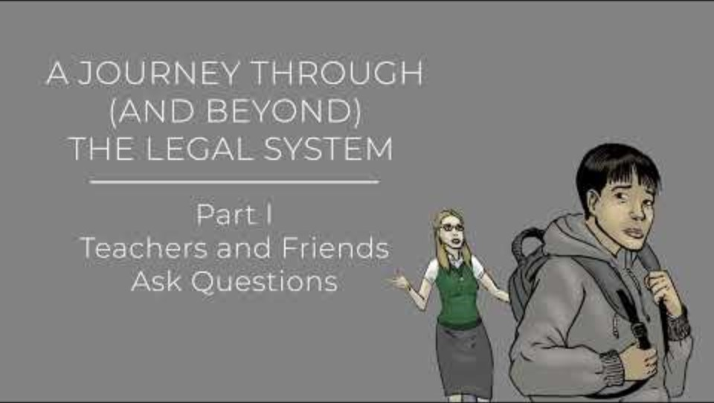
Office for Victims of Crime “Sergio’s Story Part 1” Video
Duration: 1:19 minutes
Source: https://www.youtube.com/watch?v=3jKG_cbBA3Q

Slide 9
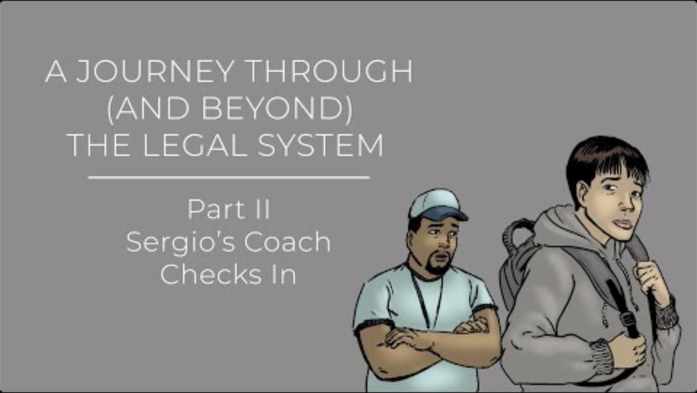
Office for Victims of Crime “Sergio’s Story Part 2” Video
Duration: 1:42 minutes
Source: https://www.youtube.com/watch?v=4umJqEip1Gw

Slide 10
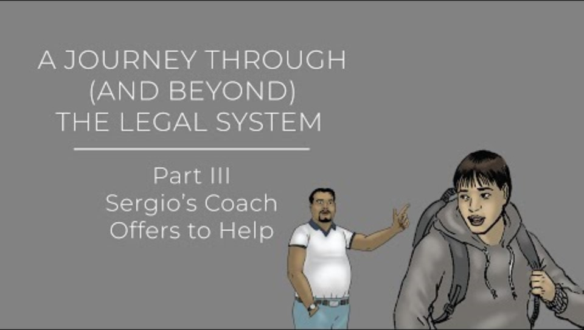
Office for Victims of Crime “Sergio’s Story Part 3” Video
Duration: 2:30 minutes
Source: https://www.youtube.com/watch?v=3m1BXGBPwMg&t=2s

Slide 11
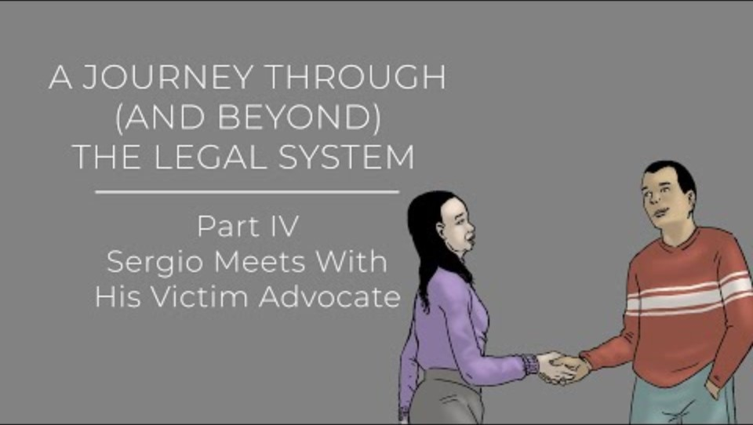
Office for Victims of Crime “Sergio’s Story Part 4” Video
Duration: 1:25 minutes
Source: https://www.youtube.com/watch?v=GrTJNLSmNIw

Slide 12
Office for Victims of Crime “Sergio’s Story” Discussion Questions
The class should get into 2 groups and the teacher will designate each group a number. Each group will answer the questions correlated with their group number and then present the answers to the class.
Group 1 Questions
Group 2 Questions
What do you think was the biggest red flag that Sergio was being labor trafficked?
Do you think this happens or could happen in your neighborhood? Why or why not?
How do you think Sergio was feeling during this process? Give examples of why.
What would you do if you or a friend was in a similar situation?

Slide 13

Child Labor Laws
There are special labor laws for anyone under the age of 18 in the United States.
Child labor laws are designed to protect the educational opportunities of youth, as well as prohibit employment in jobs that could detrimentally impact their health and safety.
There are restrictions on the number of hours you can work, the amount of money you should be paid, and your right to stop working whenever you want.
Source: https://www.dol.gov/general/topic/hiring/workersunder18

Slide 14
Check Your State’s Child Labor Laws
Visit the U.S. Department of Labor’s website below and check your State’s various restrictions for each age group.
https://www.dol.gov/agencies/whd/state/child-labor

Slide 15

Activity

Slide 16
Activity
We recommend playing
Connect for Freedom Labor Trafficking Word Search.

Slide 17


Slide 18
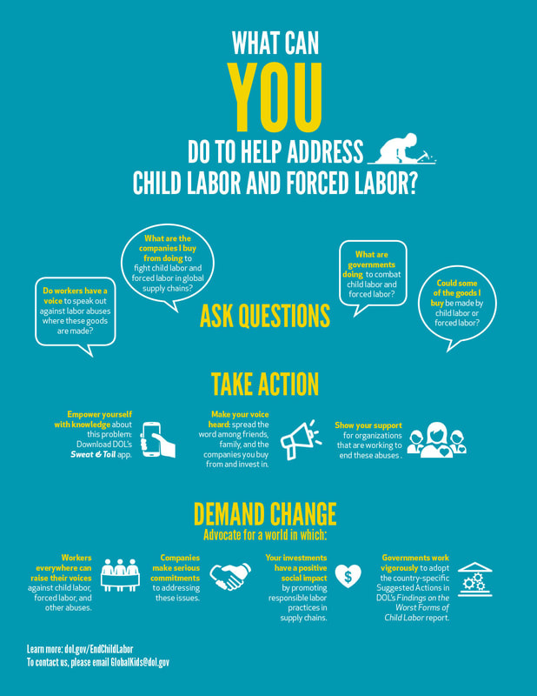
Lesson Handout from U.S. Department of Labor

Slide 19
Links to Lesson Materials
Office for Victims of Crime “Sergio’s Story Part 1” Video
Office for Victims of Crime “Sergio’s Story Part 2” Video
Office for Victims of Crime “Sergio’s Story Part 3” Video
Office for Victims of Crime “Sergio’s Story Part 4” Video
U.S. Department of Labor “Child Labor & Forced Labor” Handout
Connect for Freedom Labor Trafficking Word Search

Slide 20
Recap of Lesson
Labor trafficking is the crime of using force, fraud, or coercion to induce another individual to work or provide service. Common types include agriculture, domestic work, restaurants, cleaning services, and carnivals.
Methods of control and abuse in labor trafficking situations:
Economic abuse
Threats
Denying needs or wants
Destruction of important documents
Excessive working hours
Emotional abuse
Fraud/misrepresentation of job
Isolation
Physical abuse
Recruitment location:
Online (Facebook & dating websites/apps)
Institutional shelter
School
Detention Facility
Recruitment methods:
Job offer/advertisement
False promises/fraud
Smuggling-related

