Slide 1

Middle School Engagement- Grade 8
Dangers of the Internet & Online Predators

Slide 2

PREVENTION THROUGH EDUCATION IS THE SOLUTION
Connect for Freedom is a 501(c)(3) nonprofit committed to providing free online safety and human trafficking awareness materials to education stakeholders.

Slide 3

Lesson Outline
Lesson
  Introduction to Online Dangers
  Common Sense Education “Teen Voices: Who You’re Talking to Online” Video (3.5 min.)
    Discussion Questions
  NetSmartz “Real-Life Stories- 6 Degrees of Information” Video (7.5 min.)
    Discussion Questions
  Online Safety Recommendations
  Take the Pledge2Protect
  NCMEC Handout: So, You Need Some Help...
  Activity
Dangers of the Internet & Online Predators

Slide 4

Teens & Internet Statistics
The Data
95% of teens have access to a smartphone.
Pew Research Center
One in six teens say they have been contacted online by someone they did not know in a way that made them feel scared or uncomfortable.
Pew Research Center
Online enticement child victims range from ages 1 to 17, with a mean age of 15.
National Center for Missing & Exploited Children

Slide 5

Pros & Cons of the Internet
Pros:
Cons:
  Connects us with family and friends
  Easy access to news and information
  Introduces us to others with similar interests
  Cyber-bullying occurs here
  Lack of in-person contact
  Unrealistic views of other’s lives
Source: https://www.missingkids.org/netsmartz/topics/socialmedia

Slide 6

Online Exploitation
Online enticement involves an individual communicating with a minor via the internet with the intent to commit a sexual offense or abduction.
Sextortion is a form of child sexual exploitation where minors are threatened or blackmailed, most often with the possibility of sharing with the public a nude or sexual image of themselves, by a person who demands additional sexual content, sexual activity or money from them.
Source: https://www.missingkids.org/netsmartz/topics/onlineenticement

Slide 7


Online Enticement Grooming Tactics
Grooming is the process in which an offender sexually abuses a minor. This is often the first step in fostering a relationship with a minor and building trust.
Online enticement often begins with grooming because the offender is a stranger, and they will try to make the minor feel good and safe.
Common grooming tactics include:
  Texting you compliments
  Talking about personal and intimate topics (i.e. sex)
  Sending you gifts
  Asking you to keep your relationship a secret
  Talking negatively about others in your life
  Asking you for sexual images of yourself
Source: https://www.allianceforchildren.org/blog/2018/06/what-grooming

Slide 8

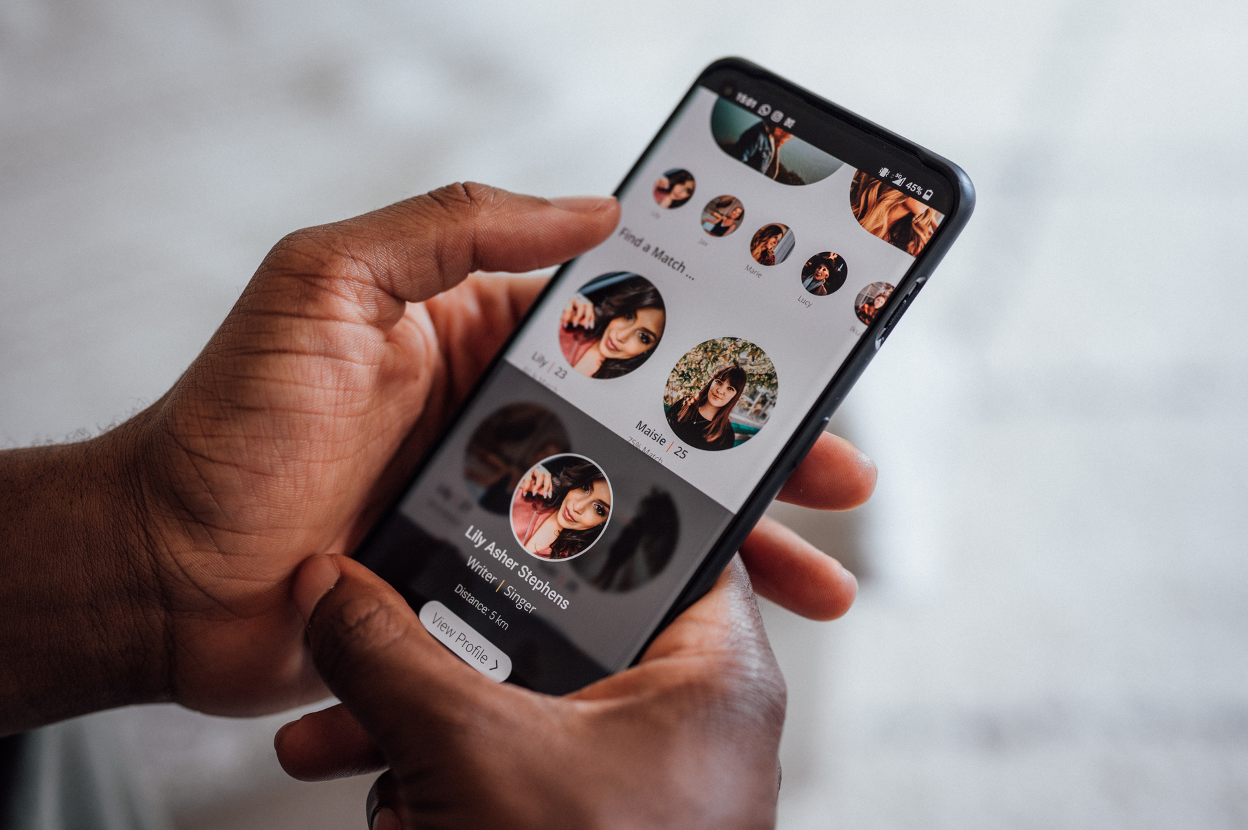
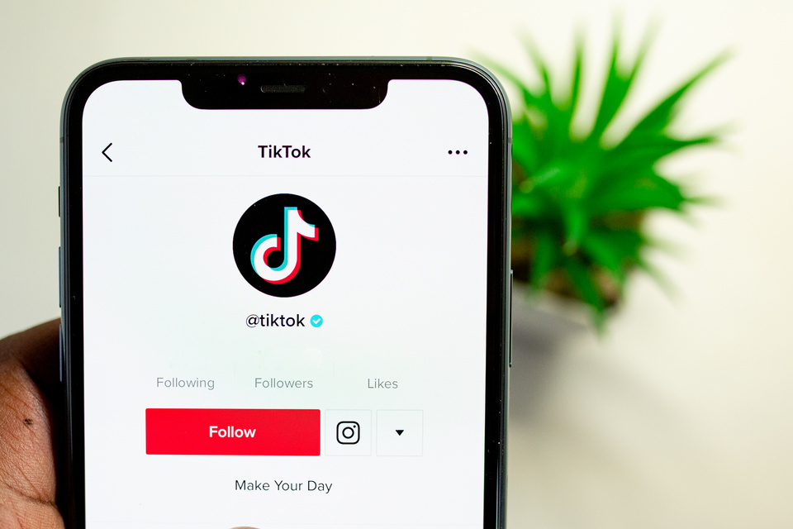
Where are Online Predators Reaching Victims?
Social media platforms
Game apps
Anonymous chat apps
Dating apps
Source: https://www.missingkids.org/theissues/onlineenticement

Slide 9
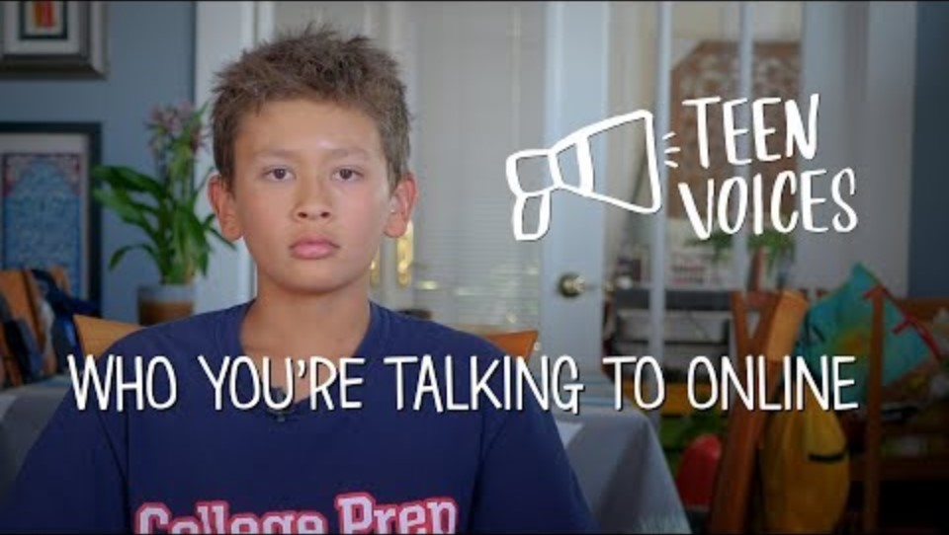
Common Sense Education “Teen Voices: Who You’re Talking to Online” Video
Duration: 3:42 minutes
Source: https://www.youtube.com/watch?v=DiI8Lj0_TGQ

Slide 10
Common Sense Education “Teen Voices: Who You’re Talking to Online” Teacher Led Discussion Questions
Do you think a lot of people your age accept friend requests from people they haven’t met in real life?
Have you ever accepted a friend request from someone you didn’t know?
Have you ever felt uncomfortable talking to someone online that you didn’t know?

Slide 11

Sharing Personal Information Online
If you post personal information online, you are also putting your safety at risk.
If you post where you are, what school you go to, the town you live in, your full name, or your birthday, you are giving online criminals personal identifying information about you. This can give them the means to find you and potentially hurt you. It is important to be careful and mindful of what we post online.

Slide 12

NetSmartz “Real-Life Stories- 6 Degrees of Information” Video
Duration: 7:26 minutes
Source: https://www.youtube.com/watch?v=-FnH78p8QkA

Slide 13
NetSmartz “Real-Life Stories- 6 Degrees of Information” Teacher Led Discussion Questions
Matt said in the beginning, “The entire experiment rests on the idea that people post a lot of information online without really thinking about what that means.”
Do you think twice before you post something online?
Do you know people who post too much of their personal information online? What do you think about that?
Do you think oversharing can be dangerous? Why?

Slide 14

Online Safety Recommendations
Only add people you know offline to your social media accounts. Never accept a friend request from someone that you personally do not know, even if you have mutual friend(s) with them.
Use privacy settings to keep yourself safe. Make sure that strangers online (and criminals) do not see what you post online by making your profiles private.
Source: https://www.missingkids.org/netsmartz/topics/socialmedia

Slide 15

Online Safety Recommendations
Remove any personal or inappropriate images from social media. Your online reputation counts offline too.
Report any criminal behavior to the police and report inappropriate posts to whatever website or app you are on. If something is illegal or inappropriate to do offline, it is not acceptable online either.
Source: https://www.missingkids.org/netsmartz/topics/socialmedia

Slide 16
Take the Pledge2Protect
  I pledge to not create or share real or AI-generated sexually explicit images of myself or my peers. Next up- review the How2Spot Peer-on-Peer Risks: A Guide for Teens.
  I pledge to review the Exit Strategy Checklist, create my own exit strategy and talk about this with my friends so we are prepared if something goes sideways online or doesn’t feel right.
  I pledge to bookmark the How2Report page and review the You’re Never Alone Support Directory resource in case online exploitation happens to me or a friend.
  I pledge to set all my apps, games, social media accounts and devices to private and to turn off location data services on social media and all apps, except the ones my family and I need.
  I pledge to know who is on my friends and followers lists, remove strangers and only accept people I know in real life and block or remove anyone who makes me feel uncomfortable.
Source: https://www.dhs.gov/know2protect/p2p/teens

Slide 17

Take the Pledge2Protect
For more information, please scan the QR code below.
Source: https://www.dhs.gov/know2protect/p2p/teens

Slide 18

Activity

Slide 19
Activity
We recommend playing the National Center for Missing and Exploited Children’s No Escape Room Interactive Sextortion Video.

Slide 20


Slide 21
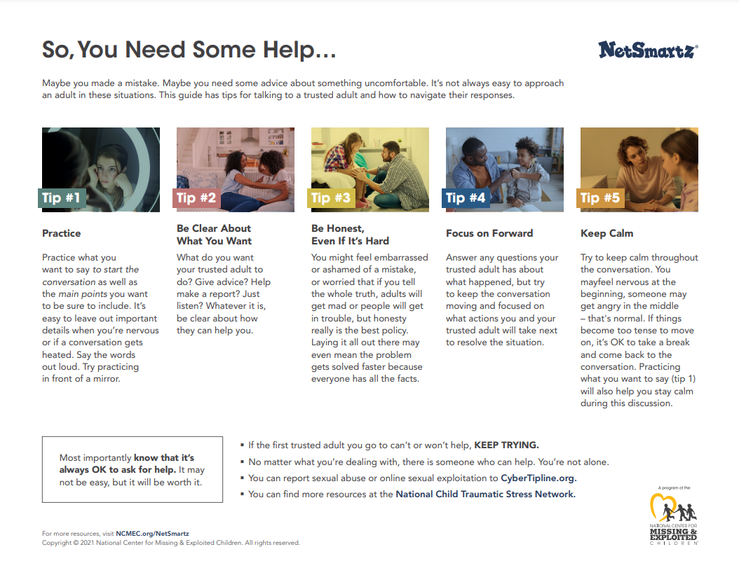
Lesson Handout from NCMEC

Slide 22
Links to Lesson Materials
Common Sense Education “Teen Voices: Who You’re Talking to Online” Video
NetSmartz “Real-Life Stories- 6 Degrees of Information” Video
know2protect Pledge2Protect for Teens
know2protect How2Spot Peer-on-Peer Risks: A Guide for Teens
know2protect Exit Strategy Checklist
know2protect How2Report
know2protect You’re Never Alone Support Directory
NCMEC Lesson Plan Handout
NCMEC Escape Room Interactive Video

Slide 23
Recap of Lesson
Online enticement involves an individual communicating with a minor via the internet with the intent to commit a sexual offense or abduction.
Sextortion is a form of child sexual exploitation where minors are threatened or blackmailed, most often with the possibility of sharing with the public a nude or sexual image of themselves, by a person who demands additional sexual content, sexual activity or money from them.
Grooming is the process in which an offender sexually abuses a minor. This is often the first step in fostering a relationship with a minor and building trust.
Where are online predators reaching victims:
Social media platforms
Game apps
Anonymous chat apps
Dating apps

