Slide 1

Middle School Engagement- Grade 6
Online Safety & Understanding Online Enticement

Slide 2

PREVENTION THROUGH EDUCATION IS THE SOLUTION
Connect for Freedom is a 501(c)(3) nonprofit committed to providing free online safety and human trafficking awareness materials to education stakeholders.

Slide 3
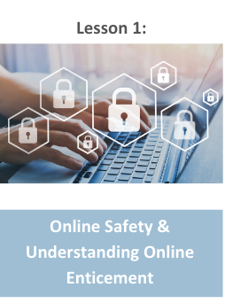
Lesson Outline
Lesson
  Introduction to Online Safety
  NetSmartz “Your Photo Fate” Video (2 min.)
    Discussion Guide
  Online Enticement
    Online Enticement vs. Bullying
    Statistics
    Grooming Tactics
  NetSmartz “Survivor Diaries” Video (3 min.)
    Discussion Question
  Take the Pledge2Protect
  NCMEC Handout: Think Before You Send
  Activity

Slide 4
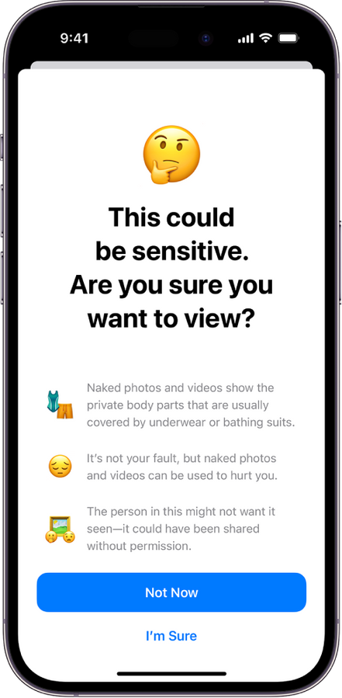





Online Safety
You should always be careful of what you post online. You should never post:
Images of alcohol/drugs
Sexual content
Profanity
Harmful/abusive words
Threats to someone’s safety
Racist, sexist, and prejudiced language
Show me

Slide 5

Online Safety
When you are using the Internet, you should ask yourself...
  Am I posting sensitive information?
  Should I share this?
  What are my privacy settings on my account?
  Should I click this link?
  Is this website legitimate?
  Are my passwords safe?
  Am I on public WiFi?

Slide 6
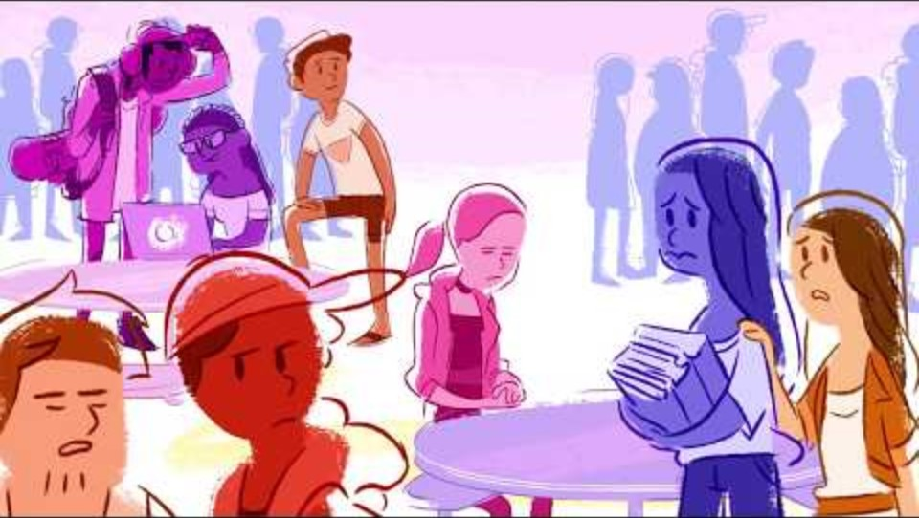
NetSmartz “Your Photo Fate” Video
Duration: 2:00 minutes
Source: https://www.youtube.com/watch?v=d5b1XZAkTIk

Slide 7
NetSmartz “Your Photo Fate” Discussion Guide
Click here to access NetSmartz “Your Photo Fate” Discussion Guide and questions.

Slide 8

Every Action Has a Reaction
Every action that we make in life has a reaction. The same goes for what we post online. What you post online gives people an idea of who you are, what you believe in, what you like, what you dislike, etc. It gives people an idea of who you are, which is why it’s important to be safe when posting online.
If you post content that isn’t appropriate, such as sexual images or verbally abusive words, people will have an opinion of you that may not be favorable.

Slide 9

Online Enticement
Online enticement involves an individual communicating with a minor on the internet with the intent to commit a sexual offense or abduction.
Source: https://www.missingkids.org/netsmartz/topics/onlineenticement

Slide 10

Online Enticement
In 2023, the CyberTipline received 186,819 reports of online enticement, the category that includes sextortion.
Between 2021 and 2023, the number of online enticement reports increased by more than 300%.
98% of reported offenders were seemingly unknown to the teen offline.
In a NCMEC analysis, 78% of reported victims were girls, 13% were boys, and for 9% of reports, gender was unknown.
Source: https://www.missingkids.org/netsmartz/topics/onlineenticement

Slide 11

Online Enticement Tactics
  Engaging in sexual conversation/role-playing
  Asking for explicit images
  Sharing explicit images
  Giving compliments
  Pretending to be younger
  Offering gifts
Source: https://www.missingkids.org/netsmartz/topics/onlineenticement

Slide 12
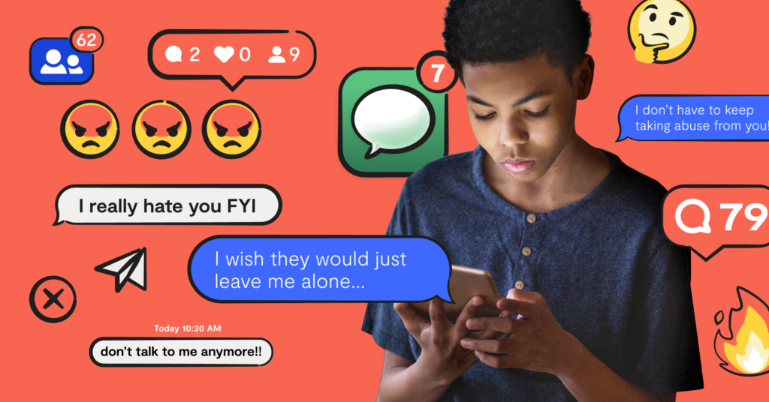
Why is Online Enticement Different than Cyberbullying?
Cyberbullying is any type of bullying that takes place online (social media platforms, texting, gaming apps, etc.) Cyberbullying includes sending, posting, or sharing negative, harmful, false, or mean content about someone else. It can also include sharing personal or private information about someone else causing embarrassment or humiliation.
It is important to note that online enticement is different from cyberbullying because it involves the intent to commit a sexual offense or abduction.
Source: https://www.missingkids.org/netsmartz/topics/onlineenticement

Slide 13


Online Enticement Grooming Tactics
Grooming is the process in which an offender sexually abuses a minor. This is often the first step in fostering a relationship with them and building trust.
Online enticement often begins with grooming because the offender is a stranger, and they will try to make a teen feel good and safe.
Common grooming tactics include:
  Texting you compliments
  Talking about personal and intimate topics (i.e. sex)
  Sending you gifts
  Asking you to keep your relationship a secret
  Talking negatively about others in your life
  Asking you for sexual images of yourself
Source: https://www.allianceforchildren.org/blog/2018/06/what-grooming

Slide 14

NetSmartz “Survivor Diaries” Video
Duration: 2:45 minutes
Source: https://www.youtube.com/watch?v=3sKSh4H2brY

Slide 15
NetSmartz “Survivor Diaries” Teacher Led Discussion Question
Ryan says, “I knew better than to meet in person with someone I’d met on the Internet,” but he continues the relationship online and gives out information about where he lives.
How does the adult get him to do that?

Slide 16
Take the Pledge2Protect
  I pledge to identify a trusted adult that I can go to if something happens online that makes me feel uncomfortable or unsafe and to review the Exit Strategy Checklist resource with them.
  I pledge to review the K2P Kids & Teens page with a parent or trusted adult and pick my favorite iGuardian character.
  I pledge to work with a parent or trusted adult to set all my apps, games, social media accounts and devices to private and to turn off location data services on social media and all apps, except the ones my family and I need.
  I pledge to review my friend lists with a parent or trusted adult, remove strangers and only accept friends I know in real life.
  I pledge to not create or share harmful content of myself or my peers online and to review the How2Spot Peer-on-Peer Risks: A Guide for Tweens resource with a parent or trusted adult.
Source: https://www.dhs.gov/know2protect/p2p/kids

Slide 17

Take the Pledge2Protect
For more information, please scan the QR code below.
Source: https://www.dhs.gov/know2protect/p2p/kids

Slide 18

Activity

Slide 19
Activity
We recommend playing
Connect for Freedom Online Safety Jeopardy.

Slide 20


Slide 21

Lesson Handout from NetSmartz

Slide 22
Links to Lesson Materials
NetSmartz "Your Photo Fate" Video
NetSmartz “Your Photo Fate” Discussion Guide
NetSmartz “Survivor Diaries” Video
know2protect Pledge2Protect for Kids
know2protect Exit Strategy Checklist
know2protect K2P Kids & Teens
know2protect How2Spot Peer-on-Peer Risks
NetSmartz “Think Before You Send” Handout
Connect for Freedom Online Safety Jeopardy

Slide 23
Recap of Lesson
Type of content to never post online:
  Images of alcohol/drugs
  Sexual content
  Profanity
  Harmful/abusive words
  Threats to someone’s safety
  Racist, sexist, and prejudiced language
Online enticement: communicating with someone believed to be a minor via the internet with the intent to commit a sexual offense or abduction.
Online enticement is different from cyberbullying because
it involves the intent to commit a sexual offense or abduction.
Someone trying to groom you online might:
  Text you compliments
  Talk about personal/intimate topics
  Send you gifts
  Ask you to keep your relationship secret
  Talk negatively about others in your life
  Ask you for sexual images of yourself

