Slide 1

High School Engagement- Grade 12
Healthy Relationships & Lifestyle Choices

Slide 2

PREVENTION THROUGH EDUCATION IS THE SOLUTION
Connect for Freedom is a 501(c)(3) nonprofit committed to providing free online safety and human trafficking awareness materials to education stakeholders.

Slide 3

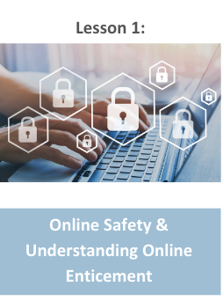
Lesson Outline
Lesson
Introduction to Healthy Relationships
Tedx Talks “The Surprising Key to Building a Healthy Relationship That Lasts” Video (8.5 min.)
Discussion Question
Setting Boundaries
Consent
Teaching Sexual Health Alberta Health Services “Understanding Consent” Video (3 min.)
Discussion Question
Fight Child Abuse “Don’t Let Pressure End Up as Sexual Abuse” Video (4.5 min.)
Discussion Questions
Real Life Story- Sandra
Therapist Aid LLC Handout: Attachment Styles
Activity
Healthy Relationships & Lifestyle Choices

Slide 4

Importance of Healthy Relationships
Healthy romantic relationships are important to happiness and overall wellbeing.
96% of teens report mental/emotional abuse in their dating relationships.
The Dibble Institute
Negative interactions and relationships with partners can lead to increased risk of anxiety, depression, and suicidal thoughts.
Mental Health Foundation
Relationship issues are a major factor of teen suicides, which is the second leading cause of teenage death.
The Dibble Institute

Slide 5

Characteristics of an Unhealthy Relationship
Physical aggression or abuse
Emotional manipulation
Name calling
Controlling
Cruel and mean communication
Shaming and/or blaming their partner
Extreme possessiveness and jealousy
Pressure for sexual activity
Threats and/or abuse

Slide 6
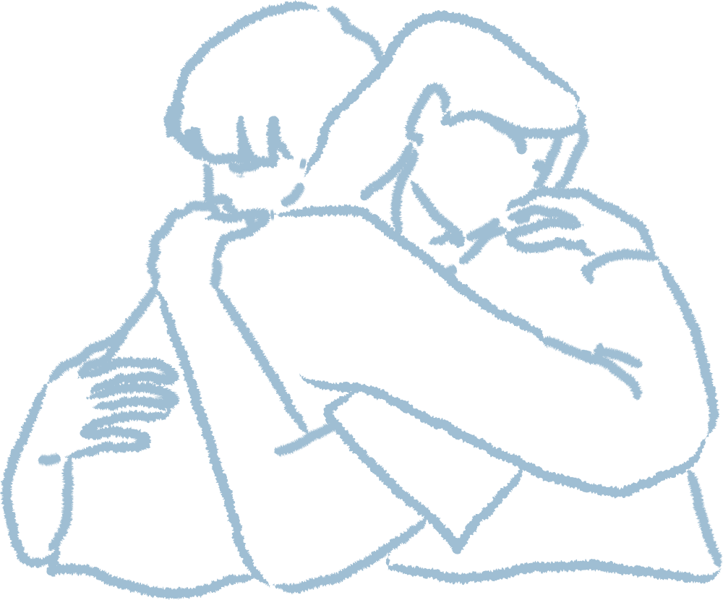

Characteristics of a Healthy Relationship
Respect one another
Honest communication
Open to positive change
Supportive during difficult times
Kind and caring
Want the best for one another
Respect one another’s boundaries
Loyalty and trust
Feel safe and secure

Slide 7

How to Maintain a Healthy Relationship
Manage your own anger.
Make decisions together.
Communicate honestly with one another.
Be generous without expectations.

Slide 8

TEDx Talks “The Surprising Key to Building a Healthy Relationship that Lasts” Video
Duration: 8:31 minutes
Source: https://www.youtube.com/watch?v=Xvb-v83qJ8U

Slide 9
TEDx Talks “The Surprising Key to Building a Healthy Relationship that Lasts” Teacher Led Discussion Question
Think about what a healthy relationship looks like to you. Think about those in your life who you see in healthy relationships.
What do you think are some important factors to having a healthy relationship that were not mentioned in the Tedx Talk?

Slide 10

Setting Boundaries for Dating
Setting boundaries for dating is important to having a healthy relationship.
Know yourself. Having self-worth and confidence will help you walk away from any relationship that does not serve you.
Know what your expectations are. Being aware of what is unacceptable behavior in a relationship will help you walk away from an unhealthy relationship.
Know when to walk away. Keeping yourself safe is the most important thing you can do for yourself. Don’t ever stay with someone who makes you feel unsafe or uncomfortable.

Slide 11
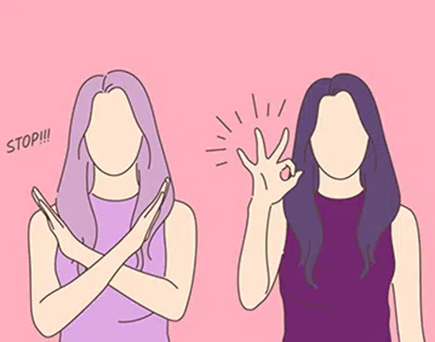
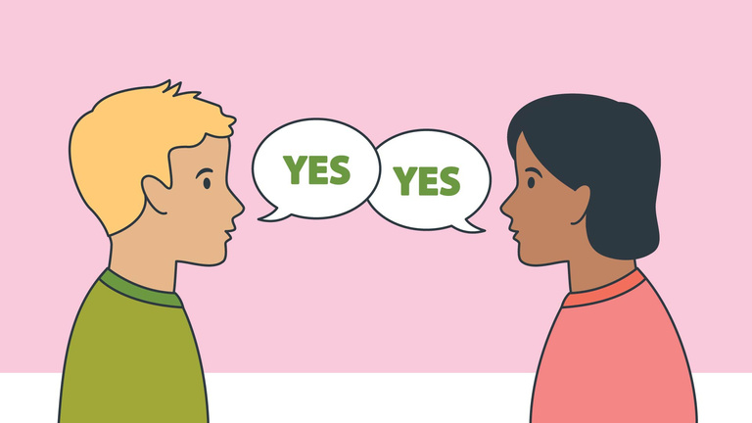
Consent
Consent is when two people agree to engage in a sexual act.
Consent cannot be given if someone is:
Pressured or threatened to do so
Under the influence of drugs or alcohol
Asleep or unconscious
Consent can be revoked at any time during a sexual encounter. A sexual act without consent from both parties is sexual assault.
Source: https://rainn.org/articles/what-is-consent

Slide 12

Teaching Sexual Health Alberta Health Services “Understanding Consent” Video
Duration: 3:02 minutes
Source: https://www.youtube.com/watch?v=raxPKklDF2k

Slide 13
Teaching Sexual Health Alberta Health Services “Understanding Consent” Teacher Led Discussion Questions
What are some examples of situations where someone cannot give consent?
What would you do if you saw someone being pressured to engage in sexual activity at a party but they were unable to consent?

Slide 14
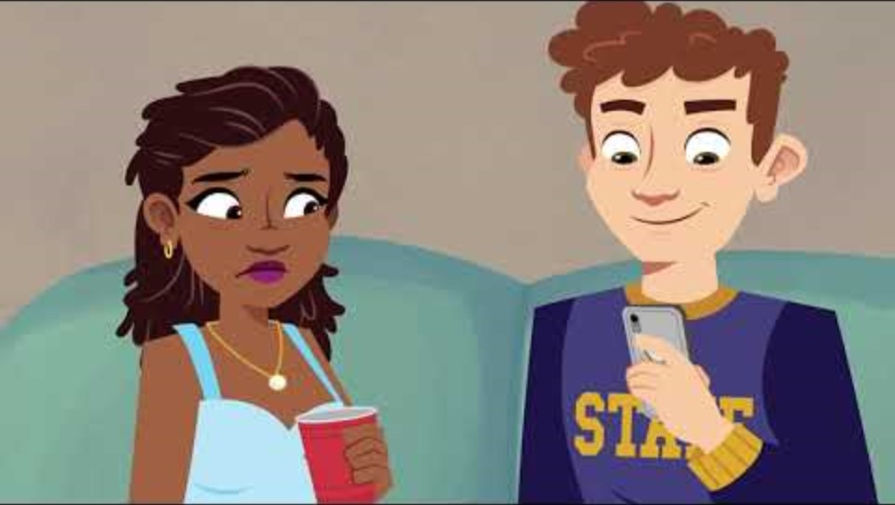
Fight Child Abuse “Don’t Let Pressure End Up As Sexual Abuse” Video
Duration: 4:35 minutes
Source: https://www.youtube.com/watch?v=F9lCVyLSHvc

Slide 15
Fight Child Abuse “Don’t Let Pressure End Up As Sexual Abuse” Discussion Questions
The class should get into 2 groups and the teacher will designate each group a number. Each group will work together and answer the questions with their group number. Then each group will take turns presenting the answers to the class.
Group 1 Questions
Group 2 Questions
Make a list of red flags that Willow overlooked in this video.
Come up with a list of ideas of how you would handle the situation.
At what point do you think Willow should have gone home?
Who would you recommend turning to if you were in this situation?

Slide 16
Real Life Story- Sandra
Sandra, 17, immigrated to the U.S. when she was 15. She has always been shy at school and has trouble connecting with her peers because of her limited English skills. She often chatted with an employee in the school cafeteria who speaks Spanish.
When Sandra first started school, she was very motivated but has recently been absent frequently and seems tired and distracted. The cafeteria worker continued to check in with Sandra and encouraged Sandra to keep coming to school.
One day, the cafeteria worker noticed Sandra has been crying and asked her if she is okay. Sandra disclosed that she was in an abusive relationship and that her boyfriend had convinced her to film videos of them engaging in sex acts, even though it made her uncomfortable. She learned that her boyfriend had been selling the videos on the Internet. When she tried to break up with him, he threatened to send the videos to her family and members of her church if she told anyone or if she refused to continue filming. She is scared that her family will disown her and is afraid of calling the police because she believes she will be deported.
Source: https://www.nj.gov/education/safety/sandp/cwss/ht/docs/HT%20Prevention%20Guidelines%20for%20Schools_Jan2022_updated%202.24.22.pdf

Slide 17

Activity

Slide 18
Activity
We recommend playing
Connect for Freedom Healthy Relationship Jeopardy.

Slide 19


Slide 20
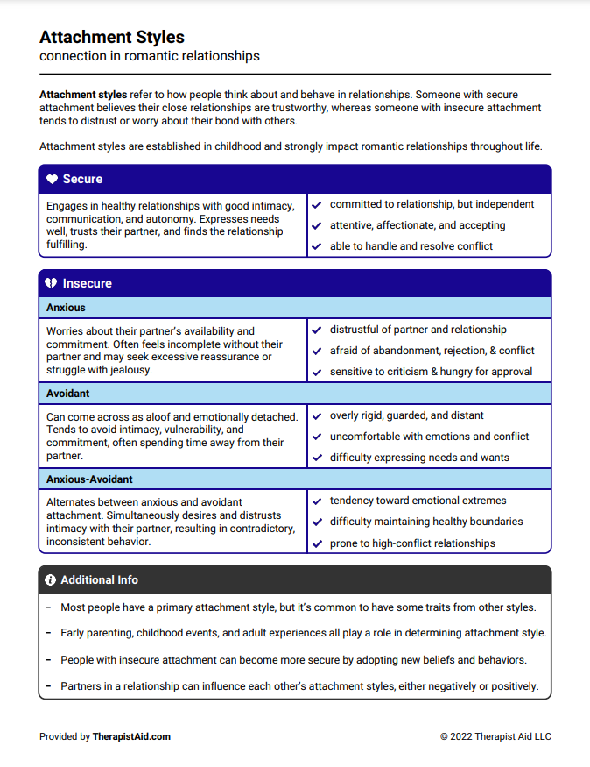
Lesson Handout from Therapist Aid LLC

Slide 21
Links to Lesson Materials
Tedx Talks “The Surprising Key to Building a Healthy Relationship That Lasts” Video
Teaching Sexual Health Alberta Health Services “Understanding Consent” Video
Fight Child Abuse “Don’t Let Pressure End Up as Sexual Abuse” Video
Therapist Aid LLC "Attachment Styles" Handout
Connect for Freedom Healthy Relationship Jeopardy

Slide 22
Recap of Lesson
Signs of a healthy relationship:
Respect one another
Honest communication
Open to positive change
Supportive during difficult times
Feel safe and secure
Kind and caring
Want the best for one another
Respect one another’s boundaries
Loyal and trustworthy
Consent is when two people agree to engage in a sexual act.
Consent cannot be given if someone is pressured or threatened to do so, under the influence of alcohol or drugs, or is asleep or unconscious.

