Slide 1

High School Engagement- Grade 12
Digital Awareness & Online Safety

Slide 2

PREVENTION THROUGH EDUCATION IS THE SOLUTION
Connect for Freedom is a 501(c)(3) nonprofit committed to providing free online safety and human trafficking awareness materials to education stakeholders.

Slide 3

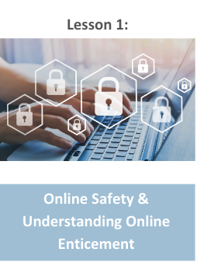
Lesson Outline
Lesson
  Introduction to Online Safety
    Online Enticement
    Sextortion
    Statistics
    Grooming
  Youth Activist Inc. “This is Human Trafficking- Social Media Recruitment” Video (2.5 min.)
    Discussion Questions
  Take the Pledge2Protect
  know2protect Handout: Tips2Identify Fake Profiles
  Activity
Digital Awareness &
Online Safety

Slide 4

Online Enticement
Online enticement involves an individual communicating with a minor via the internet with the intent to commit a sexual offense or abduction.
Source: https://www.missingkids.org/netsmartz/topics/onlineenticement

Slide 5

Sextortion
Sextortion is a form of child sexual exploitation where a minor is threatened or blackmailed, most often with the possibility of sharing with the public a nude or sexual image of themselves, by a person who demands additional sexual content, sexual activity or money from them.
Source: https://www.missingkids.org/netsmartz/topics/onlineenticement

Slide 6

Online Enticement Statistics
In 2023, the CyberTipline received 186,819 reports of online enticement, the category that includes sextortion.
Between 2021 and 2023, the number of online enticement reports increased by over 300%.
98% of reported offenders were seemingly unknown to the child offline.
In a NCMEC analysis, 78% of reported victims were girls, 13% were boys, and for 9% of reports, gender was unknown.
Source: https://www.missingkids.org/netsmartz/topics/onlineenticement

Slide 7

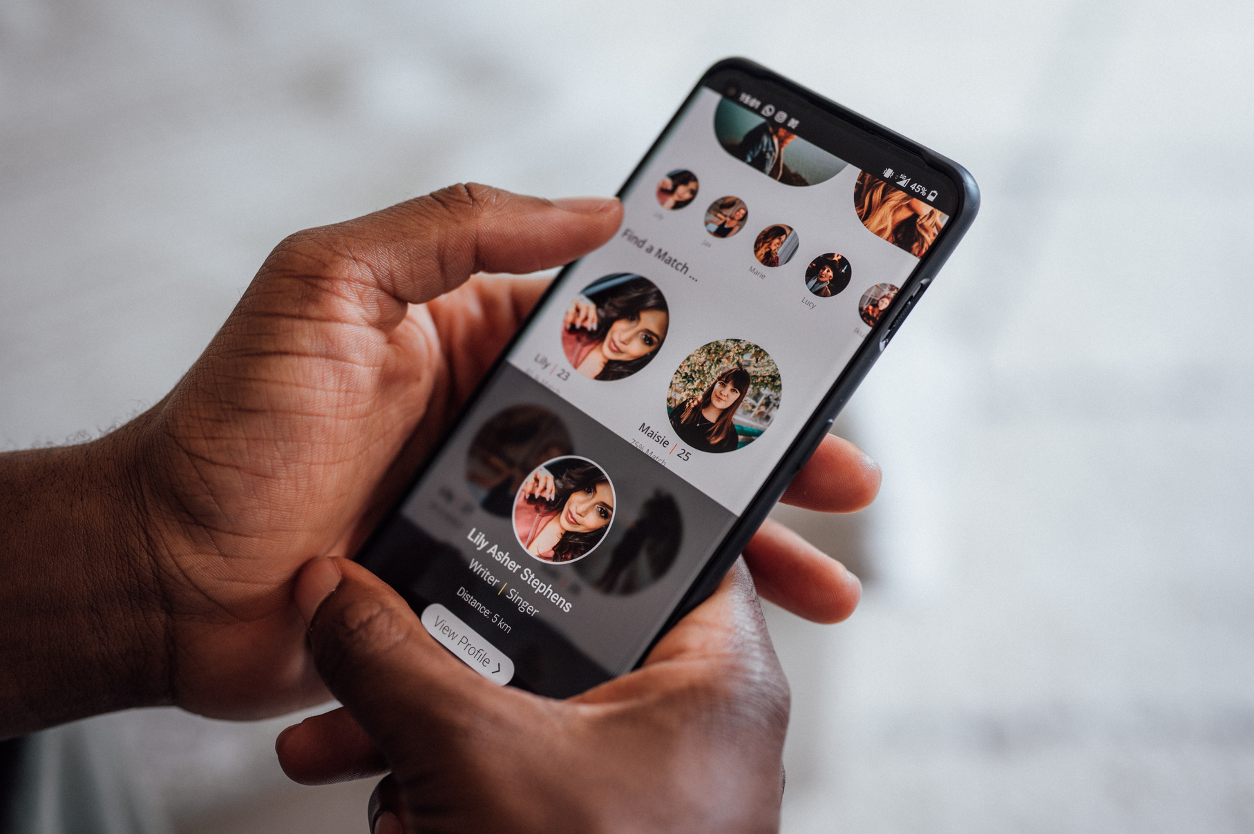
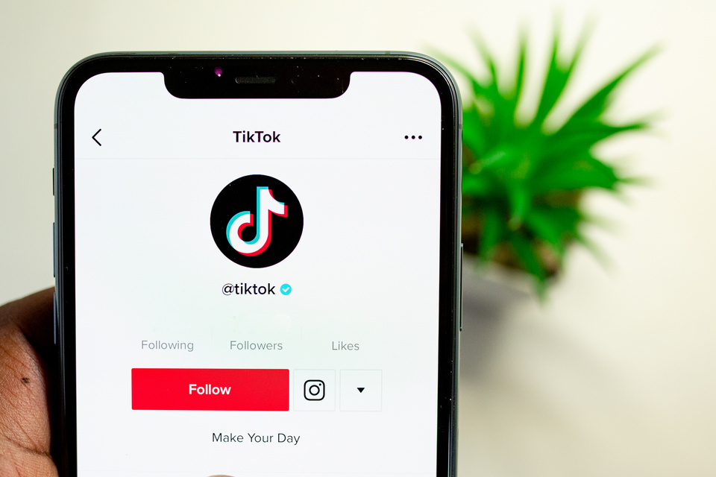
Where are Online Predators Reaching Victims?
Social media platforms
Game apps
Anonymous chat apps
Dating apps
Source: https://www.missingkids.org/theissues/onlineenticement

Slide 8


Online Enticement Grooming Tactics
Grooming is the process in which an offender sexually abuses a minor. This is often the first step in fostering a relationship with a minor and building trust.
Online enticement often begins with grooming because the offender is a stranger, and they will try to make the minor feel good and safe.
Common grooming tactics include:
  Texting you compliments
  Talking about personal and intimate topics (i.e. sex)
  Sending you gifts
  Asking you to keep your relationship a secret
  Talking negatively about others in your life
  Asking you for sexual images of yourself
Source: https://www.allianceforchildren.org/blog/2018/06/what-grooming

Slide 9

Youth Activist Inc. “This is Human Trafficking- Social Media Recruitment” Video
Duration: 2:29 minutes
Source: https://www.youtube.com/watch?v=7mH93tQ4n8M

Slide 10
Youth Activist Inc. “This is Human Trafficking- Social Media Recruitment” Teacher Led Discussion Questions
At the coffee shop, Jessica immediately notices that Brian looks different than his profile pictures. This was an immediate red flag, and her gut reaction was likely to walk away. But with prompting from Brian, she followed him to the photoshoot.
What other red flags did you notice?
Why don’t you think Jessica walked away sooner?

Slide 11
Real Life Story- Gavin
Gavin, 17, just graduated high school and was getting ready for college. He wanted to be an art teacher. Gavin was known to be nice to everyone, always looking out for others.
He got a friend request from a pretty college student who lived one state away, and started messaging her. Their conversation became flirtatious and the girl send a nude photo of herself to Gavin, and requested one in return.
Gavin sent her a nude photo of himself and then she threatened to show them to the world unless he forwarded money to an online payment app. He quickly realized that he wasn’t talking to the girl he thought he was.
The person messaging him was a scammer who posted as the girl to extort him for money. Gavin became nervous, ashamed, and embarrassed about his friends and family potentially seeing the nude photos of himself, so he went and got his dad’s firearm.
Source: https://people.com/crime/brandon-guffey-son-sextortion-victim-died-by-suicide/

Slide 12
Real Life Story-Gavin Discussion Questions
How do you think Gavin should have handled this situation?
What would you tell a friend if they were in his position?

Slide 13

Privacy Suggestions
Have a different password for each account.
Use privacy settings.
Choose carefully who you befriend.
Limit access to your location.
Look for the lock symbol or “https”.
Don’t share any personal information online.
Don’t share passwords.
Don’t share or forward explicit content.

Slide 14

Take Action
Take screenshots of anything that looks or feels dangerous.
Block individuals who exhibit inappropriate or predatory behavior.
File a report with the police, offering as much information as possible about who is involved and in what ways.
Call a Cybertipline to report potential abuse or exploitation and receive additional recommendations for action steps.
Source: https://www.missingkids.org/netsmartz/home

Slide 15
Take the Pledge2Protect
  I pledge to not create or share real or AI-generated sexually explicit images of myself or my peers. Next up- review the How2Spot Peer-on-Peer Risks: A Guide for Teens.
  I pledge to review the Exit Strategy Checklist, create my own exit strategy and talk about this with my friends so we are prepared if something goes sideways online or doesn’t feel right.
  I pledge to bookmark the How2Report page and review the You’re Never Alone Support Directory resource in case online exploitation happens to me or a friend.
  I pledge to set all my apps, games, social media accounts and devices to private and to turn off location data services on social media and all apps, except the ones my family and I need.
  I pledge to know who is on my friends and followers lists, remove strangers and only accept people I know in real life and block or remove anyone who makes me feel uncomfortable.
Source: https://www.dhs.gov/know2protect/p2p/teens

Slide 16

Take the Pledge2Protect
For more information, please scan the QR code below.
Source: https://www.dhs.gov/know2protect/p2p/teens

Slide 17

Activity

Slide 18
Activity
We recommend playing
Connect for Freedom Online Safety Jeopardy.

Slide 19


Slide 20
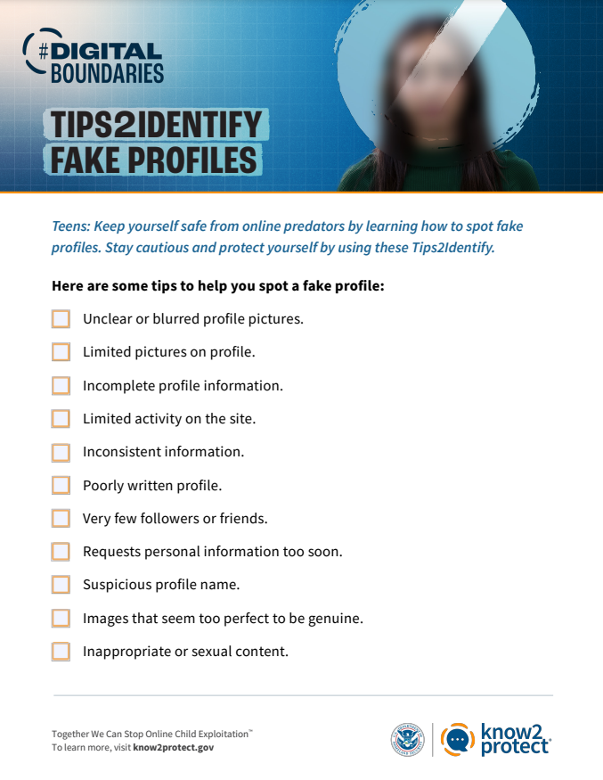
Lesson Handout from know2protect

Slide 21
Links to Lesson Materials
Oasis Mental Health Applications “Building Healthy Relationships” Video
Alliance to End Human Trafficking “Human Trafficking Basics” Video
know2protect Pledge2Protect for Teens
know2protect How2Spot Peer-on-Peer Risks: A Guide for Teens
know2protect Exit Strategy Checklist
know2protect How2Report
know2protect You’re Never Alone Support Directory
know2protect "Tips2Identify Fake Profiles" Handout
Connect for Freedom Online Safety Jeopardy

Slide 22
Recap of Lesson
Online enticement involves an individual communicating with a minor via the internet with the intent to commit a sexual offense or abduction.
Sextortion is a form of child sexual exploitation when a minor is threatened or blackmailed, most often with the possibility of sharing with the public a nude or sexual image of them, by a person who demands additional sexual content, sexual activity or money from them.
Online predators reach their victims on social media platforms, game apps, anonymous chat apps, and dating apps.
Grooming is the process in which an offender sexually abuses a minor. This is often the first step in fostering a relationship with a minor and building trust.

