Slide 1
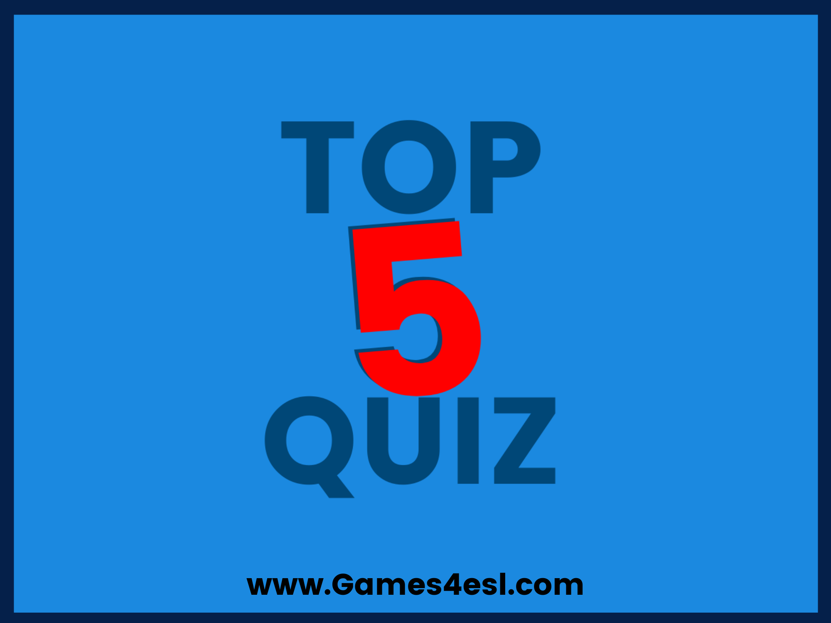

Slide 2
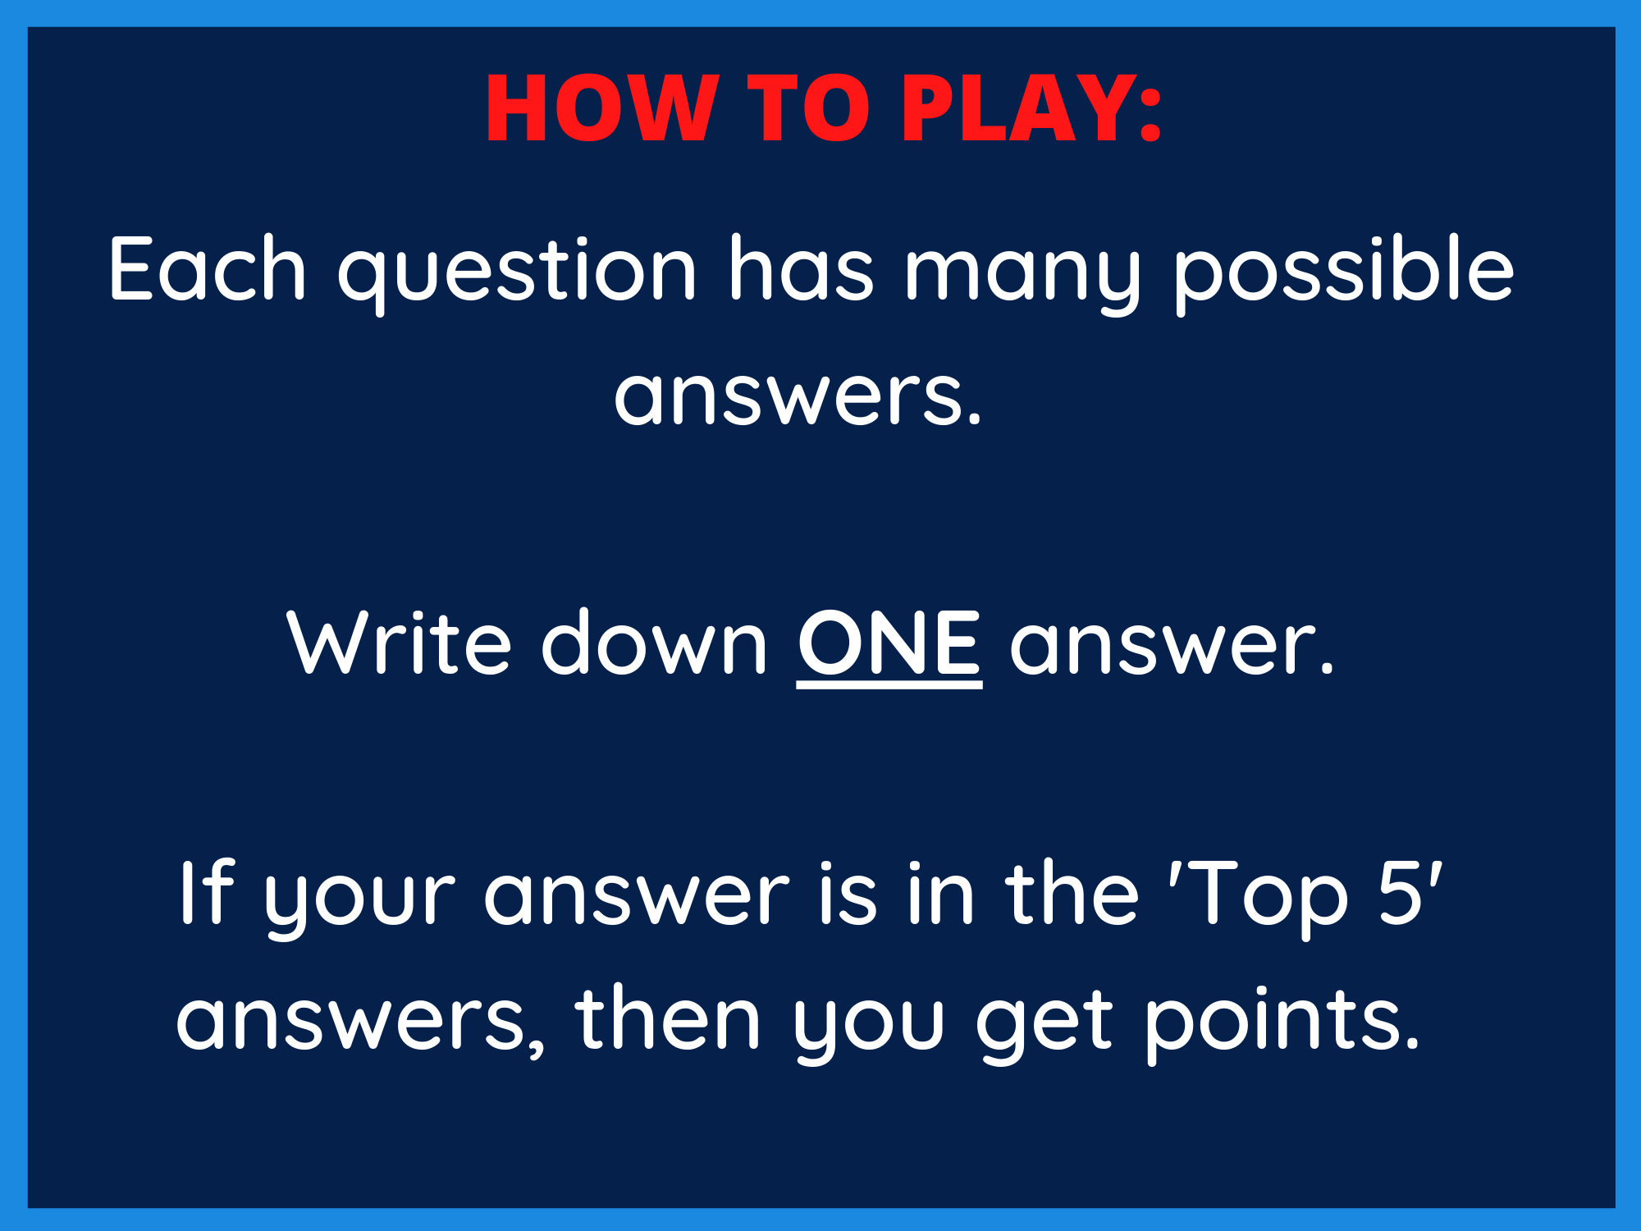

Slide 3


Slide 4
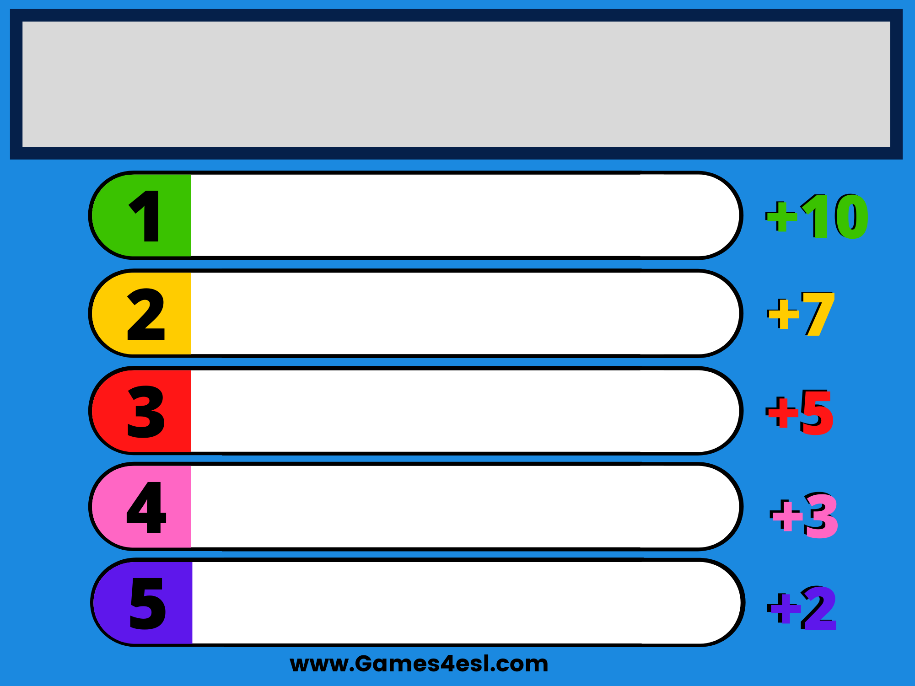
What content is inappropriate to post online?
Revealing images
Drinking & drug usage
Threats
Hate speech
Profanity

Slide 5


Slide 6
What negative consequences are there to posting something online?
Impact on future job opportunities
Repercussions to your education
Relationship with friends & family
Future romantic relationships
Public perception of you

Slide 7


Slide 8
How may you feel if your private nude images were posted online?
Suicidal
Anxious/Depressed
Violated
Ashamed
Embarrassed

Slide 9


Slide 10
What risks are associated with sexting?
Image posted on social media or inappropriate websites.
Image forwarded to others without your permission.
People talk about it at school
and you get in trouble.
You are made fun of and
bullied at school for doing it.
Your parents see it and
are upset with you.

Slide 11


Slide 12
What are the benefits of NCMEC’s “Take It Down” campaign?
Your nude images are taken down.
You no longer feel stressed/anxious about it.
You don’t have to worry about
nudes impacting your future.
It’s completely anonymous.
It’s FREE.

Slide 13


Slide 14
What are online red flags?
Tries to meet you in real life.
Sends & asks for inappropriate pictures.
Asks a lot of personal questions.
Gets mad if you’re offline.
Wants to follow all your profiles.

