Slide 1

High School Engagement- Grade 9
Online Decisions with Real Life Consequences

Slide 2

PREVENTION THROUGH EDUCATION IS THE SOLUTION
Connect for Freedom is a 501(c)(3) nonprofit committed to providing free online safety and human trafficking awareness materials to education stakeholders.

Slide 3

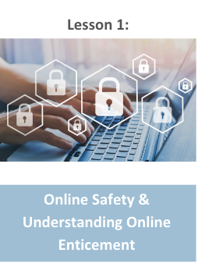
Lesson Outline
Lesson
  Introduction to Online Safety
  Common Sense Education “Teen Voices: Oversharing and Your Digital Footprint” Video (3.5 min.)
    Discussion Questions
  Sexting
  Fight Child Abuse “Online Sexual Abuse Can Happen” Video (4.5 min.)
    Discussion Questions
  NCMEC Take It Down
  NCMEC “Rewind” Video (0.5 min.)
  The Dibble Institute Handout: Sexting: Advice for Teens
  Activity
Online Decisions with Real Life Consequences

Slide 4
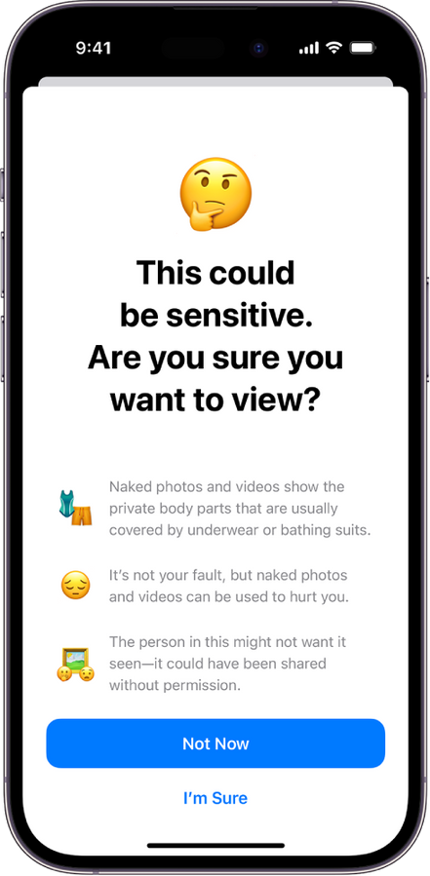





Online Safety
You should always be careful of what you post online. You should never post:
Images of alcohol/drugs
Sexual content
Profanity
Harmful/abusive words
Threats to someone’s safety
Racist, sexist, and prejudiced language
Show me

Slide 5

Every Action Has a Reaction
Every action that we make in life has a reaction. The same goes for what we post online.
What you post online gives people an idea of who you are, what you believe in, what you like, what you dislike, etc.
If you post content that is not appropriate, such as sexual images or verbally abusive words, people may have a negative image of you. If you want to depict a positive image, it is important to be mindful of what we say and do.

Slide 6

Negative Consequences
Posting harmful things online can impact even more than just people’s perception of you.
It could impact your future educational opportunities (i.e. college, law school, medical school) and job opportunities.
You do not want something you posted today to negatively impact the rest of your life.
Always be mindful of what you post.

Slide 7
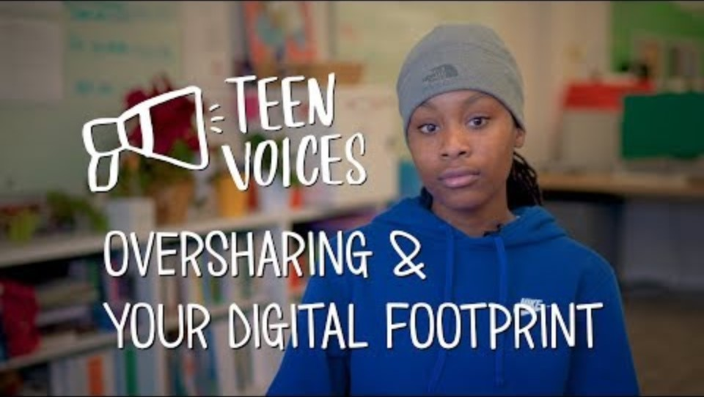
Common Sense Education “Teen Voices: Oversharing and Your Digital Footprint” Video
Duration: 3:34 minutes
Source: https://www.youtube.com/watch?v=ottnH427Fr8

Slide 8
Common Sense Education “Teen Voices: Oversharing and Your Digital Footprint” Teacher Led Discussion Questions
Do you think about the potential consequences before posting online?
Have you ever posted something online that maybe you should not have? Or known someone who has?

Slide 9

Sexting
Sending someone a nude image or sexually explicit video can also have severe negative consequences.
This online action can seem fun and flirty in the moment, but soon, that image could be posted online. This could lead to you feeling violated, embarrassed, ashamed, and even lead to anxiety, depression, or suicidal thoughts.
In some instances, sexting can lead to being trafficked.

Slide 10
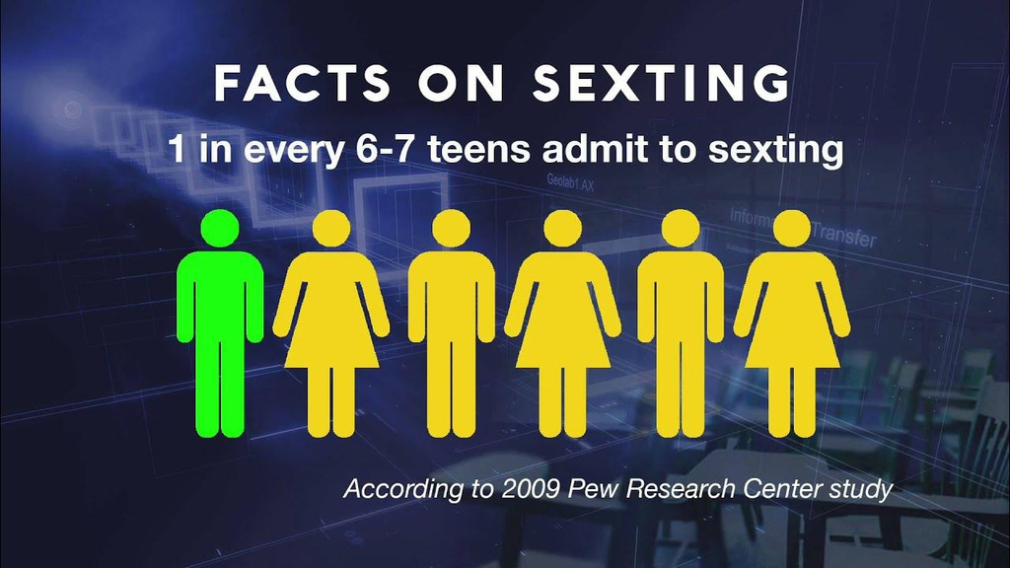
Sexting
Sexting is sending, forwarding, or receiving a sexually explicit message, nude or partially nude image or video via cell phone, computer, or other electronic device
If you are under the age of 18, a nude image of yourself is child pornography.

Slide 11

Risks of Sexting
There are risks associated with sending a nude image of yourself.
The image could be:
What are u
wearing? ;)
Posted on social media or inappropriate websites.
Send pics?
Used to embarrass or bully you at school
U r so hot.
I want 2 c u rn
Show me u
Sent or forwarded to others without your permission.
Getting you in trouble with school, your parents, future job opportunities, or educational experiences.

Slide 12
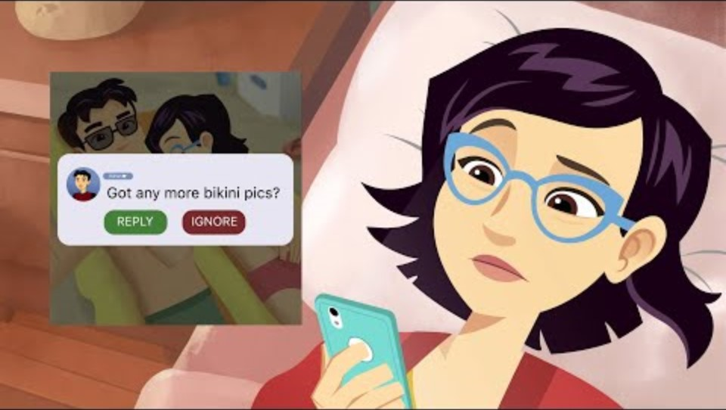
Fight Child Abuse “Online Sexual Abuse Can Happen” Video
Source: https://www.youtube.com/watch?v=CEivufW2IWs
Duration: 4:38 minutes

Slide 13
Fight Child Abuse “Online Sexual Abuse Can Happen” Teacher Led Discussion Questions
Kevin did not respect Kim or her boundaries. He showed several red flags that continued to escalate until he posted her private, intimate pictures online.
What red flags did Kevin exhibit?
What should someone do if they are in a similar position?

Slide 14
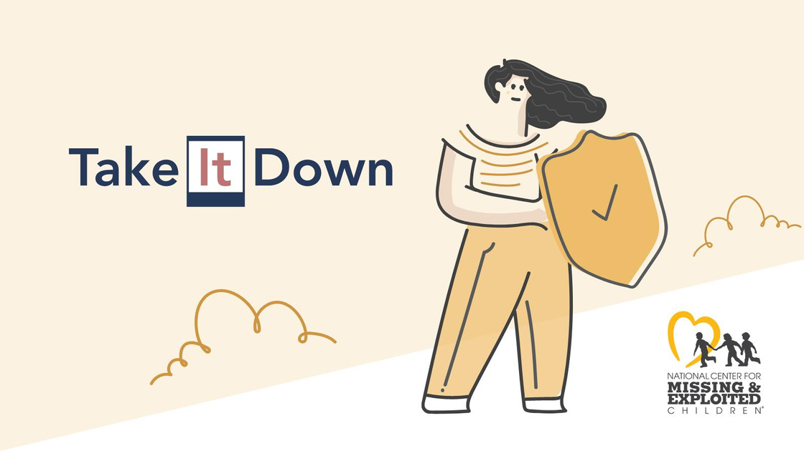
NCMEC “Take It Down”
What is it?
A free service that can help you remove or stop the online sharing of nude, partially nude, or sexually explicit images or videos taken of you when you were under 18 years old.
You can remain anonymous while using the service and you will not have to send your images or videos to anyone.
It will work on public or unencrypted online platforms that have agreed to participate.
Source: https://takeitdown.ncmec.org

Slide 15
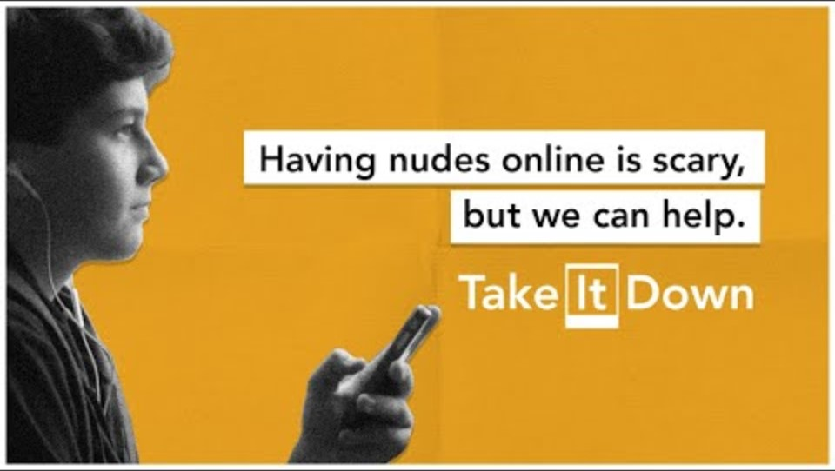
NCMEC “Rewind” Video
Duration: 0:30 minutes
Source: https://www.youtube.com/watch?v=pAaXbBzVdJE

Slide 16

Activity

Slide 17
Activity
We recommend playing
Connect for Freedom
Top 5 Quiz Online Decisions.

Slide 18


Slide 19
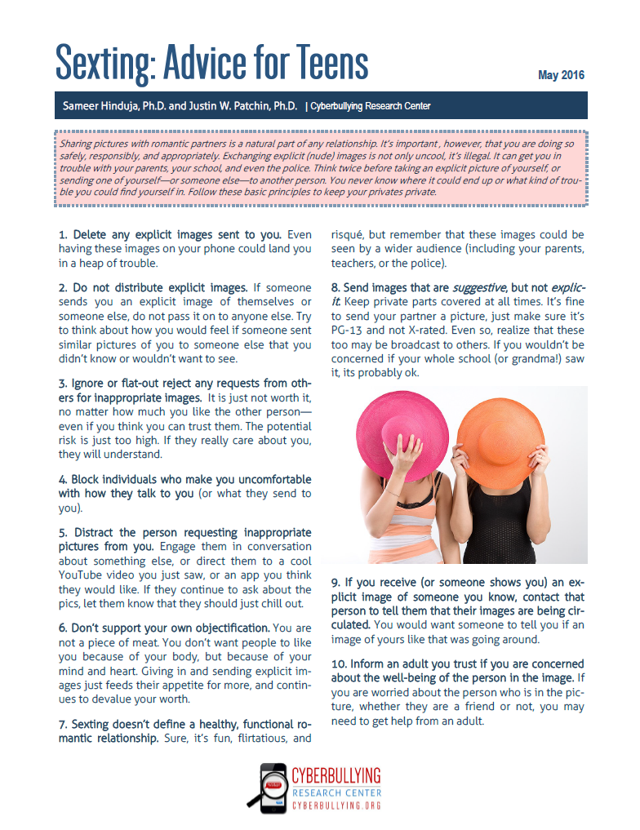
Lesson Handout from NCMEC

Slide 20
Links to Lesson Materials
Common Sense Education "Teen Voices: Oversharing and Your Digital Footprint" Video
Fight Child Abuse "Online Sexual Abuse Can Happen" Video
NCMEC "Rewind" Video
The Dibble Institute “Sexting Advice for Teens” Handout
Connect for Freedom Top 5 Quiz Online Decisions

Slide 21
Recap of Lesson
Type of content to never post online:
  Images of alcohol/drugs
  Sexual content
  Profanity
  Harmful/abusive words
  Threats to someone’s safety
  Racist, sexist, and prejudiced language
Posting negative or harmful things online can impact:
  People’s perception of you
  Education
  College opportunities
  Job opportunities
Sexting is sending, forwarding, or receiving a sexually explicit message, nude or partially nude image or video via cell phone, computer, or other electronic device
NCMEC “Take It Down”
A free service that can help you remove or stop the online sharing of nude, partially nude, or sexually explicit images or videos taken of you when you were under 18 years old.

