Slide 1

High School Engagement- Grade 9
Human Trafficking Awareness & Prevention

Slide 2

PREVENTION THROUGH EDUCATION IS THE SOLUTION
Connect for Freedom is a 501(c)(3) nonprofit committed to providing free online safety and human trafficking awareness materials to education stakeholders.

Slide 3
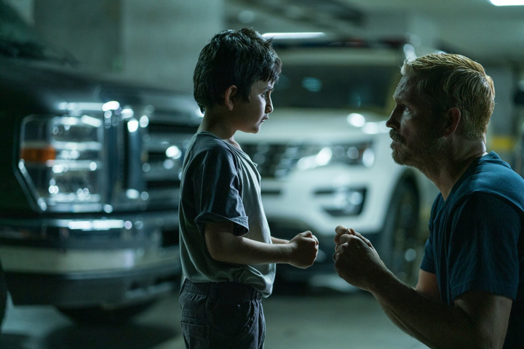
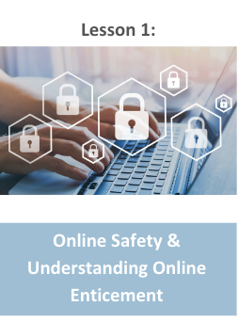
Lesson Outline
Lesson
  Introduction to Human Trafficking
  Alliance to End Human Trafficking “Human Trafficking Basics” Video (3 min.)
    Discussion Questions
  Child Sex Trafficking
    Youth Risk Factors & Vulnerabilities
    Examples of Child Sex Trafficking
    Signs of Child Sex Trafficking
  Our Rescue “2024 Human Trafficking Myth vs. Truth” Video (3 min.)
    Discussion Question
  DHS Blue Campaign Handout: What is Human Trafficking?
  Activity
Human Trafficking Awareness & Prevention

Slide 4
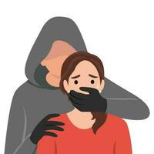
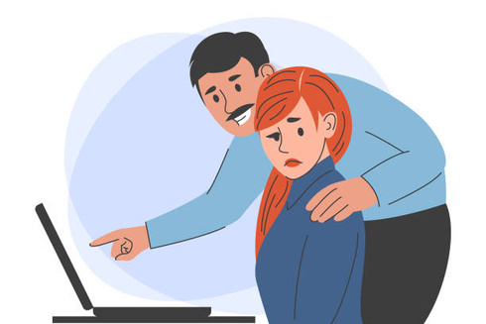
What is Human Trafficking?
The use of force, fraud, or coercion to obtain some type of labor or commercial sex act.
HSI Blue Campaign
It affects everyone, regardless of sex, age, gender, race, or nationality.
HSI Blue Campaign
If a victim is under the age of 18, any act of commercial sex is considered to be trafficking, regardless of the use of force, fraud, or coercion.
The Exodus Road

Slide 5

Types of Human Trafficking
Sex trafficking- using force, fraud, or coercion to obtain a commercial sex act
Examples: escort services, pornography, brothels, massage parlors
Labor trafficking- using force, fraud, or coercion to obtain labor
Examples: restaurant workers, landscaping, factory workers, construction

Slide 6
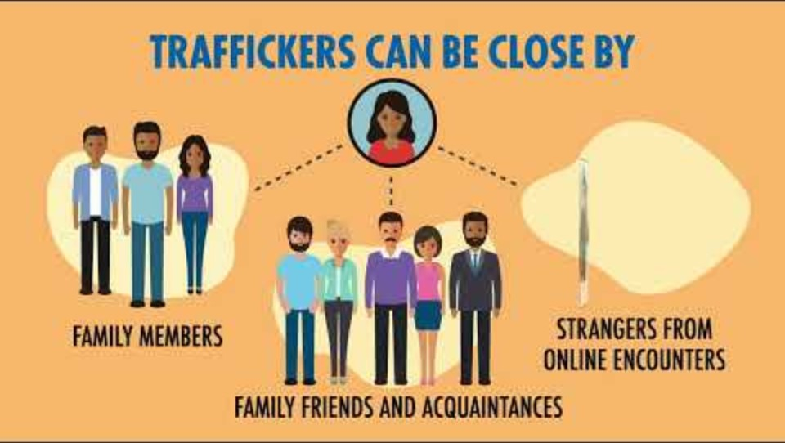
Alliance to End Human Trafficking “Human Trafficking Basics” Video
Duration: 3:19 minutes
Source: https://www.youtube.com/watch?v=XhbfGo7voB8

Slide 7
Alliance to End Human Trafficking “Human Trafficking Basics” Teacher Led Discussion Questions
Human trafficking can affect anyone, regardless of age, race, gender, sexual orientation, financial status, etc.
What are some factors that can make someone more vulnerable to being human trafficked?
What are some things we can do to stop human trafficking?

Slide 8
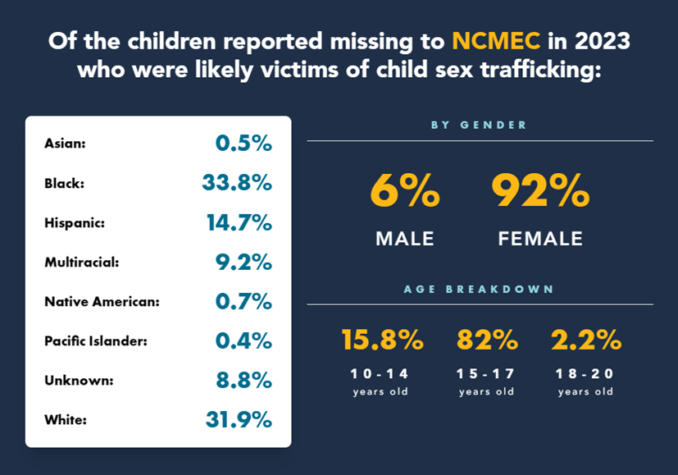
Child Sex Trafficking Statistics
Of the more than 28,800 missing children reported to NCMEC in 2023,
1 in 6 were likely victims of child sex trafficking.
Source: https://www.missingkids.org/ourwork/impact

Slide 9

Youth Risk Factors & Vulnerabilities
Poverty and/or homelessness
Interaction with foster care or juvenile justice systems
Lack of support networks, like strong relationships with friends, family, or other trusted adults
Gang involvement, especially among youth who identify as female
History of running away
Low self-esteem or being bullied
Experience discrimination due to their race, gender, identity, sexuality, disability, or other personal characteristic
Source: https://www.missingkids.org/theissues/trafficking

Slide 10

Youth Risk Factors & Vulnerabilities (cont.)
Family history of sexual abuse or violence
Community or familial history of trafficking and commercial sexual exploitation
Substance abuse or addictions
Experiencing or witnessing a traumatic event
Cultural-historical trauma (particularly among minority communities)
Being the sole or primary provider for their family
Source: https://www.missingkids.org/theissues/trafficking

Slide 11
Examples of Child Sex Trafficking
Pimp-Controlled Trafficking
Child is trafficked by an unrelated individual, male or female, who develops an intentional relationship with the child who is later used as leverage in the exploitation.
Gang-Controlled Trafficking
Child is trafficked by a member of a gang or trafficked by the gang. Gangs leverage their organizational structure, violence, and local, national, and international networks to instill fear and loyalty in the child victim.
Familial Trafficking
Child is trafficked by a relative or a person who is perceived by the child to be a family member such as individuals referred to as “auntie” or “uncle” but are not directly related to the child.
Buyer-Perpetrated Trafficking
Child is being trafficked but does not have a trafficker. Instead, the buyer is directly exploiting the child’s vulnerability by offering money, food, and/or shelter in exchange for the sexual exploitation.
Source: https://www.missingkids.org/theissues/trafficking

Slide 12

Signs of Child Sex Trafficking
Absences at school
Disconnected from friends and family
Dramatic change in mood/behavior
Seem timid or fearful
Constantly accompanied by someone
What they say sounds rehearsed
Have physical bruises

Slide 13
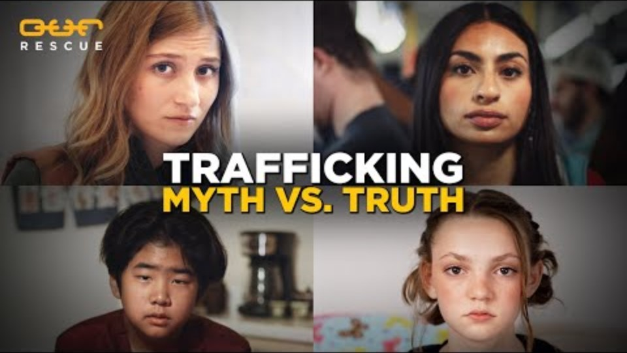
Our Rescue “2024 Human Trafficking Myth vs. Truth” Video
Duration: 3:18 minutes
Source: https://www.youtube.com/watch?v=7P6-chWY41s

Slide 14
Our Rescue “2024 Human Trafficking Myth vs. Truth” Teacher Led Discussion Question
Were you surprised by any of these myths vs. truths?
Which one stood out to you the most and why?

Slide 15

Activity

Slide 16
Activity
We recommend playing
Connect for Freedom Risk Factors BINGO.

Slide 17


Slide 18
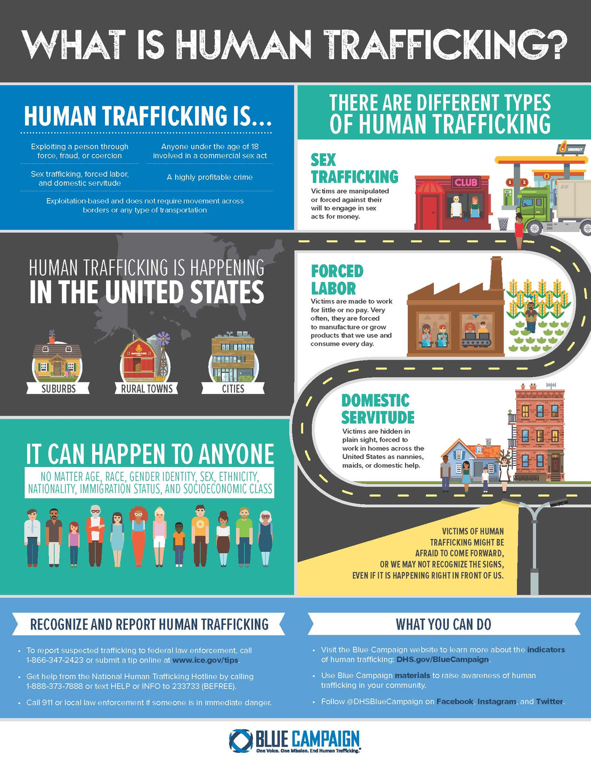
Lesson Handout from Department of Homeland Security’s Blue Campaign

Slide 19
Links to Lesson Materials
Alliance to End Human Trafficking “Human Trafficking Basics” Video
Our Rescue “2024 Human Trafficking Myth vs. Truth” Video
Department of Homeland Security's Blue Campaign "What is Human Trafficking?" Handout
Connect for Freedom Risk Factors BINGO

Slide 20
Recap of Lesson
Human trafficking is the use of force, fraud, or coercion to obtain some type of labor or commercial sex act.
2 Types of Human Trafficking: Sex & Labor
4 Types of Child Sex Trafficking: Pimp-Controlled, Familial, Gang-Controlled, Buyer-Perpetrated
Youth Risk Factors & Vulnerabilities
  Poverty and/or homelessness
  Interaction with foster care or juvenile justice systems
  Lack of support networks
  Gang involvement
  History of running away
  Low self-esteem
  Being bullied
  Experience with discrimination due to race, gender, sexuality, etc.
  Family history of sexual abuse/violence
  Community or family history of trafficking or commercial sex exploitation
  Experiencing a traumatic event
  Being a sole provider for the family

