Slide 1

Middle School Engagement- Grade 8
Healthy Relationships Lead to Safe Decision Making

Slide 2

PREVENTION THROUGH EDUCATION IS THE SOLUTION
Connect for Freedom is a 501(c)(3) nonprofit committed to providing free online safety and human trafficking awareness materials to education stakeholders.

Slide 3

Lesson Outline
Lesson
  Introduction to Teen Relationships
  Always “Healthy and Unhealthy Behaviors in Teenage Relationships" Video (2 min.)
    Discussion Questions
  Consent
  American Academy of Pediatrics “Teens & Why Consent is Important?” Video (6 min.)
    Discussion Questions
  Sexting
  NCMEC “Rewind” Video (0.5 min.)
  U.S. Department of Health and Human Services Handout: Dangers of Sexting
  Activity
Healthy Relationships Lead to Safe Decision Making

Slide 4

Teen Relationships
The Data
96% of teens report mental/emotional abuse in their dating relationships.
The Dibble Institute
1 in 11 students said they had been hit, slapped, or physically abused in the past year.
The Dibble Institute
28% of teens who have been in relationships are victims of digital dating abuse.
The Dibble Institute

Slide 5
Healthy Relationship vs. Unhealthy Relationship
Healthy Relationship:
Unhealthy Relationship:
  Respect one another
  Honest communication
  Open to positive change
  Supportive during difficult times
  Kind and caring
  Want the best for one another
  Respect one another’s boundaries/space
  Loyalty and trust
  Feel safe and secure
  Physical aggression or abuse
  Emotional manipulation
  Name calling
  Controlling
  Cruel and mean communication
  Shaming and/or blaming their partner
  Extreme possessiveness and jealousy
  Pressure for sexual activity
  Threats and/or abuse

Slide 6
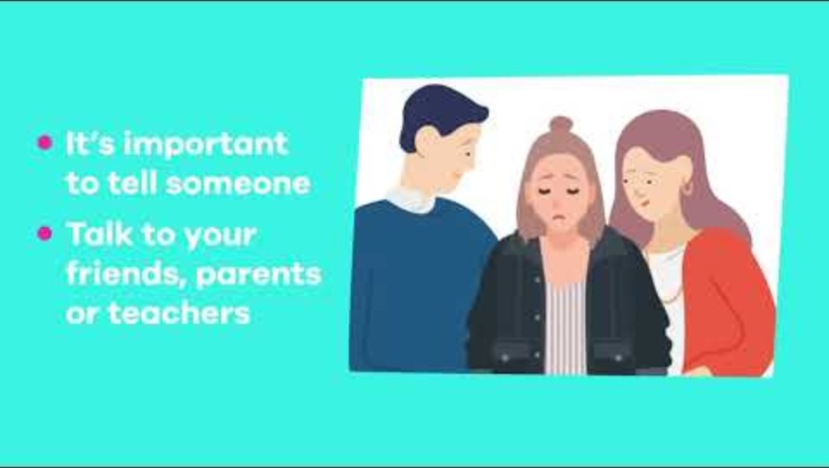
Always “Healthy and Unhealthy Behaviors in Teenage Relationships” Video
Duration: 1:57 minutes
Source: https://www.youtube.com/watch?v=AcGXlM7vrMQ

Slide 7
Always “Healthy and Unhealthy Behaviors in Teenage Relationships” Discussion Questions
Do you think it’s more common to see healthy relationships or unhealthy relationships amongst your peers? Why?
What are some indicators you see of unhealthy relationships?

Slide 8

Taking Time to Get to Know Someone is Healthy
Learn about who they really are. It takes time to learn someone’s interests, hobbies, likes, dislikes, etc.
Build trust. Trust is essential to having a healthy relationship. See how the person reacts to different situations, how they deal with emotions, how they communicate and problem solve.
Explore your feelings. Sometimes we can have strong initial chemistry or attraction but that doesn’t mean you are compatible with someone.
Source: https://www.missingkids.org/theissues/onlineenticement

Slide 9

Setting Boundaries for Dating
Setting boundaries for dating is important to having a healthy relationship.
Know yourself. Having self-worth and confidence will help you walk away from any relationship that does not serve you.
Know your expectations. Being aware of what is unacceptable behavior in a relationship will help you walk away from an unhealthy relationship.
Know when to walk away. Keeping yourself safe is the most important thing you can do for yourself. Do not ever stay with someone who makes you feel unsafe or uncomfortable.

Slide 10
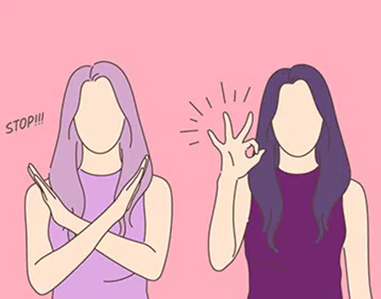
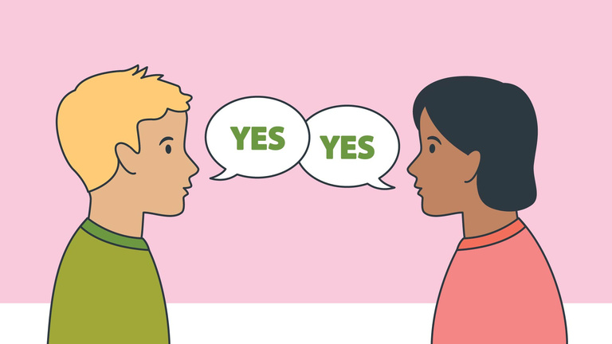
Consent
Consent is when two people agree to engage in a sexual act.
Consent cannot be given if someone is:
  Pressured or threatened to do so
  Under the influence of drugs or alcohol
  Asleep or unconscious
Consent can be revoked at any time during a sexual encounter. A sexual act without consent from both parties is sexual assault.
Source: https://rainn.org/articles/what-is-consent

Slide 11

American Academy of Pediatrics “Teen & Why Consent is Important?” Video
Duration: 6 minutes
Source: https://www.youtube.com/watch?app=desktop&v=liegjyYog3c&t=104s

Slide 12
American Academy of Pediatrics “Teen & Why Consent is Important?” Discussion Questions
Do you think most of your peers think that sexting is normal?
Do you feel that there is a societal pressure to engage in sexting?
What advice would you give a friend if they feel pressured to send their significant other a sext but they don’t really want to?

Slide 13
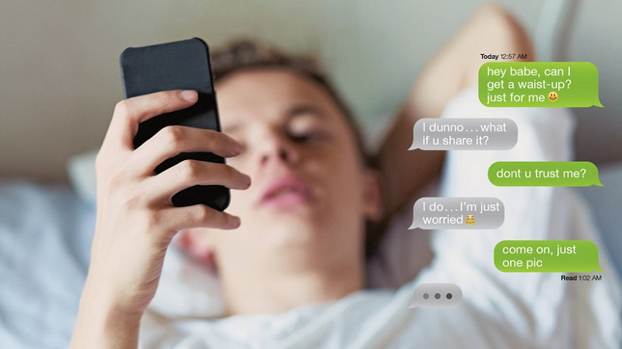
Sexting
Sexting is the sharing and receiving of sexually explicit messages and nude or partially nude images via cell phones.
Once a sext is shared, there is no guaranteed privacy to that image. The other person can choose to share that image with others.
If you sext, you may be at risk of sextortion, getting in trouble at school, being bullied or harassed, or getting into legal trouble.
Source: https://www.missingkids.org/netsmartz/topics/sexting

Slide 14
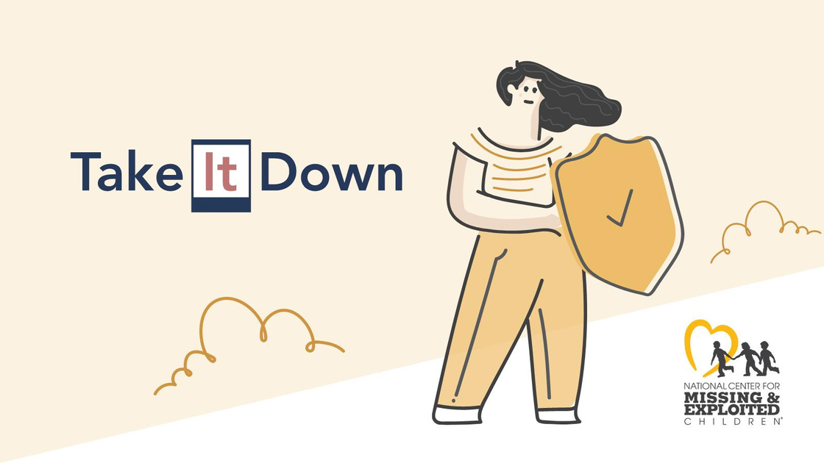
NCMEC “Take It Down”
What is it?
A free service that can help you remove or stop the online sharing of nude, partially nude, or sexually explicit images or videos taken of you when you were under 18 years old.
You can remain anonymous while using the service and you won’t have to send your images or videos to anyone.
It will work on public or unencrypted online platforms that have agreed to participate.
Source: https://takeitdown.ncmec.org

Slide 15
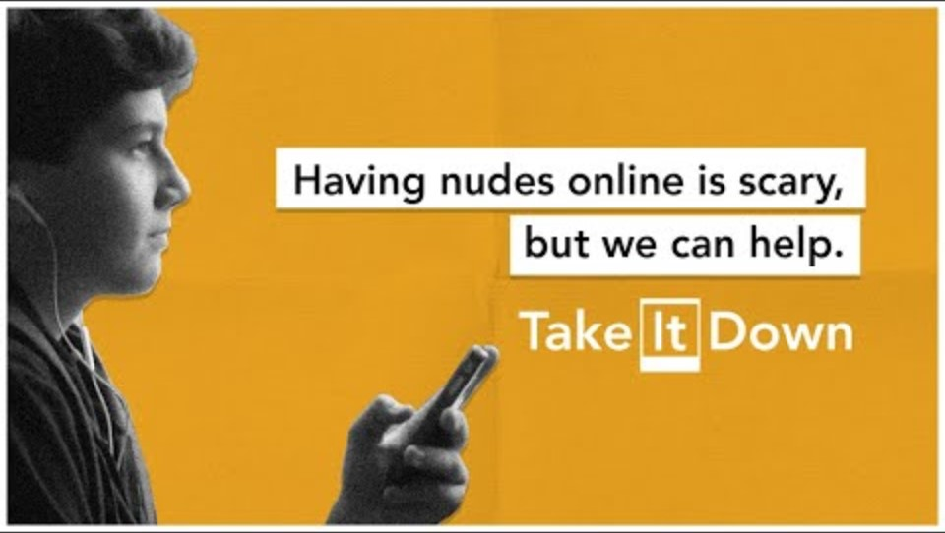
NCMEC “Rewind” Video
Duration: 0.5 minutes
Source: https://www.youtube.com/watch?v=pAaXbBzVdJE

Slide 16

Activity

Slide 17
Activity
We recommend playing
Connect for Freedom
Healthy vs. Unhealthy Relationships.

Slide 18


Slide 19
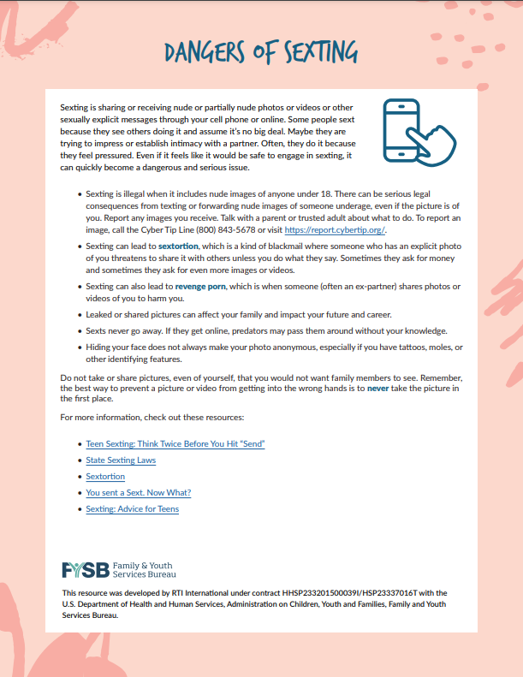
Lesson Handout from U.S. Department of Health and Human Services

Slide 20
Links to Lesson Materials
Always “Healthy and Unhealthy Behaviors in Teenage Relationships” Video
American Academy of Pediatrics “Teens & Why Consent is Important?” Video
NCMEC “Rewind” Video
U.S. Department of Health and Human Services Lesson Plan Handout
Connect for Freedom Healthy vs. Unhealthy Relationships

Slide 21
Recap of Lesson
Consent is when two people agree to engage in a sexual act.
Healthy Relationship:
  Respect one another
  Honest communication
  Open to positive change
  Supportive during difficult times
  Kind and caring
  Want the best for one another
  Respect one another’s boundaries/space
  Loyalty and trust
  Feel safe and secure
Consent can be revoked at any time during a sexual encounter. A sexual act without consent from both parties is sexual assault.
Sexting is the sharing and receiving of sexually explicit messages and nude or partially nude images via cell phones.
If you sext, you may be at risk of sextortion, getting in trouble at school, being bullied or harassed, or getting into legal trouble.

