Slide 1

Middle School Engagement- Grade 6
Sextortion & Understanding Offender Tactics

Slide 2

PREVENTION THROUGH EDUCATION IS THE SOLUTION
Connect for Freedom is a 501(c)(3) nonprofit committed to providing free online safety and human trafficking awareness materials to education stakeholders.

Slide 3
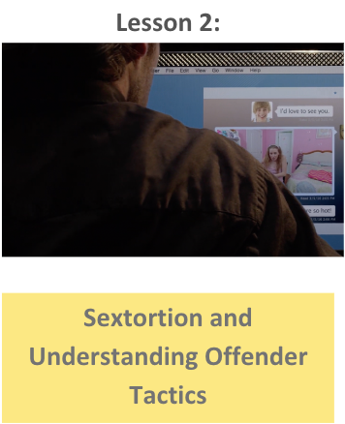

Lesson Outline
Lesson
  Introduction to Sextortion
  DHS “Carter’s Story Pt. 1 & 2” Video (4.4 min.)
  Sextortion Tactics
  Auroris Media “Sextortion Module 1" Video (6 min.)
    Discussion Question
  Protect Yourself
    Risks of Revealing Images
    How to Protect Yourself
    NCMEC “Take It Down”
  NCMEC Handout: If Sextortion is Happening to You
  Activity
Sextortion & Understanding Offender Tactics

Slide 4
What is Sextortion?
Sextortion is a form of child sexual exploitation where minors are threatened or blackmailed, most often with the possibility of sharing with the public a nude or sexual image of them, by a person who demands additional sexual content, sexual activity or money from them.
Source: https://www.missingkids.org/netsmartz/topics/onlineenticement

Slide 5

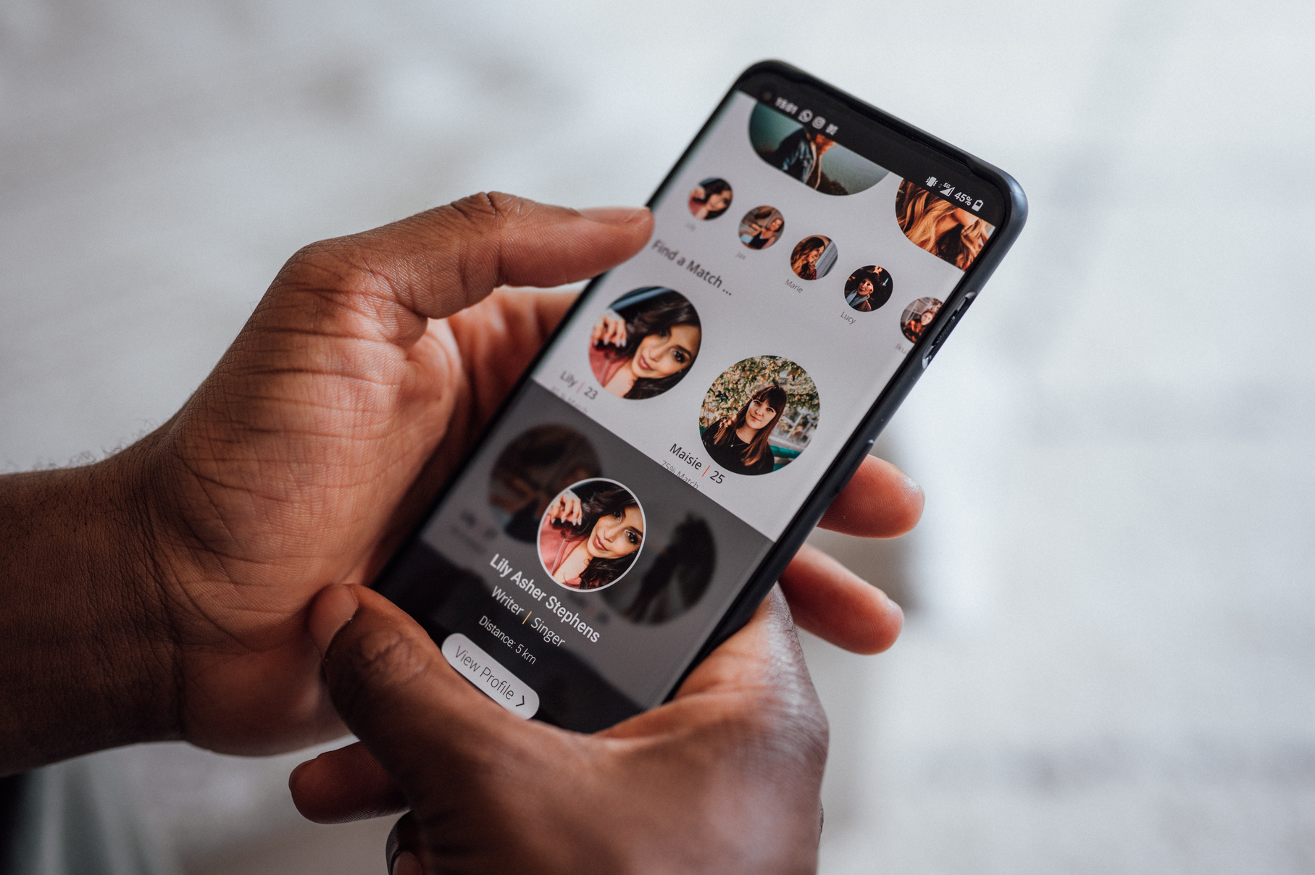
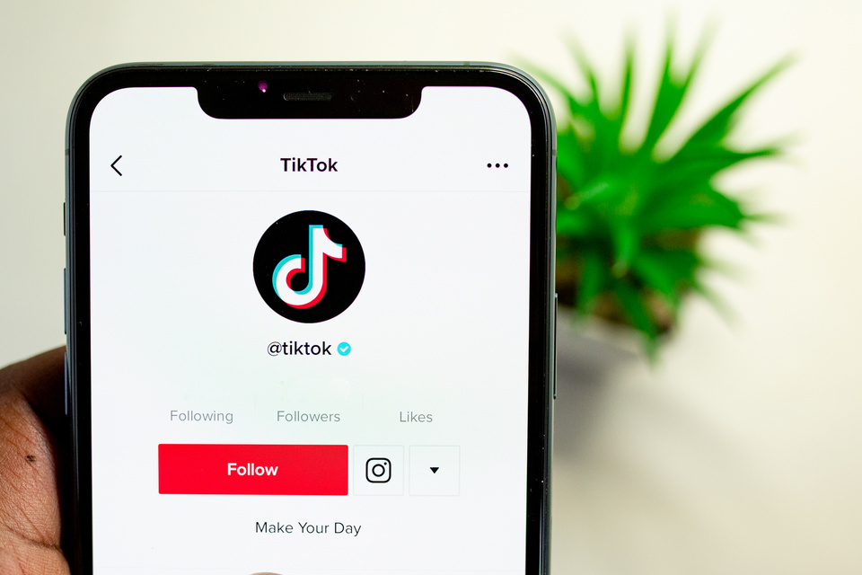
Where are Online Predators Reaching Victims?
Social media platforms
Game apps
Anonymous chat apps
Dating apps
Source: https://www.missingkids.org/theissues/onlineenticement

Slide 6
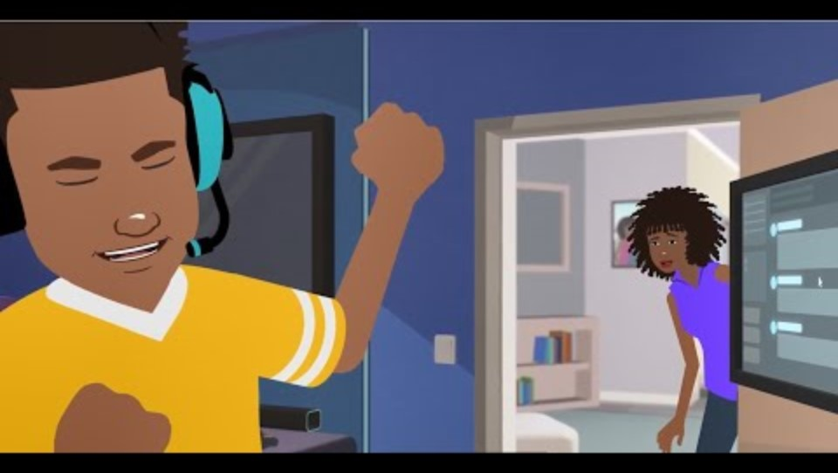
Department of Homeland Security’s “Carter’s Story Pt. 1” Video
Duration: 2:20 minutes
Source: https://www.dhs.gov/medialibrary-assets/assets/videos/d21dfb73-d274-4650-9ec4-4ff3260f7fe6/23_1129_bc_carter_online_safety.mp4

Slide 7
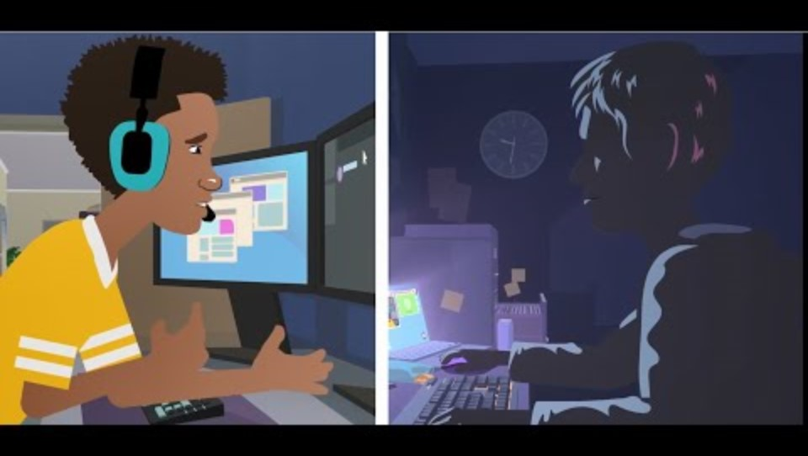
Department of Homeland Security’s “Carter’s Story Pt. 2” Video
Duration: 2:19 minutes
Source: https://www.dhs.gov/medialibrary-assets/assets/videos/e19ccd73-f1ad-4404-99a7-1191dad49e5b/23_1129_bc_carter_online_safety_2.mp4

Slide 8

Sextortion Tactics
  Reciprocation (“I’ll show you if you show me first.”)
  Pretending to work for a modeling agency to obtain sexual images of a minor
  Developing a bond with a minor by establishing a friendship or romantic relationship
  Using false online identities to contact a minor
  Pretending to be younger than their real age and/or a member of the opposite sex
  Accessing a minor’s online account without authorization and stealing sexual images or videos of them
  Threatening to create sexual images or videos of a minor using digital-editing tools
Source: https://www.missingkids.org/theissues/sextortion

Slide 9
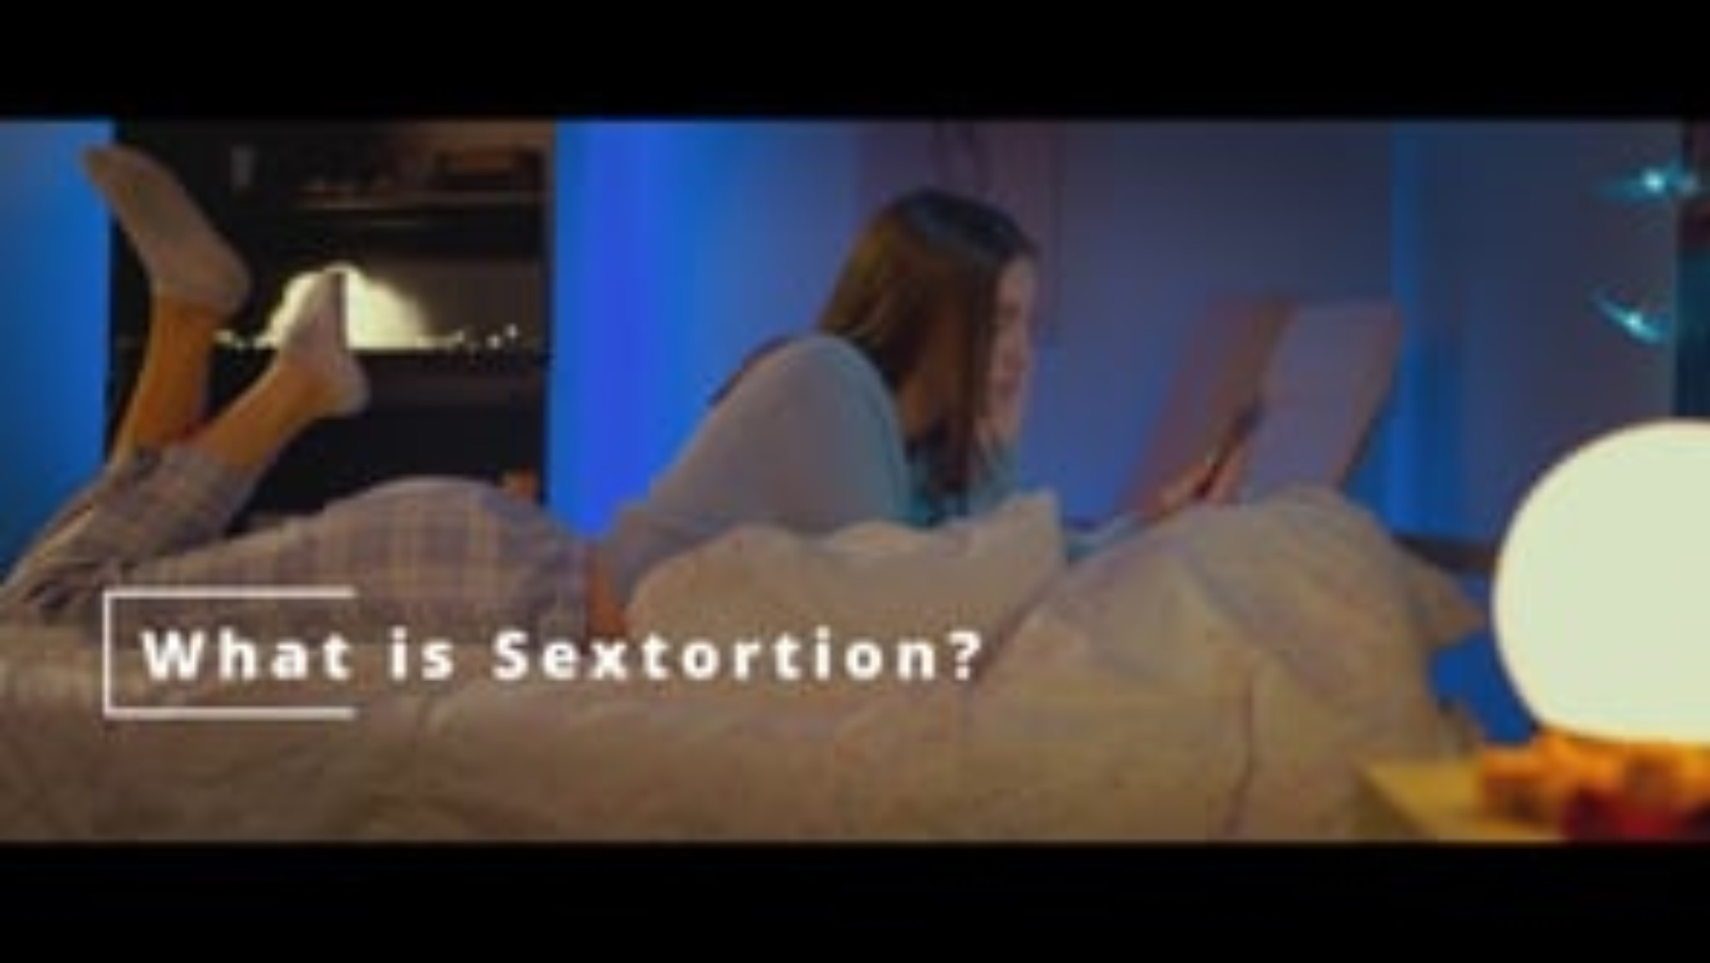
Auroris Media “Sextortion Module 1” Video
Duration: 6:04 minutes
Source: https://vimeo.com/713031554

Slide 10
Auroris Media “Sextortion Module 1” Teacher Led Discussion Question
Do you think it is normal or common for people your age to communicate with strangers on social media?
Why or why not?

Slide 11

Risks of Revealing Images
If you send a revealing image of yourself, there is no way to take it back. The image could end up:
Being sent to others without your permission.
On social media or other inappropriate websites.
Getting you in trouble with your parents, school, job, or future job opportunities.
Being used to embarrass and bully you.
Being used to blackmail you.

Slide 12
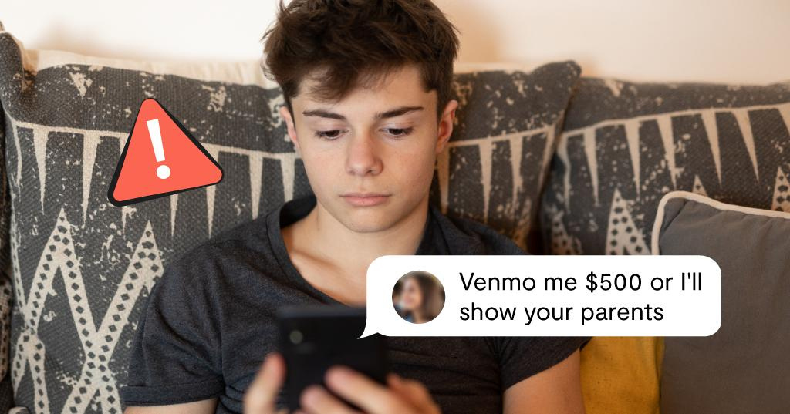
Take Action to Protect Yourself
Don’t take images of yourself that you wouldn’t want everyone to see.
Don’t forward anyone else’s image.
Confide in a trusted adult.
Do not comply with sextortion demands or meet them offline.
Block anyone who tries to blackmail you.
Report any inappropriate behavior to the website/app and to the CyberTipline.
Source: https://www.missingkids.org/theissues/sextortion

Slide 13

NCMEC “Take It Down”
What is it?
A free service that can help you remove or stop the online sharing of nude, partially nude, or sexually explicit images or videos taken of you when you were under 18 years old.
You can remain anonymous while using the service and you won’t have to send your images or videos to anyone.
It will work on public or unencrypted online platforms that have agreed to participate.
Source: https://takeitdown.ncmec.org

Slide 14
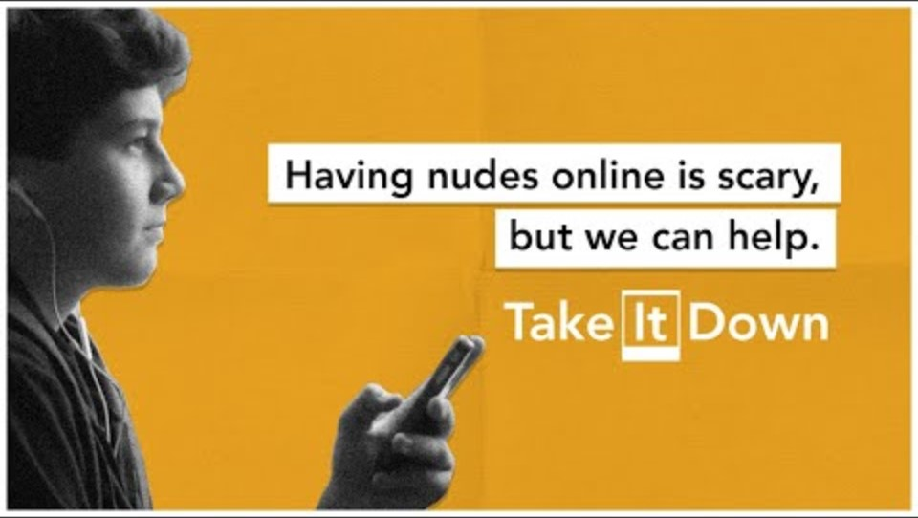
NCMEC “Take It Down” Video
Duration: 0:30 minutes
Source: https://takeitdown.ncmec.org

Slide 15

Activity

Slide 16
Activity
We recommend playing
Connect for Freedom Online Safety Kahoot!

Slide 17


Slide 18
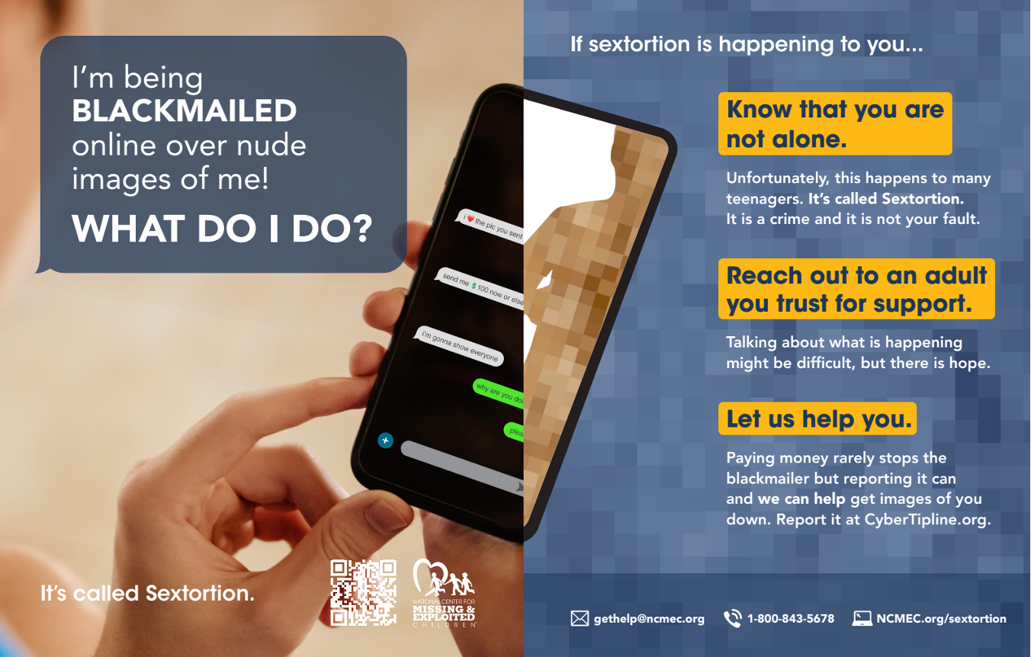
Lesson Handout from NCMEC

Slide 19
Links to Lesson Materials
DHS “Carter’s Story Pt 1” Video
DHS Carter’s “Story Pt 2” Video
Auroris Media “Sextortion Module 1" Video
NCMEC “Sextortion” Handout
Connect for Freedom Online Safety Kahoot!

Slide 20
Recap of Lesson
Sextortion is a form of child sexual exploitation where minors are threatened or blackmailed by a person who demands additional sexual content, sexual activity, or money from them.
Sextortion Tactics:
  Pretending to work for a modeling agency.
  Developing a bond with a minor by establishing a friendship or romantic relationship.
  Using multiple false online identities, pretending to be younger than their real age and/or of the opposite sex.
  Threatening to create sexual images or videos of a minor using digital editing tools.
If you feel like someone is trying to exploit you online:
  Don’t engage with them.
  Block them.
  Don’t meet them offline.
  Tell a trusted adult, and/or report to the website/app and CyberTipline.

