Slide 1

Middle School Engagement- Grade 6
Protecting Yourself from Online Predators

Slide 2

PREVENTION THROUGH EDUCATION IS THE SOLUTION
Connect for Freedom is a 501(c)(3) nonprofit committed to providing free online safety and human trafficking awareness materials to education stakeholders.

Slide 3
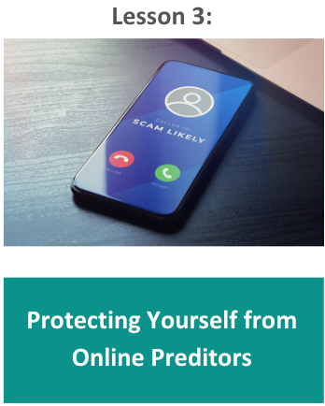
Lesson Outline
Lesson
Auroris Media “Sextortion Module 2" Video (6 min.)
Discussion Questions
Vulnerabilities Offenders Prey On
Online Red Flags
Auroris Media “Sextortion Module 3" Video (6 min.)
Discussion Questions
Privacy Suggestions
Additional Reminders
NCMEC Handout: You Sent a Sext
Activity
Protecting Yourself from Online Predators

Slide 4

Auroris Media “Sextortion Module 2” Video
Source: https://vimeo.com/718061896
Duration: 6:29 minutes

Slide 5
Auroris Media “Sextortion Module 2” Discussion Guide
Click here to access Auroris Media and NCMEC “Sextortion Module 2” Discussion Guide and questions.

Slide 6
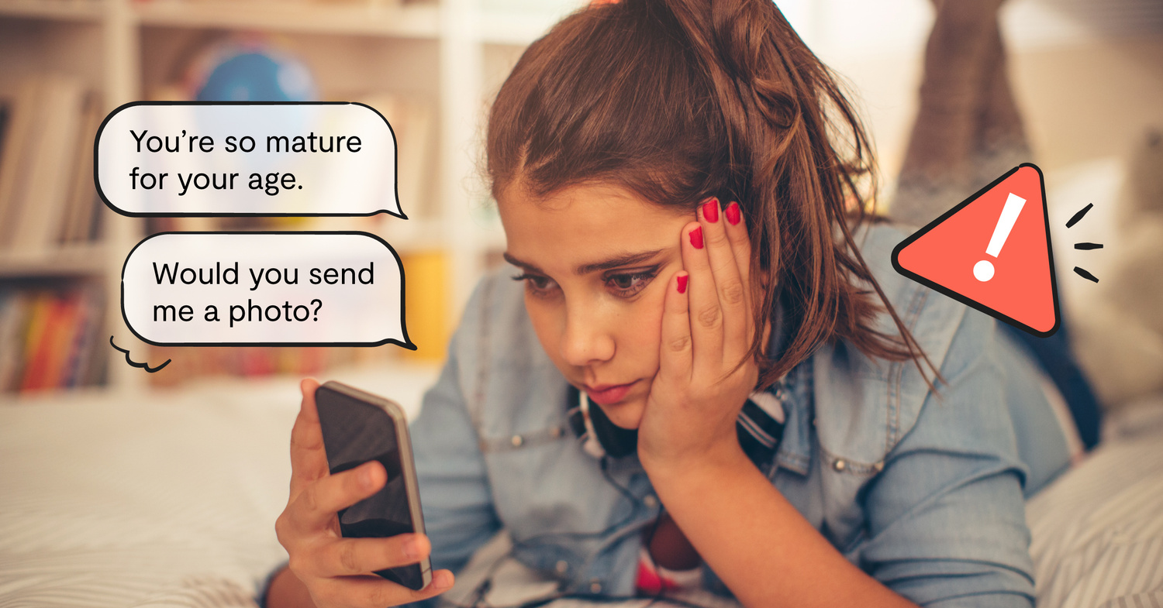
Vulnerabilities Offenders Prey On
Lack of supportive family and friends
Familial history of abuse, addiction, or mental health issues
History of running away from home
Financial instability
Low self-esteem
History of trauma
Involvement in child welfare or juvenile justice system
Nonacceptance of sexual orientation

Slide 7
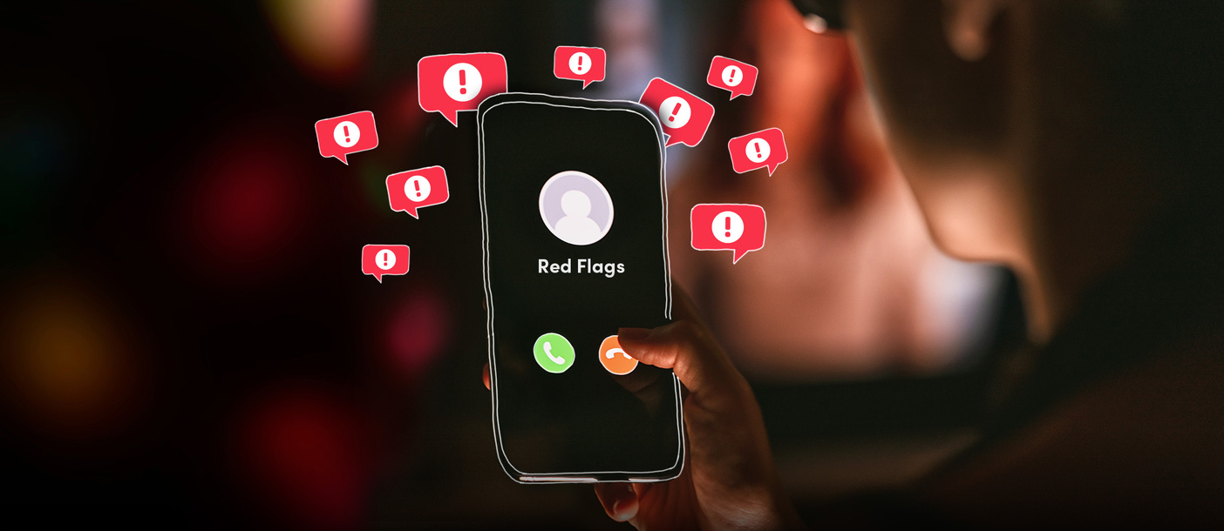
Red Flags Online
Asks you personal questions
Initiates conversations about sex and intimacy
Sends you inappropriate pictures
Asks for pictures of you
Makes you feel uncomfortable
Tries to meet in real life
Wants to follow all your social media accounts on multiple apps
Gets mad at you if you’re not online
Isolates you from your friends and family
Talks badly about other people in your life

Slide 8
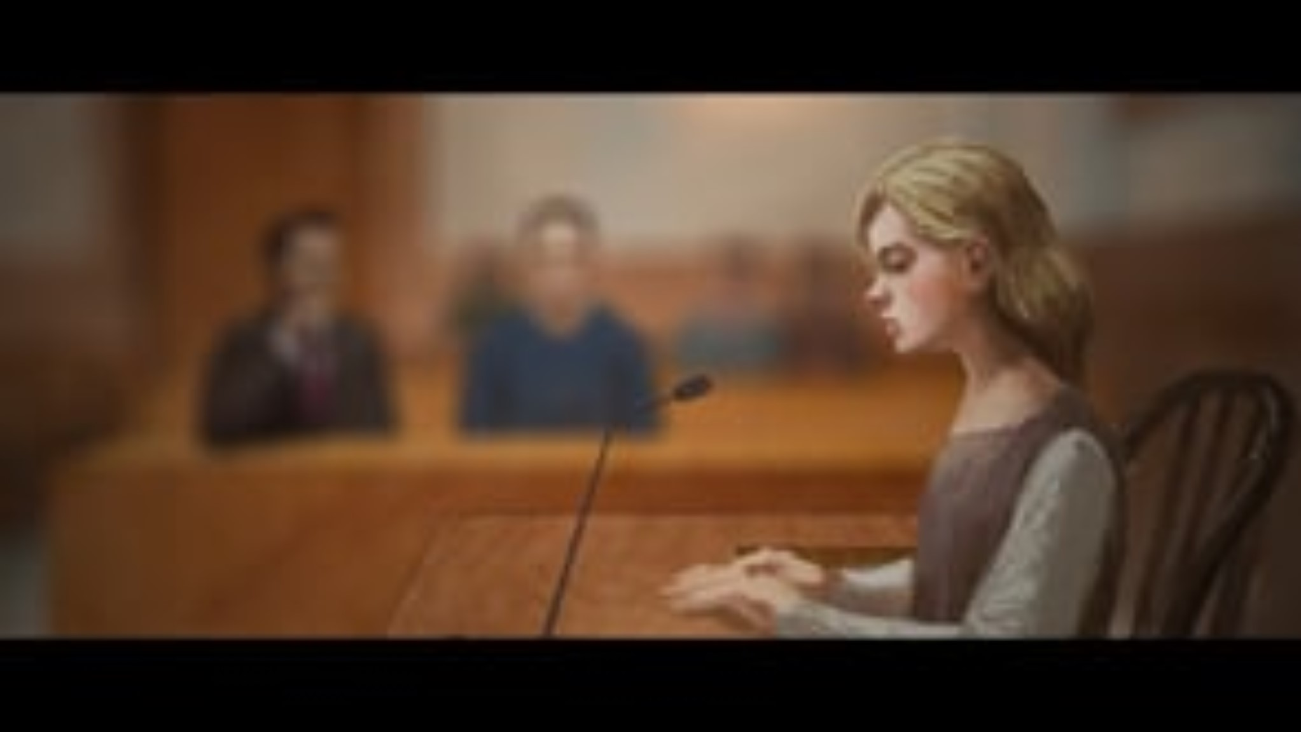
Auroris Media “Sextortion Module 3" Video
Source: https://vimeo.com/717550746
Duration: 5:52 minutes

Slide 9
Auroris Media “Sextortion Module 3” Discussion Guide
Click here to access Auroris Media and NCMEC “Sextortion Module 3” Discussion Guide and questions.

Slide 10
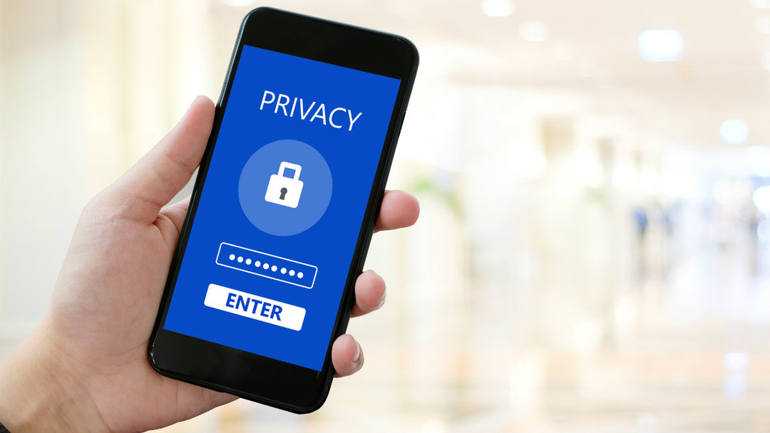
Privacy Suggestions
Have a different password for each account.
Use privacy settings.
Choose carefully who you friend.
Limit access to your location.
Look for the lock symbol or “https”.
Don’t share any personal information online.
Don’t share passwords.
Don’t share or forward explicit content.

Slide 11

Additional Reminders
Take screenshots of anything that looks or feels dangerous.
Block individuals who exhibit inappropriate or predatory behavior.
Source: https://www.missingkids.org/netsmartz/home

Slide 12

Additional Reminders
File a report with the police, offering as much information as possible about who is involved and in what ways.
Call a Cybertipline to report potential abuse or exploitation and receive additional recommendations for action steps.
Source: https://www.missingkids.org/netsmartz/home

Slide 13

Activity

Slide 14
Activity
We recommend playing
Connect for Freedom Top 5 Quiz
Online Safety & Online Enticement.

Slide 15


Slide 16
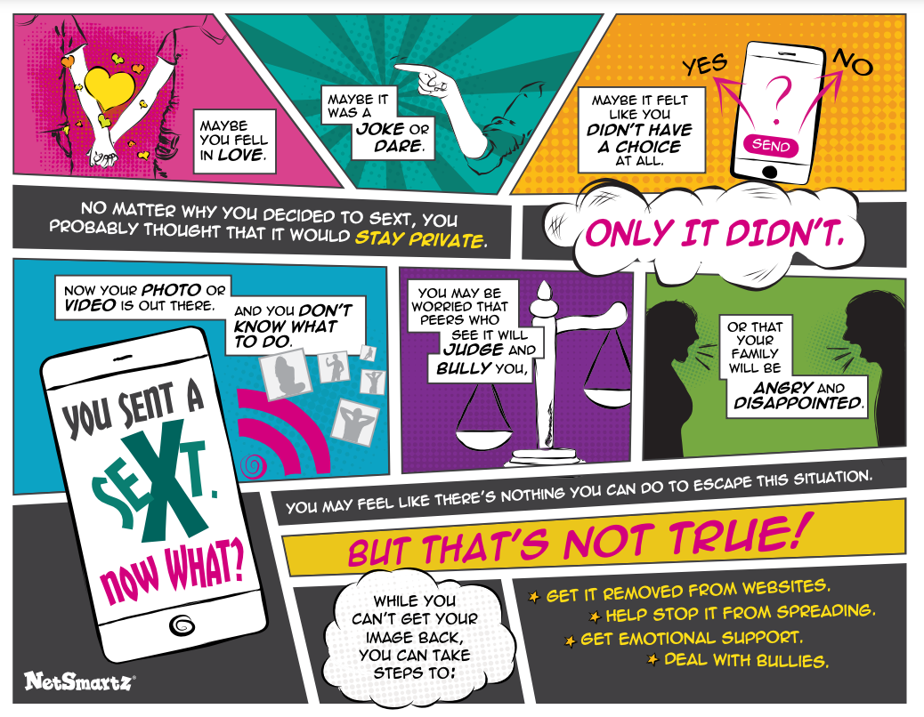
Lesson Handout from NCMEC

Slide 17
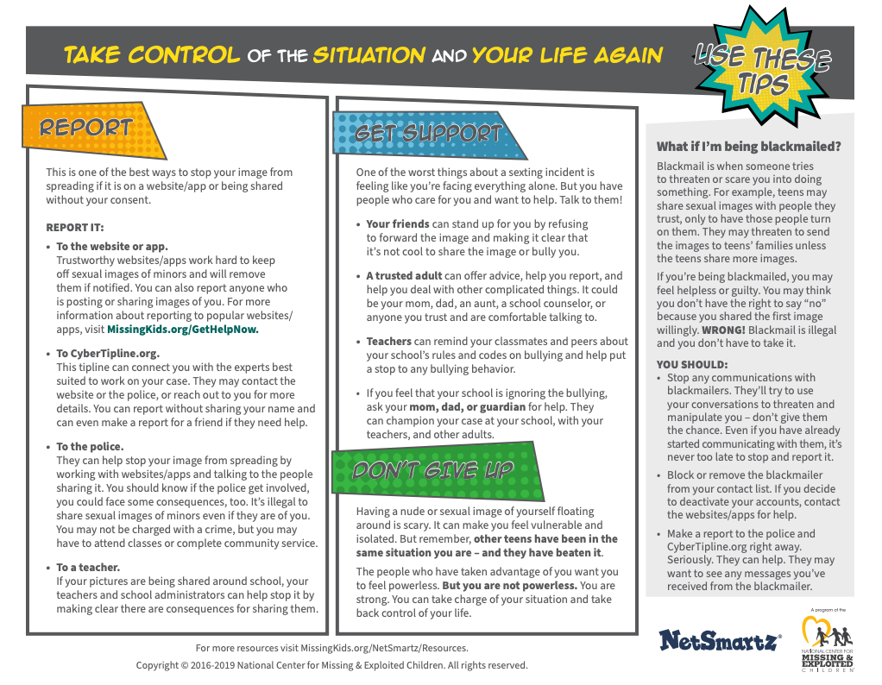
Lesson Handout from NCMEC

Slide 18
Links to Lesson Materials
Auroris Media “Sextortion Module 2” Video
Auroris Media & NCMEC “Sextortion Module 2” Discussion Guide
Auroris Media “Sextortion Module 3” Video
Auroris Media & NCMEC “Sextortion Module 3” Discussion Guide
NCMEC “You Sent a Sext” Handout
Connect for Freedom Top 5 Quiz Online Safety & Online Enticement

Slide 19
Recap of Lesson
Vulnerabilities that offender’s prey on:
Lack of supportive family and friends
Familial history of abuse, addiction, or mental health issues
History of running away from home
Financial instability
Low self-esteem
History of trauma
Involvement in child welfare or juvenile justice system
Nonacceptance of sexual orientation
Online red flags:
Someone sending inappropriate pictures
Talking to you about sex
Asking for pictures of you
Trying to meet up in real life
Following all your profiles
Asking a lot of personal questions
Getting mad if you aren’t online

