Slide 1

High School Engagement- Grade 12
A Breakdown of Human Trafficking

Slide 2

PREVENTION THROUGH EDUCATION IS THE SOLUTION
Connect for Freedom is a 501(c)(3) nonprofit committed to providing free online safety and human trafficking awareness materials to education stakeholders.

Slide 3

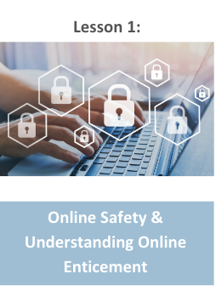
Lesson Outline
Lesson
  Introduction to Human Trafficking
  Department of Homeland Security “What is Human Trafficking” Video (4.5 min.)
    Discussion Questions
  Human Trafficking Industries
  Love146 “’I’m gonna make it’ - Stories of Child Trafficking from Survivors” Video (4.5 min)
    Discussion Question
  Polaris Project Handout: Human Trafficking Power and Control Wheel
  Activity
A Breakdown of
Human Trafficking

Slide 4
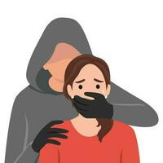
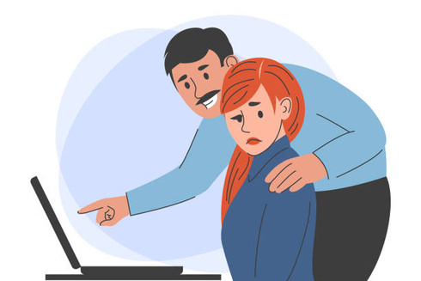
What is Human Trafficking?
The use of force, fraud, or coercion to obtain some type of labor or commercial sex act.
HSI Blue Campaign
It affects everyone, regardless of sex, age, gender, race, or nationality.
HSI Blue Campaign
If a victim is under the age of 18, any act of commercial sex is considered to be trafficking, regardless of the use of force, fraud, or coercion.
The Exodus Road

Slide 5

Types of Human Trafficking
Sex trafficking- using force, fraud, or coercion to obtain a commercial sex act
Examples: escort services, pornography, brothels, massage parlors
Labor trafficking- using force, fraud, or coercion to obtain labor
Examples: restaurant workers, landscaping, factory workers, construction

Slide 6
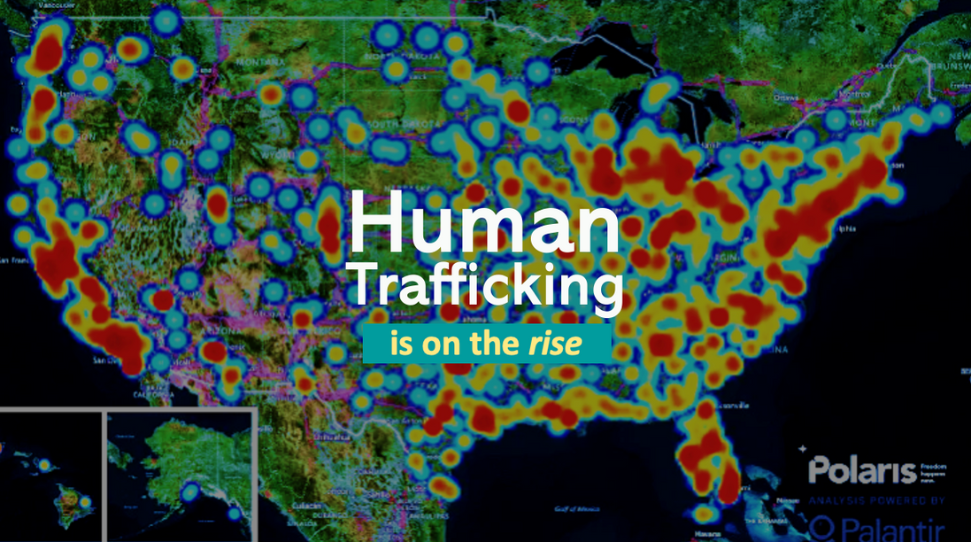
A Pervasive Problem
The Data
The U.S. is the #1 consumer of sex trafficking.
US Institute Against Human Trafficking
The average age of child sex trafficking victims is 12.
US Institute Against Human Trafficking
Human trafficking is a
$150 billion dollar industry.
Polaris
Only 2.7% of human trafficking cases are prosecuted.
Polaris

Slide 7
Action-Means-Purpose (AMP) Model
Action-Means-Purpose (AMP) Model can help explain the federal law for human trafficking.
The trafficker takes ACTION (transports, recruits, provides), then employs the MEANS (force, fraud, or coercion) for the PURPOSE of compelling a victim to provide labor or a commercial sex act.
At a minimum, one of each element (AMP) must be present to establish a human trafficking situation.
Source: https://polarisproject.org/understanding-human-trafficking/

Slide 8
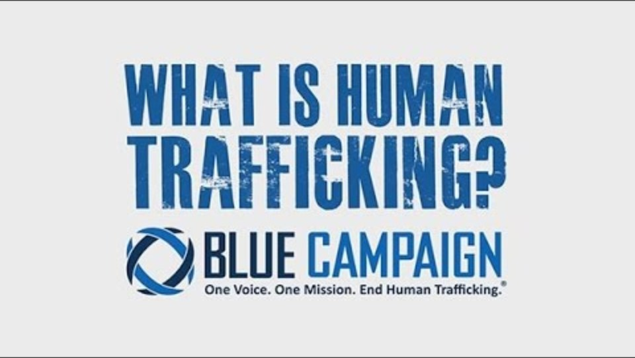
Department of Homeland Security “What is Human Trafficking?” Video
Duration: 4:22 minutes
Source: https://www.youtube.com/watch?v=35uM5VMrZas

Slide 9
Department of Homeland Security “What is Human Trafficking?” Teacher Led Discussion Questions
Human trafficking can affect anyone, regardless of age, race, gender, sexual orientation, financial status, etc.
What are some factors that can make someone more vulnerable to being human trafficked?
What are some things we can do to stop human trafficking?

Slide 10
Where Does Trafficking Occur the Most?
Labor Trafficking:
  Recreational Facilities
    ex. golf courses, summer camps
  Health Care
    ex. nursing homes, health aides
  Carnivals
  Forestry
    ex. logging
  Factories & Manufacturing
    ex. food processing, clothing industry
  Commercial Cleaning Services
    ex. janitors, housekeepers
  Landscaping
  Hotels & Hospitality
  Construction
    ex. welding, roofing, carpentry
  Health & Beauty Services
    ex. nail or hair salons
  Agriculture & Animal Husbandry
    ex. dairy farms, corn fields
  Peddling & Begging
    ex. sell candy, solicit donations
  Restaurants & Food Services
  Traveling Sales Crew
    ex. selling fraudulent products
  Domestic Work
    ex. live-in nanny or housekeeper
Source: https://polarisproject.org/the-typology-of-modern-slavery/

Slide 11
Where Does Trafficking Occur the Most? (cont.)
Sex Trafficking:
Sex and Labor Trafficking:
  Pornography
  Residential Brothels
    ex. trafficker gives card with brothel location information
  Outdoor Solicitation
    ex. pimp forcing young girls to meet men outside in their cars
  Remote Interactive Sex Acts
    ex. webcams, phone sex
  Personal Sexual Servitude
    ex. girl is sold to pay off family debt
  Escort Services
    ex. women delivered to a location
  Arts & Entertainment
    ex. exotic dancing, modeling, sports
  Illicit Activities
    ex. drugs, firearms, etc.
  Bars & Strip Clubs
  Massage Parlors
Source: https://polarisproject.org/the-typology-of-modern-slavery/

Slide 12

Love146 “’I’m gonna make it’ - Stories of Child Trafficking from Survivors” Video
Duration: 4:44 minutes
Source: https://www.youtube.com/watch?v=TwrM6c38rWY

Slide 13
Love146 “’I’m gonna make it’ - Stories of Child Trafficking from Survivors” Teacher Led Discussion Question
In this video, we saw how there were children of different races, ethnicities, genders, etc. that human trafficking affected. They were also trafficked in multiple different ways.
Do you think that you will be more aware of these issues after seeing this video? If so, how?

Slide 14

Activity

Slide 15
Activity
We recommend playing
Connect for Freedom Human Trafficking BINGO.

Slide 16


Slide 17
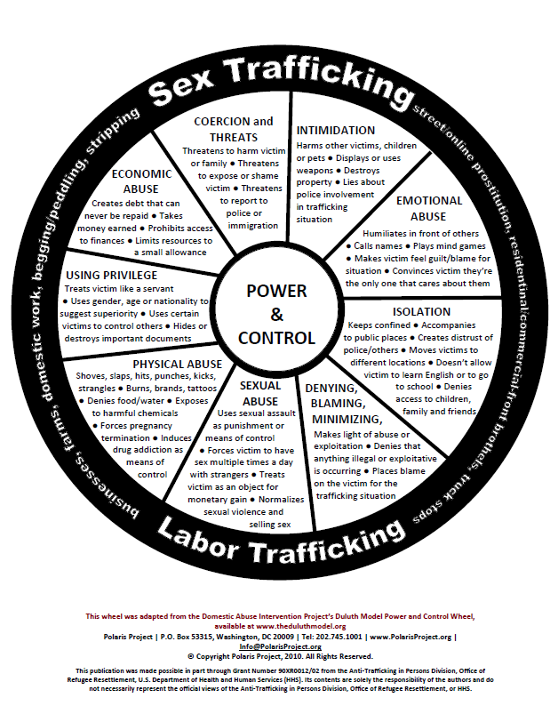
Lesson Handout from Polaris Project

Slide 18
Links to Lesson Materials
Oasis Mental Health Applications “Building Healthy Relationships” Video
Alliance to End Human Trafficking “Human Trafficking Basics” Video
Polaris Project "Human Trafficking Power and Control Wheel" Handout
Connect for Freedom Online Safety Jeopardy

Slide 19
Recap of Lesson
Human trafficking- the use of force, fraud, or coercion to obtain some type of labor or commercial sex act.
If a victim is under the age of 18, any act of commercial sex is considered to be trafficking, regardless of the use of force, fraud, or coercion.
2 Types of Human Trafficking:
Sex Trafficking & Labor Trafficking
Action-Means-Purpose (AMP) Model can help explain the federal law for human trafficking.
The trafficker takes ACTION (transports, recruits, provides), then employs the MEANS (force, fraud, or coercion) for the PURPOSE of compelling a victim to provide labor or a commercial sex act.

