Slide 1

High School Engagement- Grade 12
Exploitation & How to Identify It

Slide 2

PREVENTION THROUGH EDUCATION IS THE SOLUTION
Connect for Freedom is a 501(c)(3) nonprofit committed to providing free online safety and human trafficking awareness materials to education stakeholders.

Slide 3
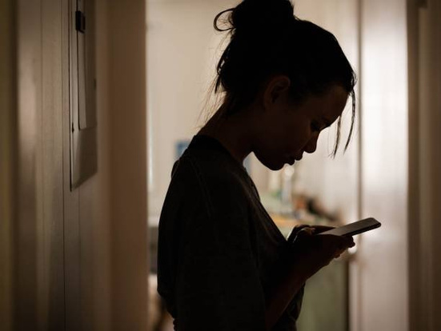
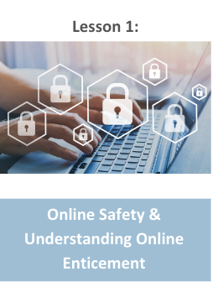
Lesson Outline
Lesson
Introduction to Exploitation
Fight Child Abuse “Sexual Abuse in the Family” Video (5 min.)
Discussion Questions
Kent Police “Modern slavery and human trafficking” Video (1 min.)
Real Life Story
Christian
Discussion Questions
Mary
Discussion Questions
know2protect Handout: How2Spot Online Predators
Activity
Exploitation &
How to Identify It

Slide 4
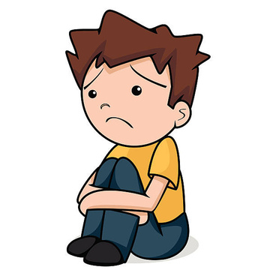
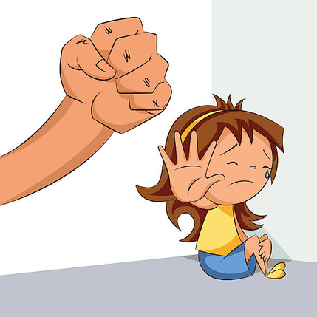
What is Child Exploitation?
Child exploitation refers to a range of crimes that include the exploitation of a minor for sexual, financial, or other personal gain.
SchoolSafety.gov
As technology evolves and more people have access to the internet, youth are at a greater risk than ever.
Department of Homeland Security
Predators can be someone a minor knows personally or someone online who gains their trust over time.
SchoolSafety.gov

Slide 5

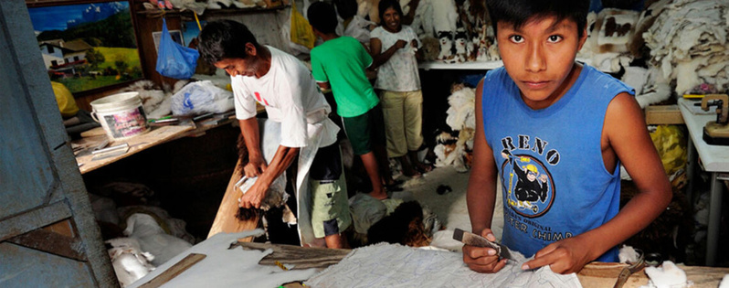
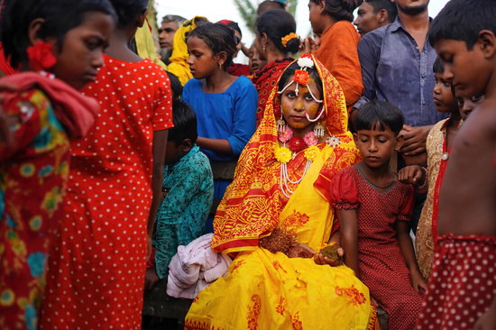
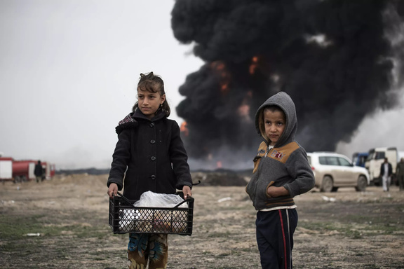
Types of Exploitation of Children
Sexual exploitation
Forced labor
Child marriage
Use of children in armed conflict

Slide 6

Who Commits Child Exploitation?
When we think of child exploitation, we often think of a stranger abducting a minor from their family. But child exploitation is more likely to happen by someone the minor knows in real life. This person can be a parent, family member, teacher, coach, pastor, etc.
The person is often someone that is trusted and someone the youth’s parents and family trust as well.

Slide 7
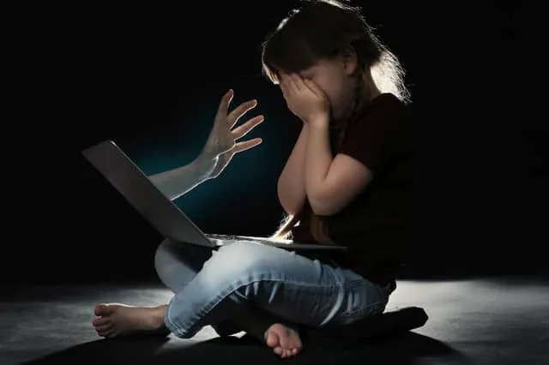
Child Sexual Exploitation Statistics
Child sexual abuse material (CSAM) is any visual depiction of sexually explicit conduct involving a minor.
National Center for Missing & Exploited Children
67% of all identified child victims with child sexual abuse material in circulation online are prepubescent or younger (infants and toddlers).
Thorn
2 in 3 victims are abused by someone known to them in their offline communities.
Thorn
Males are more likely to be seen in imagery with higher levels of violence than female victims.
INTERPOL & ECPAT

Slide 8
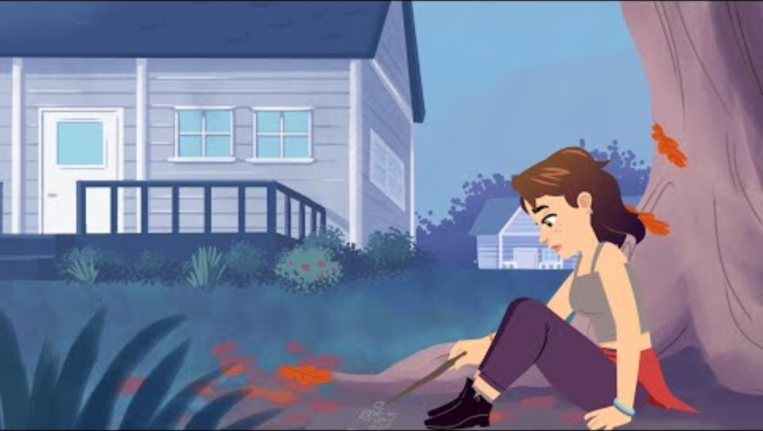
Fight Child Abuse “Sexual Abuse in the Family” Video
Duration: 4:46 minutes
Source: https://www.youtube.com/watch?v=WOyg6IrfuzA

Slide 9
Fight Child Abuse “Sexual Abuse in the Family” Teacher Led Discussion Questions
Human trafficking can affect anyone, regardless of age, race, gender, sexual orientation, financial status, etc.
What are some factors that can make someone more vulnerable to being human trafficked?
What are some things we can do to stop human trafficking?

Slide 10

Kent Police “Modern slavery and human trafficking” Video
Duration: 1:06 minutes
Source: https://www.youtube.com/watch?v=vkSU5r9rdUY

Slide 11
Real Life Story- Christian
Christian, 15, comes into school with his hand wrapped up in bandages. Christian explains to his teacher that he was injured using a machine at work. Christian becomes very uncomfortable answering questions about his job.
He tells his teacher that his entire family works for this business and he doesn’t want to get anyone in trouble. He explains that their boss took care of the injury because he told Christian’s parents that if Christian went to the emergency room, they would be deported.
Christian tells his teacher that his family owes the boss for helping them get to the United States. He is afraid to answer any other questions and says they just need to keep working for their boss until their debt is paid off or else the boss says he won’t give them back their documentation and will call ICE on them.
Source: https://www.nj.gov/education/safety/sandp/cwss/ht/docs/HT%20Prevention%20Guidelines%20for%20Schools_Jan2022_updated%202.24.22.pdf

Slide 12
Real Life Story- Christian Teacher Led Discussion Questions
Christian was very worried about his parent’s immigration status in the United States. He feared deportation for not only himself, but his entire family.
What other manipulation tactics do you think criminals do to exploit their victims?
Do you think that Christian was smart to turn to his teacher?
What do you think his teacher can do?

Slide 13
Real Life Story- Mary
Mary, 8, wakes up and gets ready to go to school like any other child. She gets herself ready and gets on the bus a couple houses down on her street. Mary is a quiet and shy girl, but enjoys going to school and being around her peers. She is dreading when the clock strikes 3:00 PM and she has to go back home.
Once Mary gets home, her mother is waiting for her. She doesn’t ask Mary about her day, she just pushes her towards the bathroom door and tells her she has ten minutes to shower and get ready. Mary knows if she doesn’t listen her mother will hit her, so she obeys. She does not want to upset her mother.
Once Mary gets out of the bathroom, she is quickly ushered into her bedroom. The camera is already set up, and as Mary sits on the bed, her mother hits record. The laptop is open and Mary can see herself, and people commenting in an open forum. Mary feels her mother touch her back and sit on the bed with her.
Source: https://www.nytimes.com/2024/12/07/us/child-abuse-apple-google-apps.html?unlocked_article_code=1.fk4.97Y2.QoL30KHC7DwP&smid=nytcore-ios-share&referringSource=articleShare

Slide 14
Real Life Story- Mary Teacher Led Discussion Questions
Mary’s mother was sexually abusing her and exploiting her for money. This is sadly a common form of child exploitation, and there are many children who are exploited by trusted adults, even family members for financial profit.
How do you think Mary felt in this situation?
Do you think this would be a difficult situation to get out of? Why?

Slide 15

Activity

Slide 16
Activity
We recommend playing
Connect for Freedom Exploitation Kahoot!.

Slide 17


Slide 18

Lesson Handout from know2protect

Slide 19
Links to Lesson Materials
Oasis Mental Health Applications “Building Healthy Relationships” Video
Alliance to End Human Trafficking “Human Trafficking Basics” Video
know2protect "How2Spot Online Predators" Handout
Connect for Freedom Exploitation Kahoot!

Slide 20
Recap of Lesson
Child exploitation refers to a range of crimes that include the exploitation of a child for sexual, financial, or other personal gain.
As technolology evolves and more people have access to the internet, children are at a greater risk than ever.
Predators can be someone a child knows personally or someone online who gains their trust over time.
Types of exploitation of children:
Sexual exploitation
Forced labor
Child marriage
Use of children in armed conflict

